Slide 1





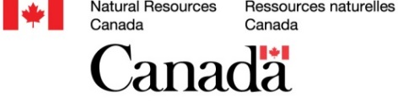

Winter Soil Processes in Transition
Project contact information: Fereidoun Rezanezhad, frezanez@uwaterloo.ca
https://uwaterloo.ca/winter-soil-processes
Project coordinates: PI, email, website, etc
Winter Soil Processes in Transition
Notes:
It can help to frame your main research objective as a question. For example,
How will climate change affect agriculture in Canada?
How can we improve water quality and reduce algal blooms in Canadian lakes?
What are the links between fish health, food safety and food security in the Indigenous North?
What is the significance of groundwater fluxes on surface water flow?

Slide 2
Objective and Approaches
Importance of Winter Soil Processes on the export of Carbon and nutrients to Groundwater, Surface Water and Lakes
1 PhD
1 MSc
1 PDF
3 UG Thesis
4 UG RA
Cold Regions are warming more than twice as fast as the rest of the planet, with the
“Greatest Warming Occurring During the Winter”.
Project coordinates: PI, email, website, etc
Winter Soil Processes in Transition

Slide 3
Transformational Science
How will changing winter conditions affect
Agriculture Best Practices?
The response of nutrient leaching and GHG fluxes to
Winter Pulse Warming
Spring runoff of carbon/nutrients from agricultural soil
Best management practices for fertilizer application
How are fall fertilizer amendments affected by freeze-thaw conditions?
How can placement of fertilizer affect the nutrient leaching in frozen ground?
  Relevant to current 4R Fertilization questions
Project Title
Winter Soil Processes in Transition
THE NUTRIENT STEWARDSHIP
4R POCKET GUIDE
Notes:
These accomplishments slides will be also be used to build slide bank for use in GWF presentations
How are these results key to advancing the science
How are these results linked to the needs of your partners/users?

Slide 4
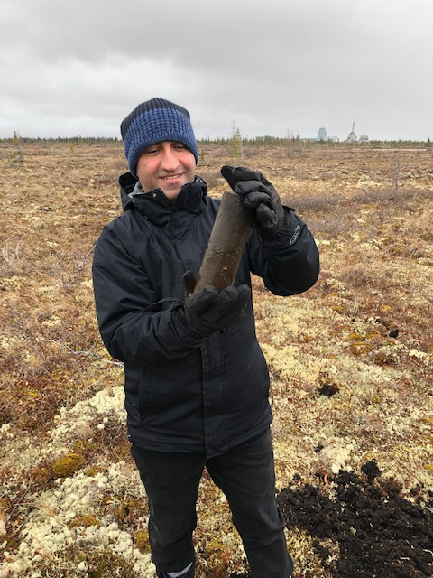
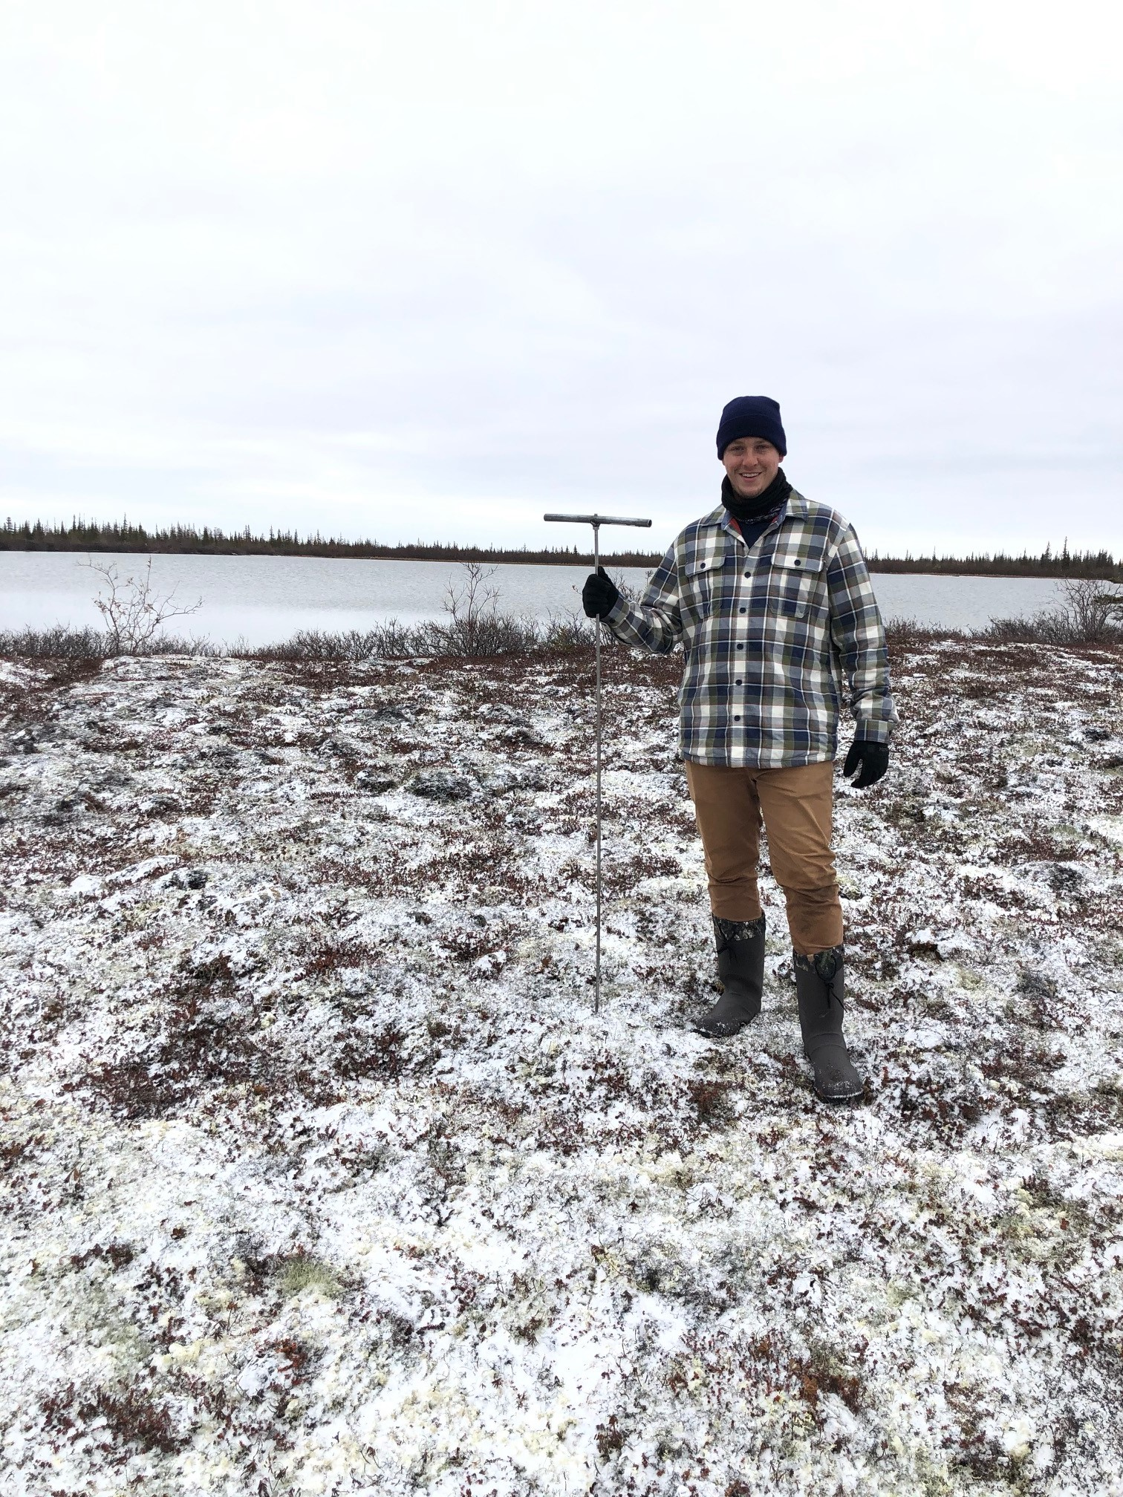
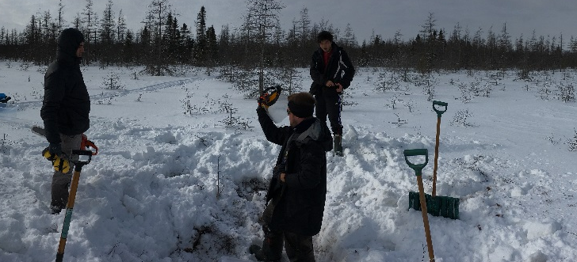
Transformational Science
Winter Carbon Losses in Wetlands under Current and Future Climates
(NSERC Advancing Climate Change Science in Canada, 2019-2022, $500K)
Study sites:
Wetlands/Peatlands/Permafrost
Historical data synthesis, laboratory experiments and modelling:
Hydrological and climatic factors driving microbial NGS carbon cycling → Carbon Budget Model
Project Title
Winter Soil Processes in Transition
THE NUTRIENT STEWARDSHIP
4R POCKET GUIDE
Notes:
These accomplishments slides will be also be used to build slide bank for use in GWF presentations
How are these results key to advancing the science
How are these results linked to the needs of your partners/users?

Slide 5
Project Impact and Aspirations
Interest to Partners:
Implications for Water Quality, Soil Health (Crop Production)
Inform government decision-making on climate action to see the impacts of winter warming on the export of carbon and nutrients under different climatic scenarios
In the Coming Year:
Complete identifying the winter biogeochemical drivers on soil microbial community composition, functions and dynamics
Complete developing process-based models (RTM &Bioenergetics)
→ Process Hypothetical Scenarios
Project Title
Winter Soil Processes in Transition

