Slide 1
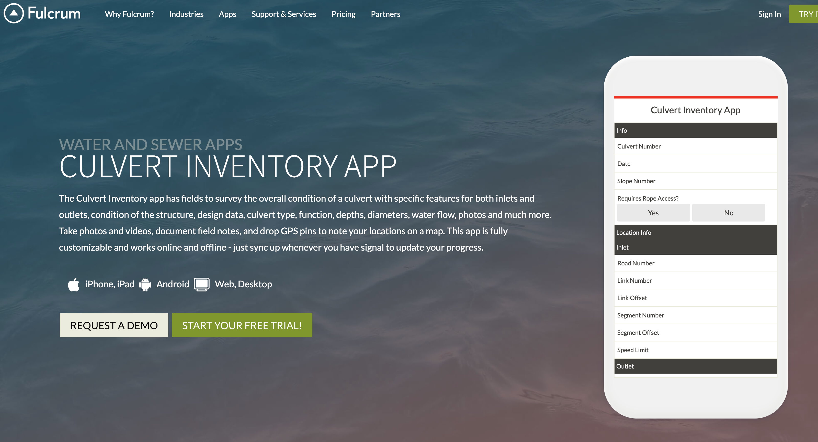
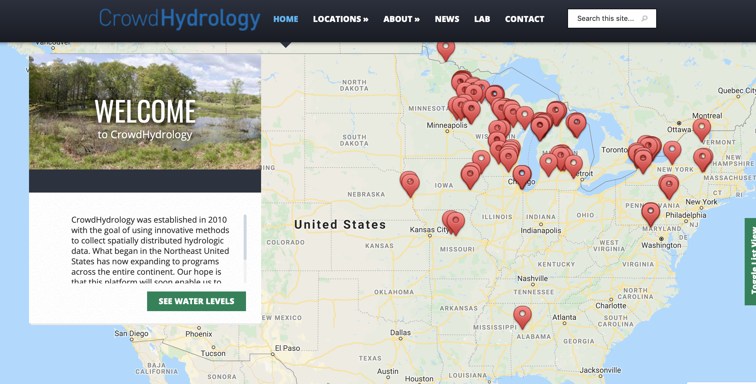
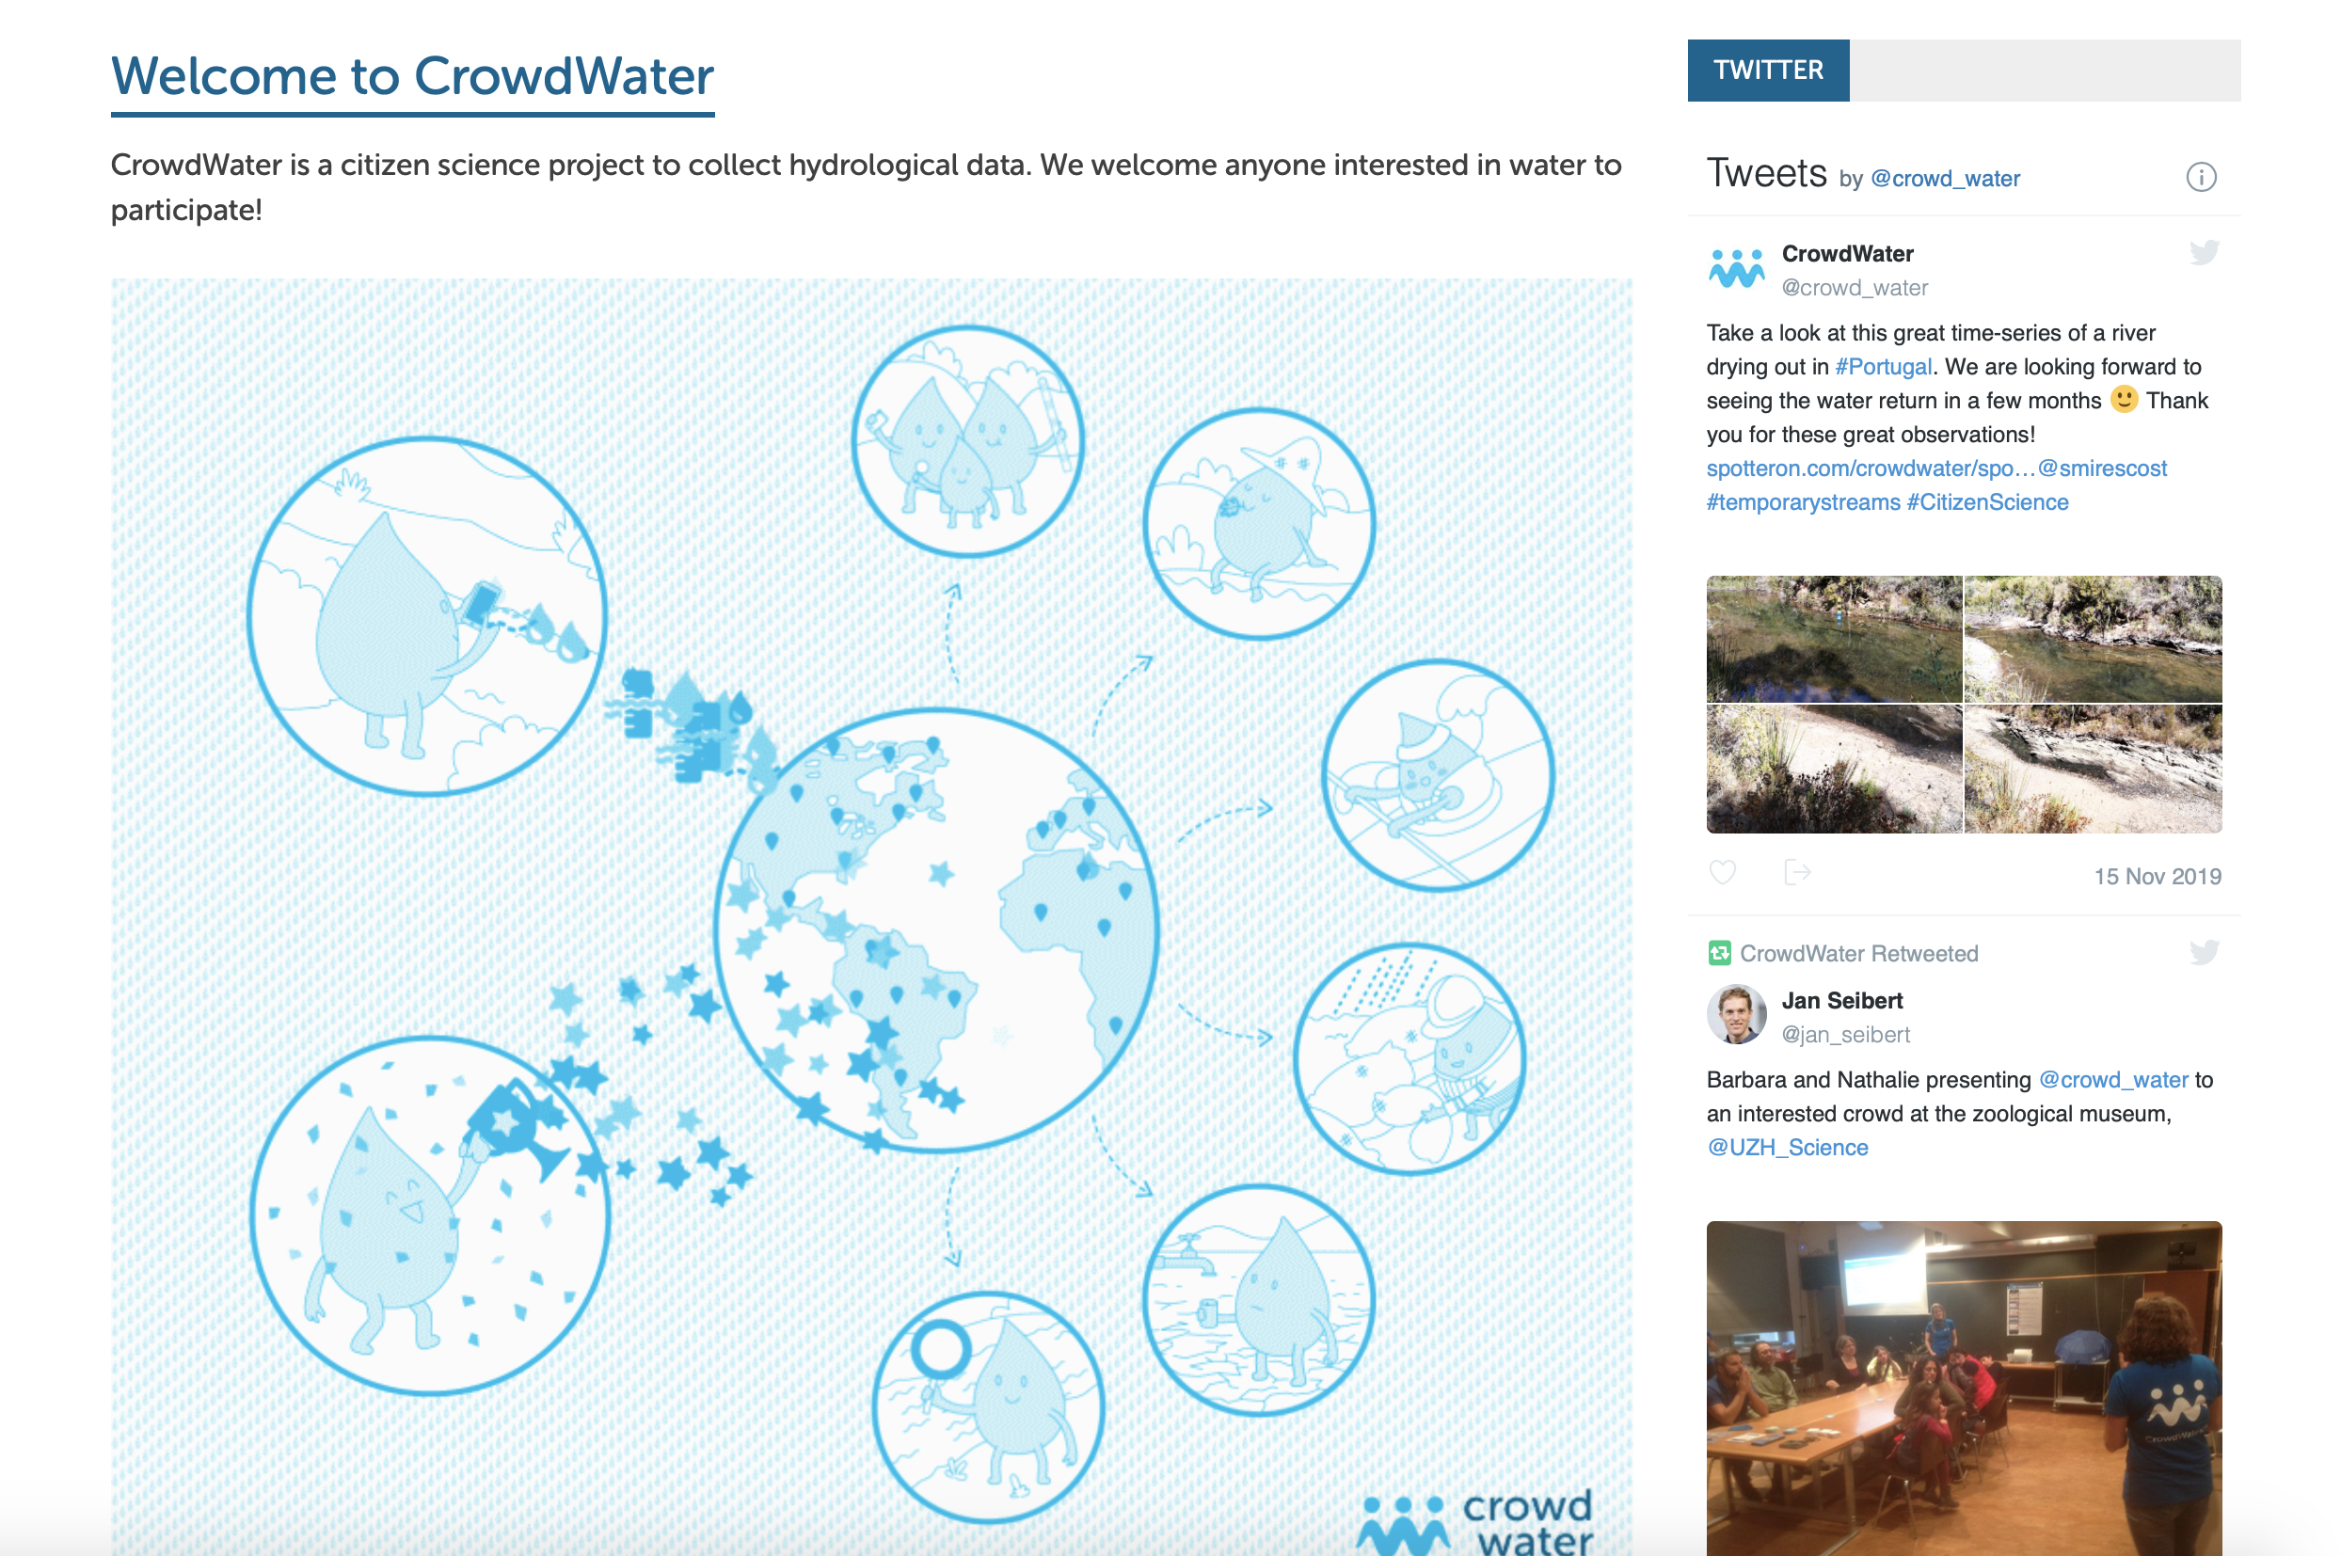
Transformational Science Highlights
We reviewed other citizen water science apps:
Culvert Inventory App
CrowdHydrology
CrowdWater
In collaboration with computer scientists, we then built a new tool focused on the backend trust relationships for sharing sensitive water data (e.g. unlicensed drainage, sacred places, flood impacts, broken infrastructure)
Project Title
Distributed Water Secience
Notes:
These accomplishments slides will be also be used to build slide bank for use in GWF presentations
How are these results key to advancing the science
How are these results linked to the needs of your partners/users?
CrowdWater (2017)
Author: Jan Seibert
Barbara Strobl
Simon Etter
Marc Vis
Van Meerveld
www.crowdwater.ch
Origin: Zurich Switzerland
Measurement of water level, water flow and soil moisture
Google play store and Apple store
Data is georeferenced, and time stamped
Virtual scale superimposed on the image is used for water level measurements
Data stored on the server is viewed on a map both on the App and website (OpenStreetMaps)
Data can be edited, deleted, updated and downloaded on the App
Ranks and scores provided to encourage citizens to participate
Every new site updated is shared to all users through the application and Facebook
Data shared are used by researchers for hydrological modelling of streamflow
Crowd Hydrology (2010)
Author: Dr. Chris Lowry
Dr. Mike Fienen
www.crowdhydrology.org
Origin: New York
Measurement of stream water level
Stream gauging staffs at nine locations
Observation and data shared by text messages to a common server and forwarded to the website
Signage/Posters at every location on how to crowdsource the data
Data presented as hydrographs, table and web-based map on the website
Measurements send to the server were timestamped by the software
Data downloaded as CSV files from the website
Data important to resource managers, researches, teachers & outdoor enthusiasts to monitor trends in stream stage

Slide 2
Distributed Water Science: Developing Trusted Citizen-Science Tools
Trusted sharing of geo-located photos of sensitive water data
Main objective: Empowered data collection
Blockchain enabled data sharing
Study regions
Sask River Delta
Mistawasis Nehiyawak
Qu’Appelle Valley
Project coordinates: PI, email, website, etc
Distributed Water Science
Notes:
It can help to frame your main research objective as a question. For example,
How will climate change affect agriculture in Canada?
How can we improve water quality and reduce algal blooms in Canadian lakes?
What are the links between fish health, food safety and food security in the Indigenous North?
What is the significance of groundwater fluxes on surface water flow?

Slide 3
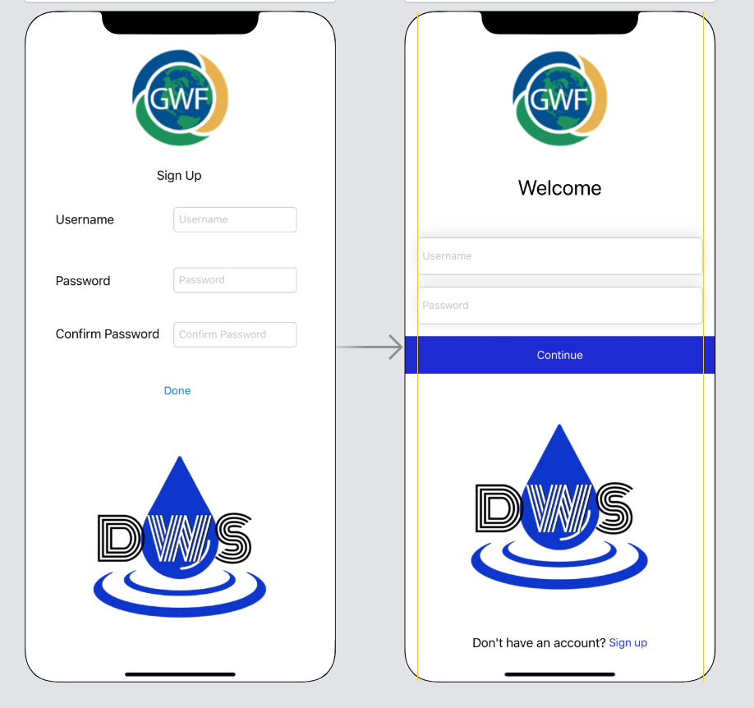
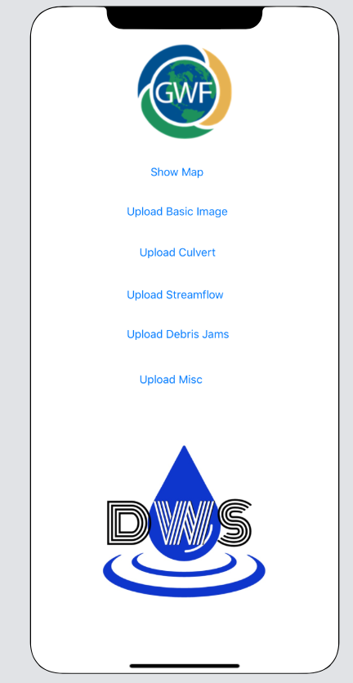
Notes:
The sharing of content is all it does as if now. The system speed is tedious as for obvious reasons and to make it faster and smarter, machine learning part is in progress (to generate trust factor of the media content owner)

Slide 4
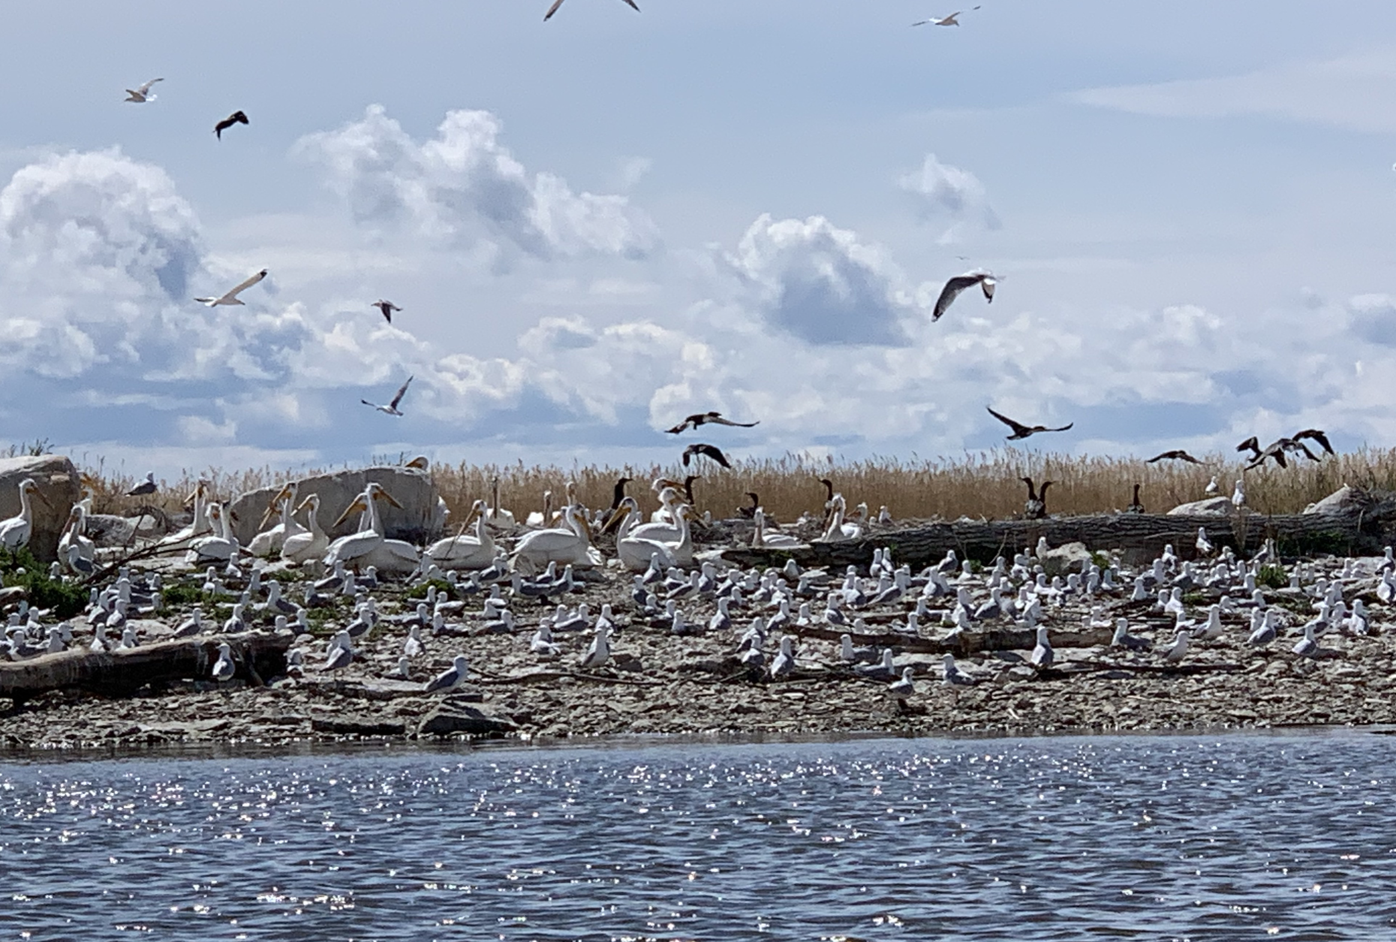
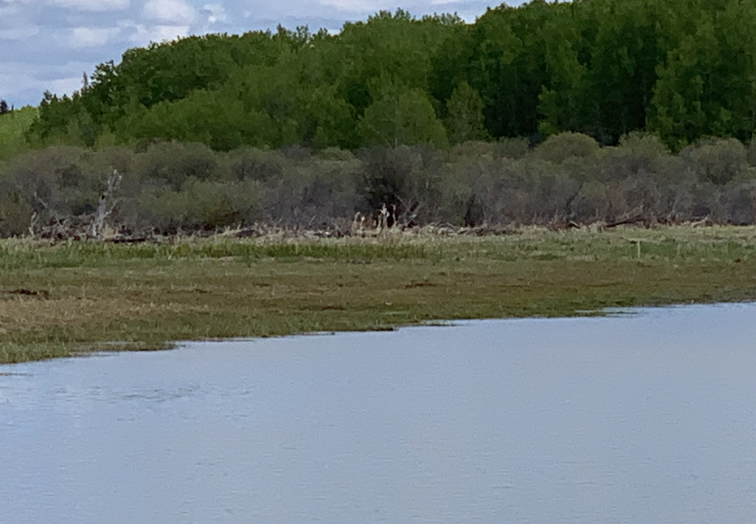
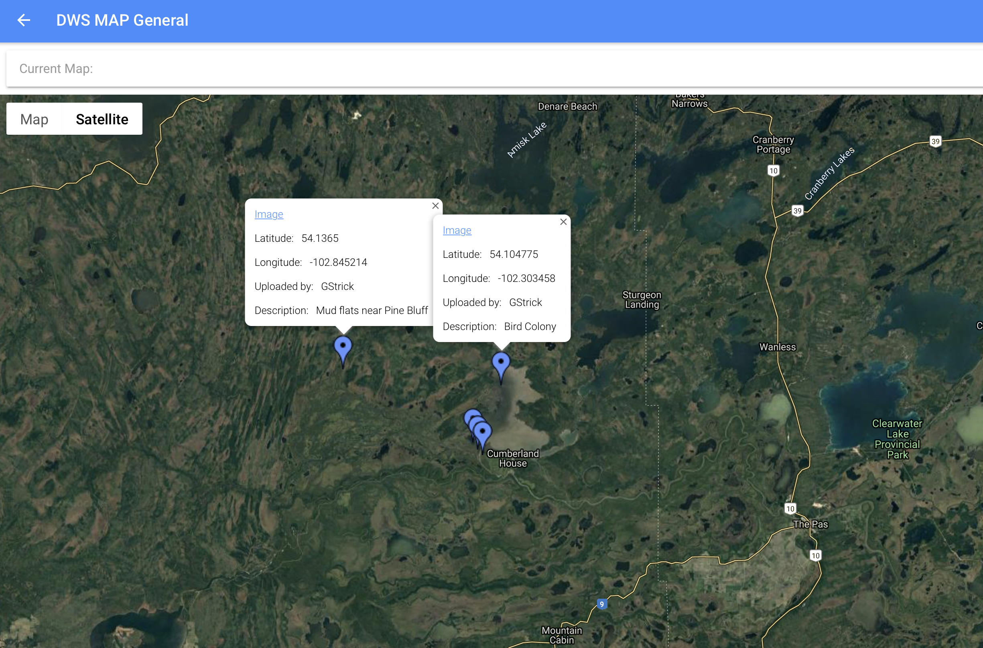
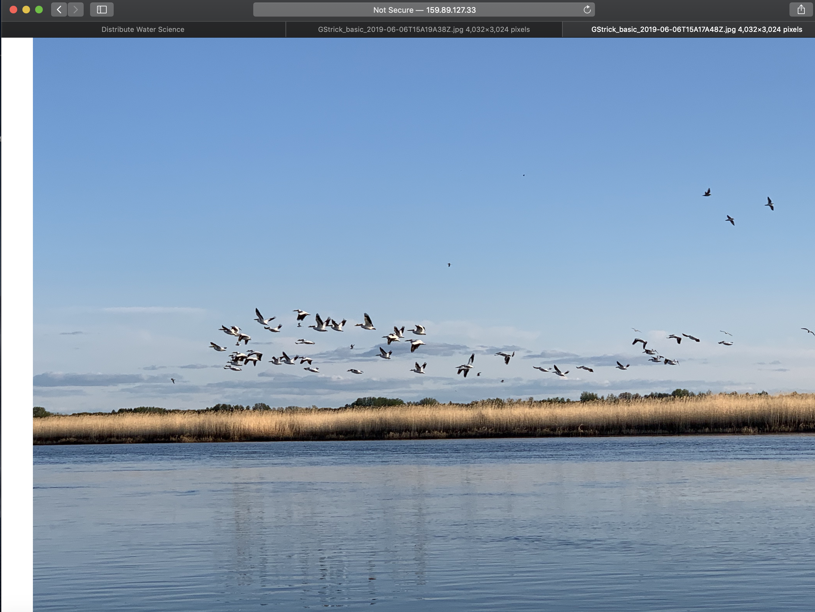
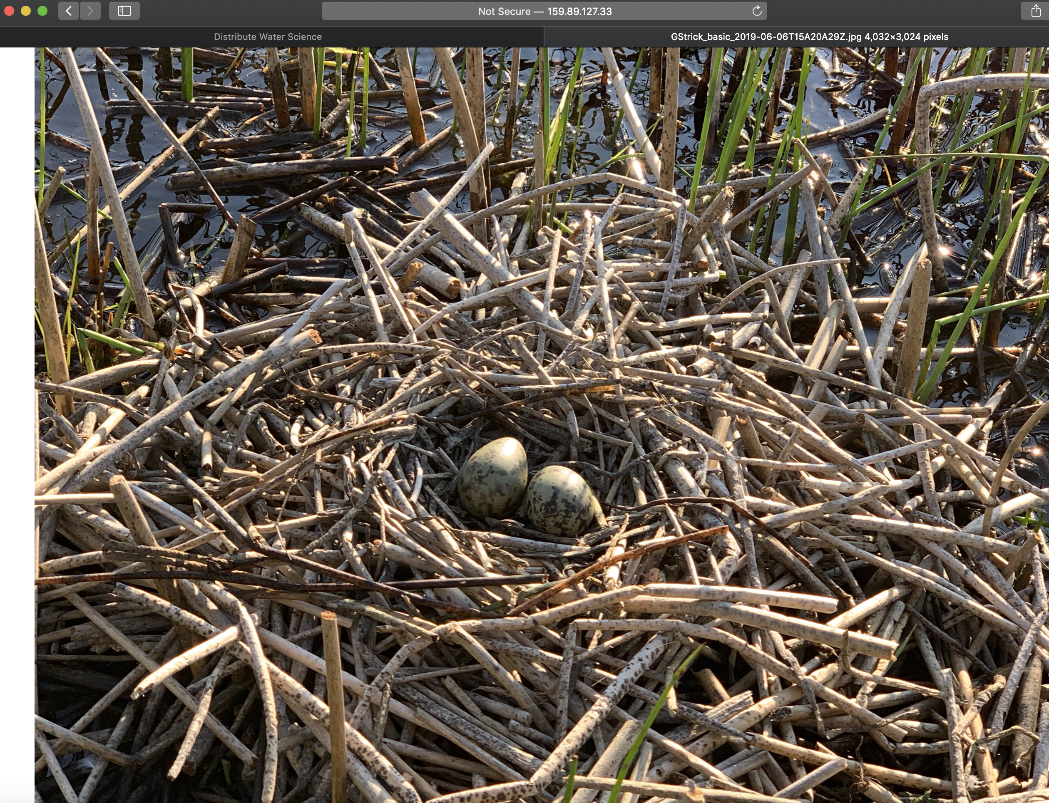
Example: Sask River Delta
Notes:
A – Upstream of areas not affected by human controls of water flows – mud flats still exist and they are teaming with life.
B – Nesting colonies of birds (e.g. Pelicans, Cormorants, Gulls and Turns)
C – Many migrating birds, ducks and geese used the delta for foraging, but an invasive grass (Fragmities Australis has established) Application tool may be useful to help with burning or harvesting the grasses in an attempt to reestablish more biologically productive mudflats.
D – Knowing the location of nesting colonies could be helpful

Slide 5
Project Impact and Aspirations
Results:
Built a functional Web app and Android app
Partners gained interest and understanding of encrypted data sharing
Lots of interest beyond basic functions (e.g. geo-located photos)
Next Steps:
Trust agreements between users
Apps that don’t sell data to any third parties
ECCC - Maritimes would like to use the app as a way to engage fishers in data collection
Project Title
Distributed Water Science

Slide 6
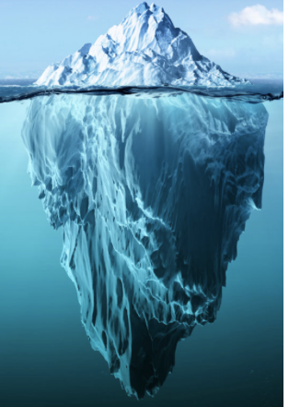
Challenges and Cross-Project Collaboration Opportunities
RMS T R U S T
People are rapidly losing trust in social media and apps
Blockchain backend of our app might be useful to other GWF apps
Would love to meet and share with other GWF app developers
Project Title
Distributed Water Science
Notes:
Image from Black Tie Digital Marketing

