Slide 1
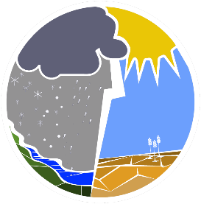
Climate-Related Precipitation Extremes
Focus on precipitation extremes (drought, intense precipitation events, hail, freezing precipitation, snow…) to provide new insights into their occurrence
Work closely with a wide range of users in multiple sectors
Develop, use and interpret observed and simulated data for the analysis of extremes
Principal Investigators:
Ronald Stewart (U of Manitoba) - Ronald.Stewart@umanitoba.ca
Francis Zwiers (UVIC) - fwzwiers@uvic.ca
Website: https://gwf.usask.ca/extremes/index.php
Project coordinates: PI, email, website, etc
Climate-Related Precipitation Extremes
Notes:
It can help to frame your main research objective as a question. For example,
How will climate change affect agriculture in Canada?
How can we improve water quality and reduce algal blooms in Canadian lakes?
What are the links between fish health, food safety and food security in the Indigenous North?
What is the significance of groundwater fluxes on surface water flow?

Slide 2
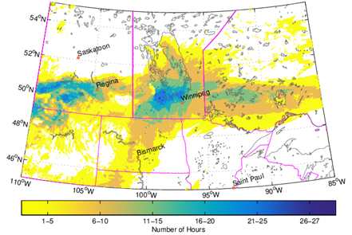
Transformational Science Highlights
08/2020?
07/2019
New 4 km CONUS II runs: Launched in July, continental scale, 20-year simulations of the present and future climate using a carefully updated version of the convection permitting WRF model
~40% done
11/2019
CONUS II domain
Hazardous freezing precipitation: Identification and analysis of events affecting electrical utilities; Factors leading to extended power outages, including local topographic effects, are being understood using the WRF CONUS I (PGW) runs
Hours of wet snow on May 11, 2004
Project Title
Project name
Climate-Related Precipitation Extremes
Notes:
These accomplishments slides will be also be used to build slide bank for use in GWF presentations
How are these results key to advancing the science
How are these results linked to the needs of your partners/users?

Slide 3
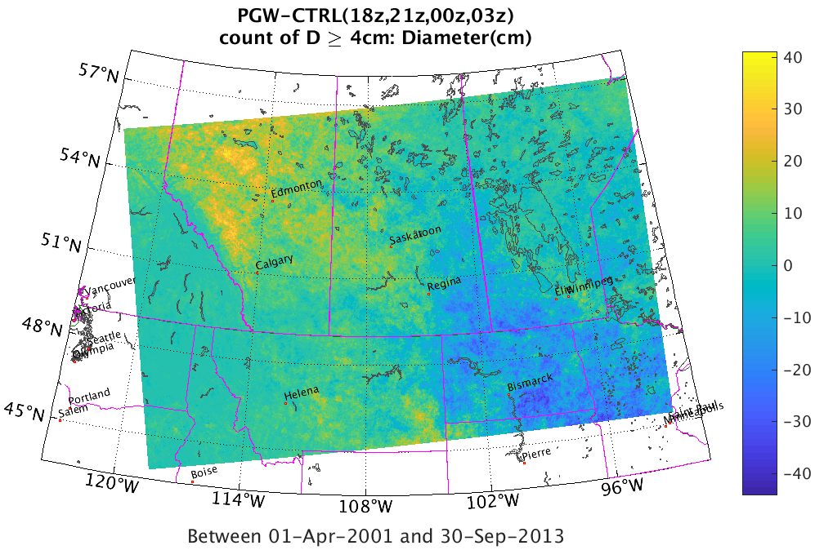
Transformational Science Highlights
Hail: Changes in hail occurrence are being studied using the Hailcast model driven by WRF CONUS I runs
Projected change in frequency of hail ≥ 4 cm
Return levels for very long periods: Becoming critical for engineering design; standard methods based in extreme value theory are not adequate; Developing a more physically based approach with promising results based on testing with the CanRCM4 large ensemble
Performance improvement at locations where GEV distribution does not fit well
Compound model (50 years of data)
GEV (50 years of data)
GEV (1750 years of data)
Fraction of points
Relative RMSE (%)
Project Title
Project name
Climate-Related Precipitation Extremes
Notes:
These accomplishments slides will be also be used to build slide bank for use in GWF presentations
How are these results key to advancing the science
How are these results linked to the needs of your partners/users?

Slide 4
Project Impact and Aspirations
Overall Goal: Demonstrate research and applications addressing important issues for several sectors and facilitate effective utilization of knowledge by our users, GWF colleagues, broader community
    Electrical Utilities: Improve the resilience of electrical supply systems by providing information needed to better understand precipitation related impacts on transmission and distribution systems
    Insurance: Contribute to continued viability of insurance based risk sharing mechanisms by better quantifying risk from extreme precipitation events and long term changes in risk profiles
    Engineering: Enable future climate resilient infrastructure design by increasing confidence in estimates of current and future extreme climatic loads and provide building code guidance
    Agriculture: Better manage impact of future precipitation extremes, prolonged drought periods, hail, etc., on crop yields
Climate-Related Precipitation Extremes

Slide 5
Challenges and Cross-project Collaboration Opportunities
Key Challenge
CONUS II data management and user support
Opportunities
Active connections with MWF and Pillar I projects ”Short-duration extreme precipitation” and “Mountain Water Futures”
CONUS II simulations will provide many more opportunities (driving hydrologic models, extremes assessment, evaluation of extremes producing processes, etc).
But, capacity within our project for additional collaboration is extremely limited
Climate-Related Precipitation Extremes

