Slide 1
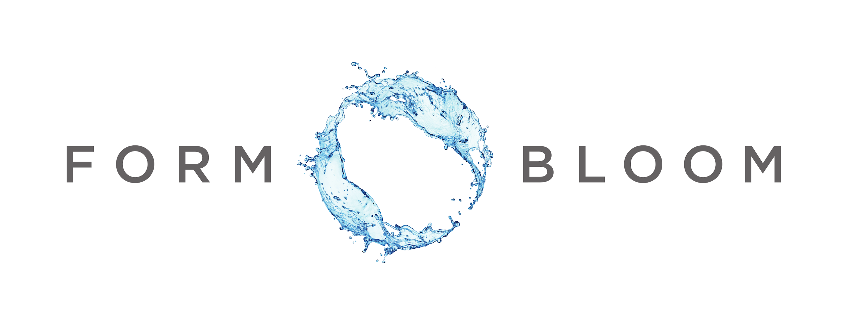
FORMBLOOM: Forecasting and Mitigation of Bloom-affected lakes
Cyanobacterial blooms are a global risk that is rapidly growing worse
1:
reduce current risk via improved risk communications, forecasting & remote sensing
understand the triggers of cyanobloom initiation and collapse to inform in-lake mitigation measures
field work, sensors, process-oriented & predictive models
2:
deploy & test mitigation techniques in lakes
improve communication methods between managers and public
Helen Baulch helen.baulch@usask.ca Jason Venkiteswaran jvenkiteswaran@wlu.ca formbloom.ca
Project coordinates: PI, email, website, etc
FORMBLOOM
Notes:
It can help to frame your main research objective as a question. For example,
How will climate change affect agriculture in Canada?
How can we improve water quality and reduce algal blooms in Canadian lakes?
What are the links between fish health, food safety and food security in the Indigenous North?
What is the significance of groundwater fluxes on surface water flow?

Slide 2
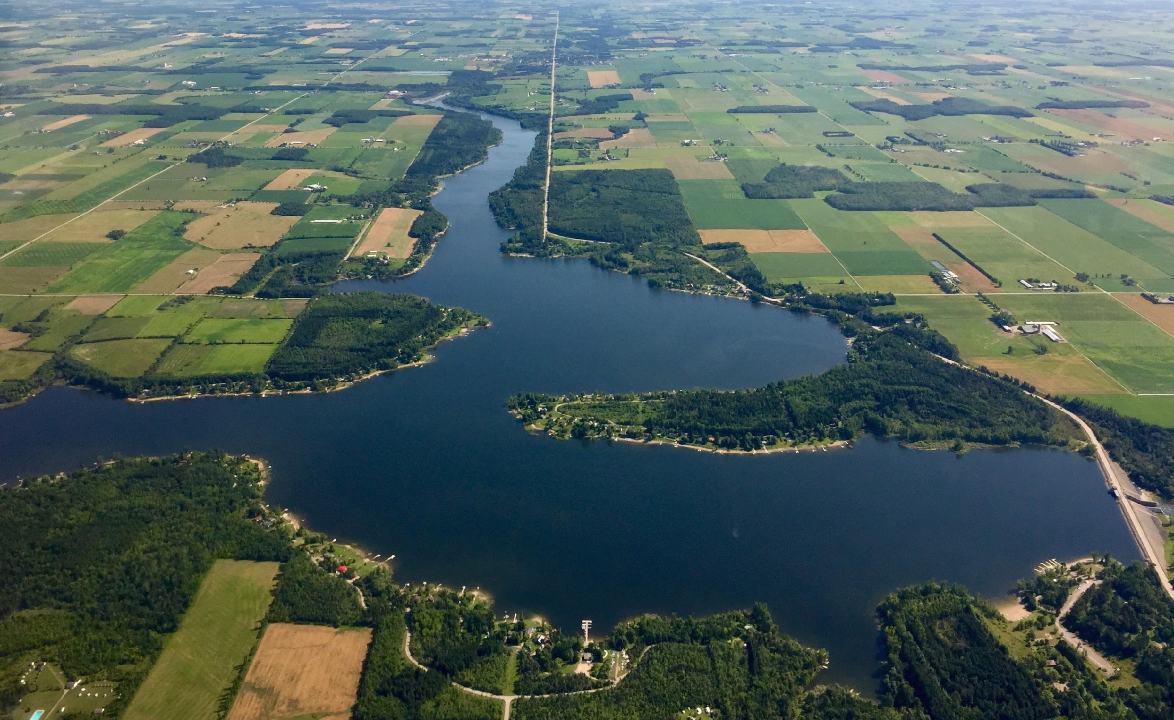
Transformational Science Highlights
Climate & precipitation linked to bloom changes
Extreme event led to early onset bloom
Can predict bloom onset 4-7 days in advance
Novel seasonal patterns of diverse cyano-toxins
Toxin diversity greater than anticipated
Reason for major concern
Predict timing of bloom pre-conditions
Test science-based bloom mitigation options
Project Title
FORMBLOOM
Notes:
These accomplishments slides will be also be used to build slide bank for use in GWF presentations
How are these results key to advancing the science
How are these results linked to the needs of your partners/users?

Slide 3
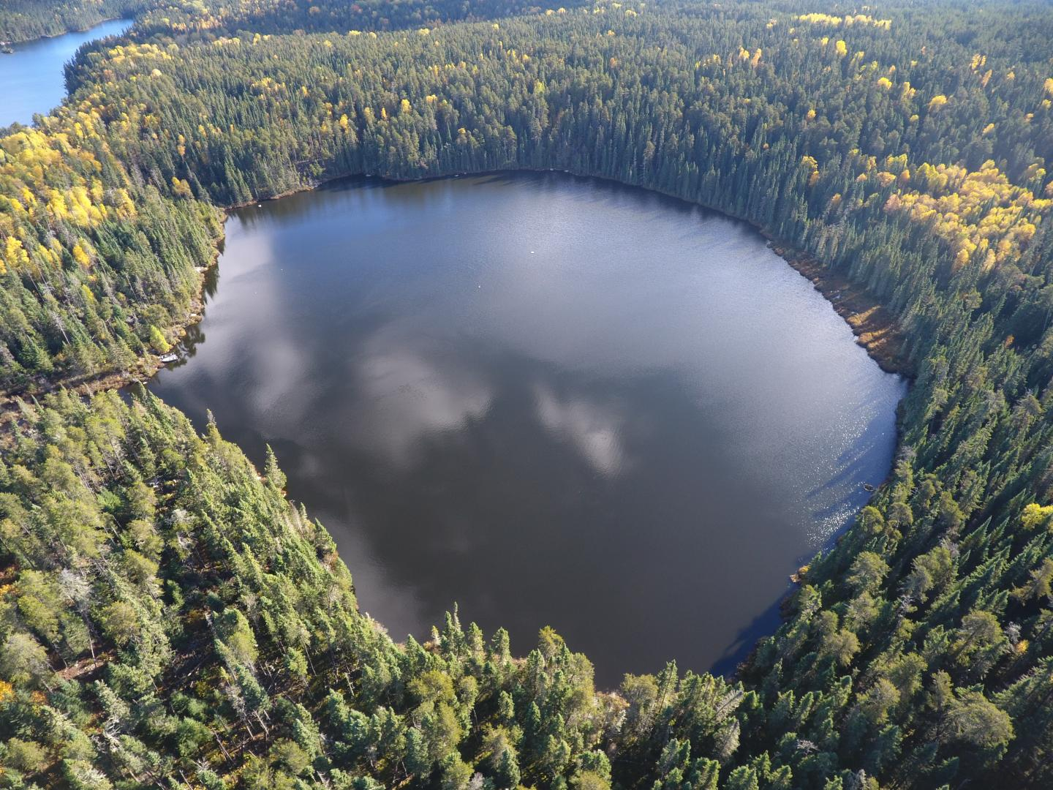
Project Impact and Aspirations
Applications:
Developing decision support structures for WTP
More requests from partners than anticipated
Improved risk communications from partners
Improved bloom forecasting
Test science-based mitigation options considering feasibility, economic, social factors
Project Title
FORMBLOOM

Slide 4
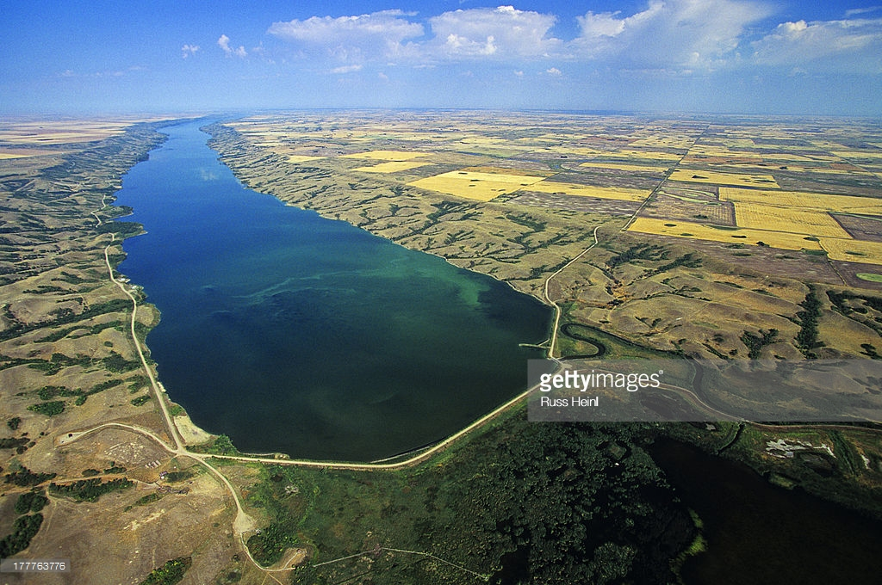
Challenges and Cross-project Collaboration Opportunities
Opportunities:
Joint meeting with partners to reduce burnout
Challenges:
Time-limited world – catalysing communications and synergies across projects (ensuring coherent messaging)
High needs from users (many requests and needs from partners – established, new, & potential additions)
Project Title
FORMBLOOM

