Slide 1
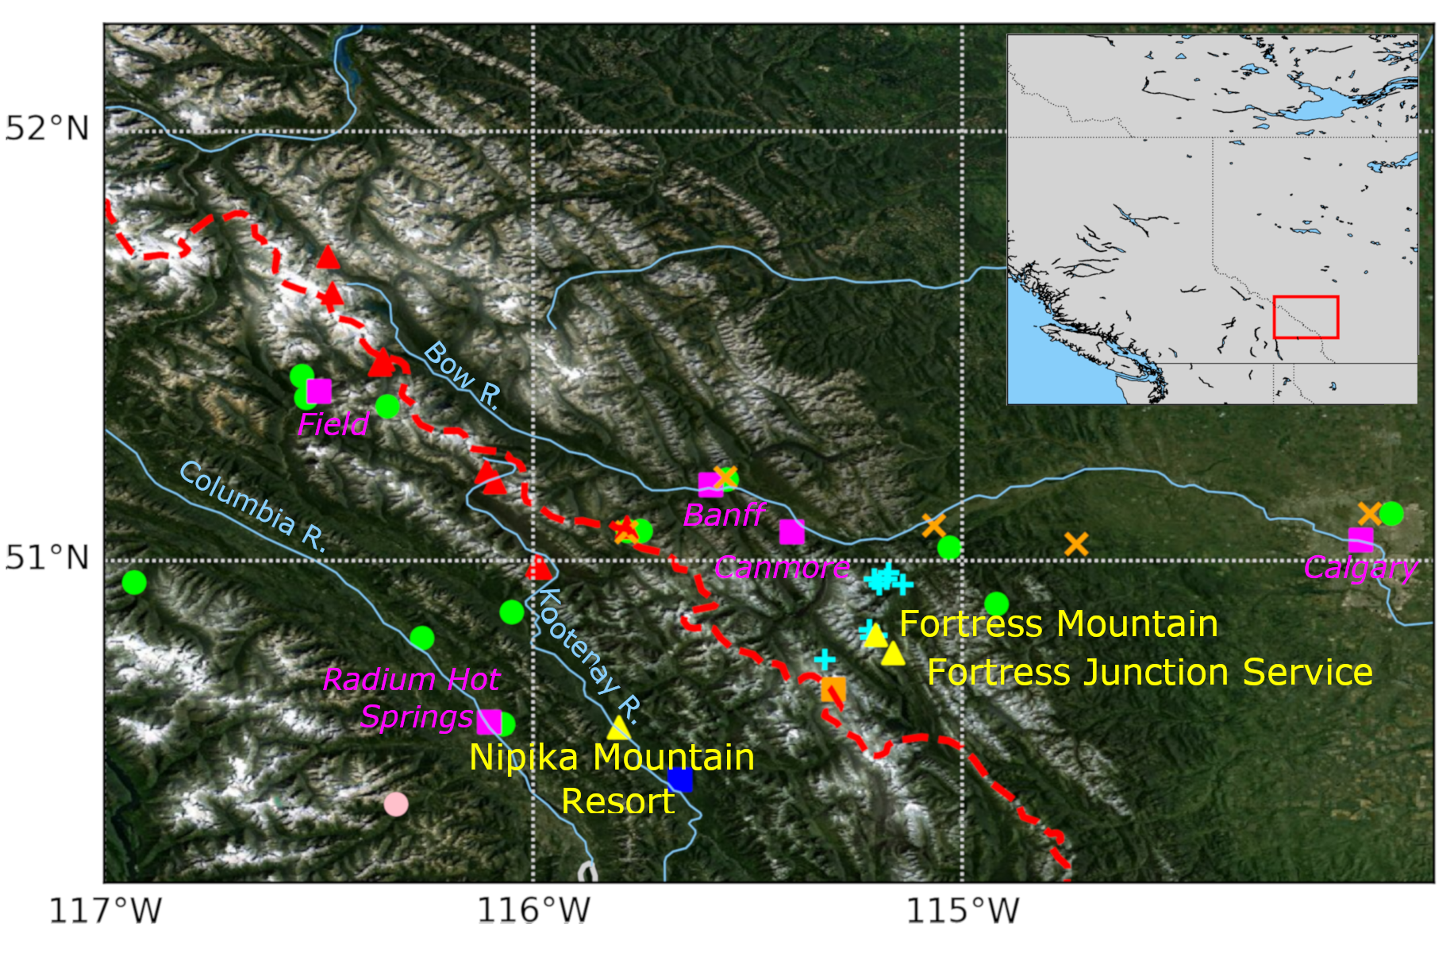
Storms and Precipitation Across the continental Divide Experiment (SPADE)
Storms and their precipitation at the top of the western Cordillera are some of the key water-related issues in North America.
Science question: How is the precipitation, amount and type, distributed across the continental divide?
Approach: Conducted a field experiment from April to June 2019
Principal investigator: Prof Julie Thériault, Email: theriault.julie@uqam.ca https://gwf-spade.weebly.com/
Project coordinates: PI, email, website, etc
SPADE: Storms and Precipitation Across the continental Divide Experiment
Notes:
It can help to frame your main research objective as a question. For example,
How will climate change affect agriculture in Canada?
How can we improve water quality and reduce algal blooms in Canadian lakes?
What are the links between fish health, food safety and food security in the Indigenous North?
What is the significance of groundwater fluxes on surface water flow?

Slide 2
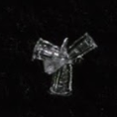
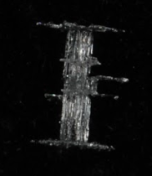
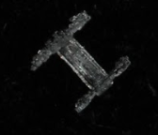
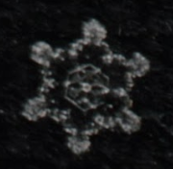
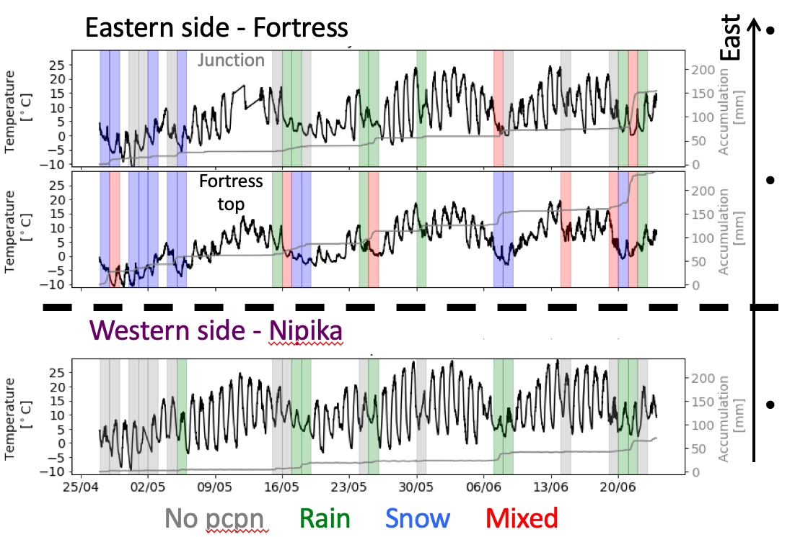
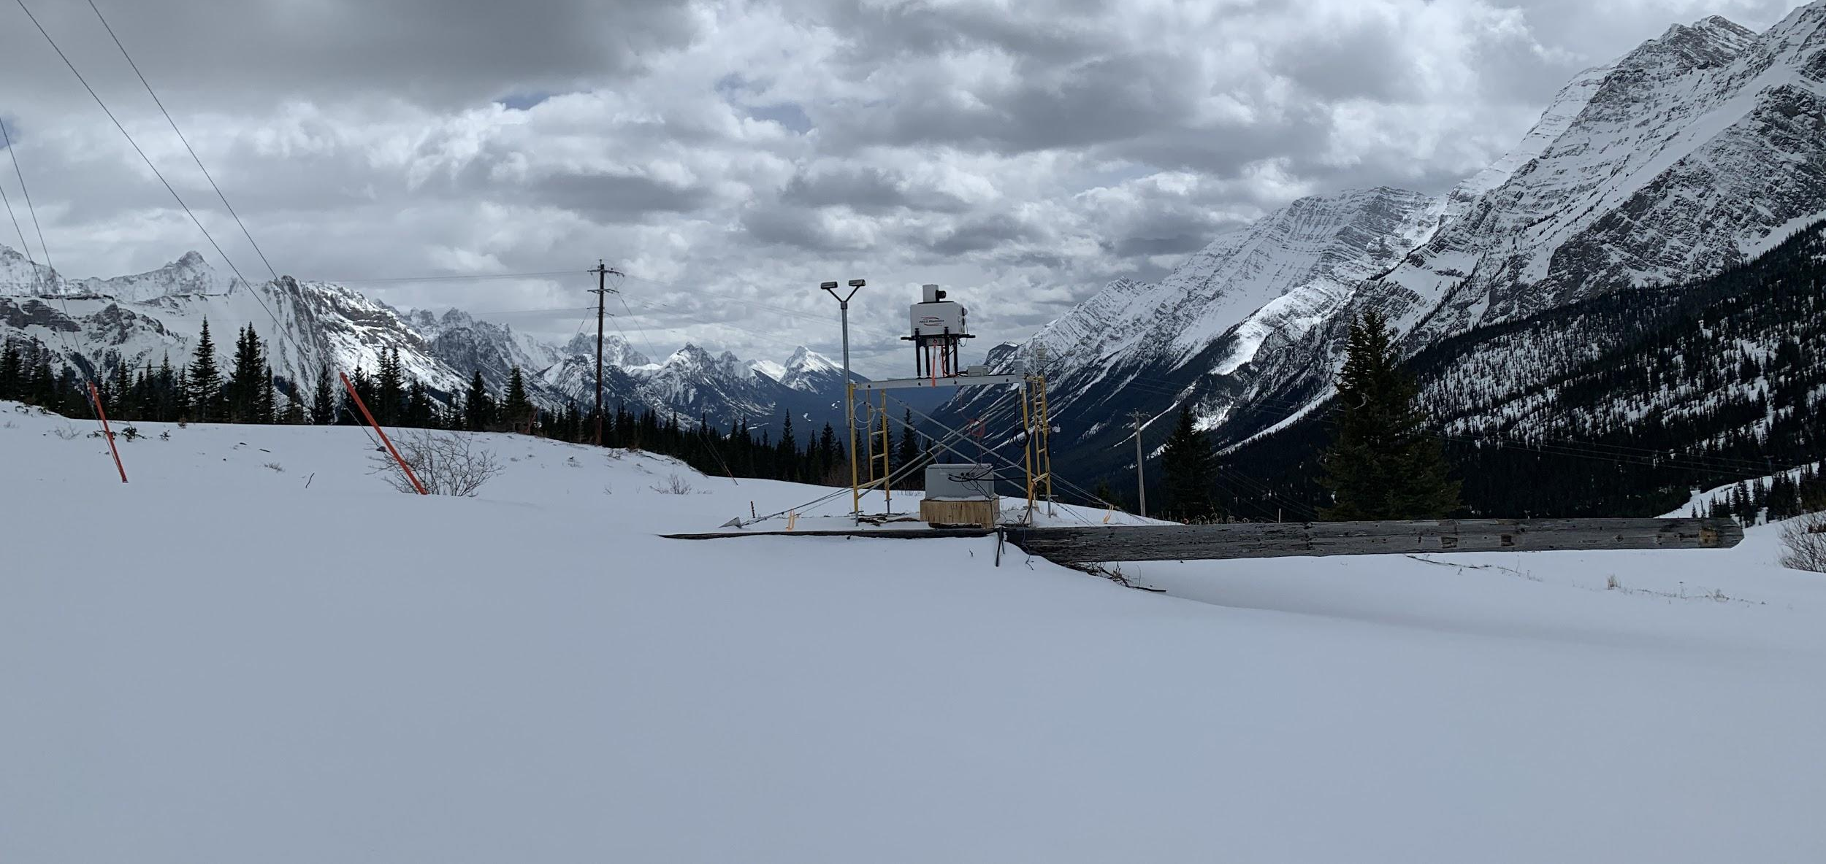
Transformational Science Highlights
18 precipitation events were documented across the continental divide
High temporal variation of precipitation characteristics among storms and location
3 major storms occurred
Project Title
SPADE: Storms and Precipitation Across the continental Divide Experiment
Notes:
Notes:
-Temperature is similar to climatology: warmer on western side by ~5°C
-Amount of precipitation is different than climatology: more on the eastern side than the western side (265 mm compared to 65 mm)
-21 days of precipitation documented, 18 events documented with only 8 of those having occurred on the western side
-3 major storms: (W to E)
-26-27 April: T=9°C and trace precip, -5°C<T<-2°C and 33 mm (snow)
-7-8 June: T=6.5°C and 14 mm (rain), 0°C<T<3°C and 21 mm (snow)
-19-20 June: T=7°C and 19 mm (rain), T~0°C and 56 mm (snow -> rain)
These accomplishments slides will be also be used to build slide bank for use in GWF presentations
How are these results key to advancing the science
How are these results linked to the needs of your partners/users?

Slide 3
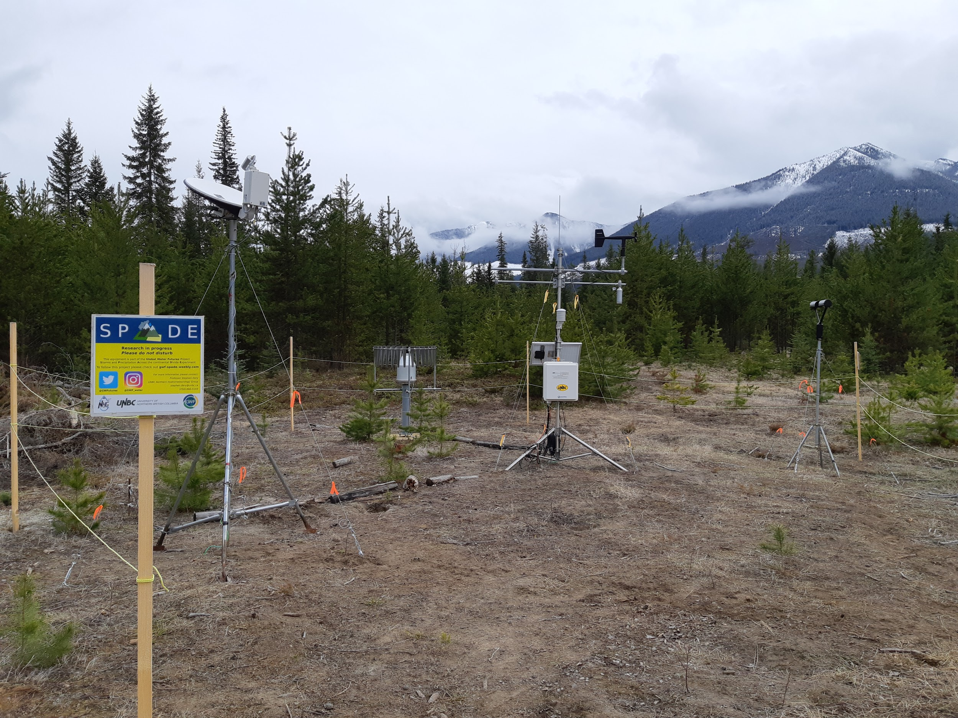
Project Impact and Aspirations
Better understanding of major precipitation events over mountainous areas. In particular:
Processes governing the amount of moisture crossing the continental divide, including the precipitation amounts and phase
Precipitation amounts and types falling during the spring, often responsible for extreme flooding events
Small scale precipitation thermodynamic and dynamic processes, some of which can lead to extreme storms and flooding events
Project Title
SPADE: Storms and Precipitation Across the continental Divide Experiment
Notes:
How have the results so far been, or will be, of interest to your partners and other potential users?
What opportunities have you identified to put these results into action that you will be taking up in the coming year?
What do you foresee will be the impact of this research to society?

Slide 4
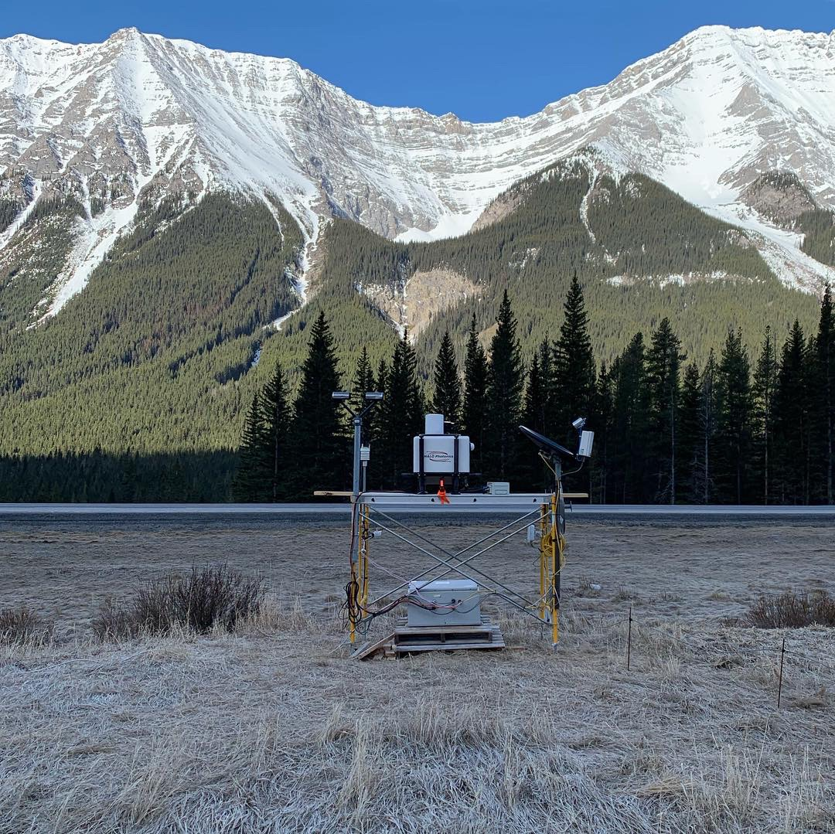
Challenges and Cross-project Collaboration Opportunities
Operational challenges that you want to highlight to the network
Data management and submission - large file sizes and a large number of files
Collaboration with other projects:
Mountain Water Futures (Pillar 3)
Short-duration extreme precipitation in Future Climate (Pillar 1)
Help from the operation team:
Data management team: To help with the data repository
KM team: to coordinate activities with other projects
Project Title
SPADE: Storms and Precipitation Across the continental Divide Experiment
Notes:
﻿Short‐Duration Extreme Precipitation in Future Climate

