Slide 1
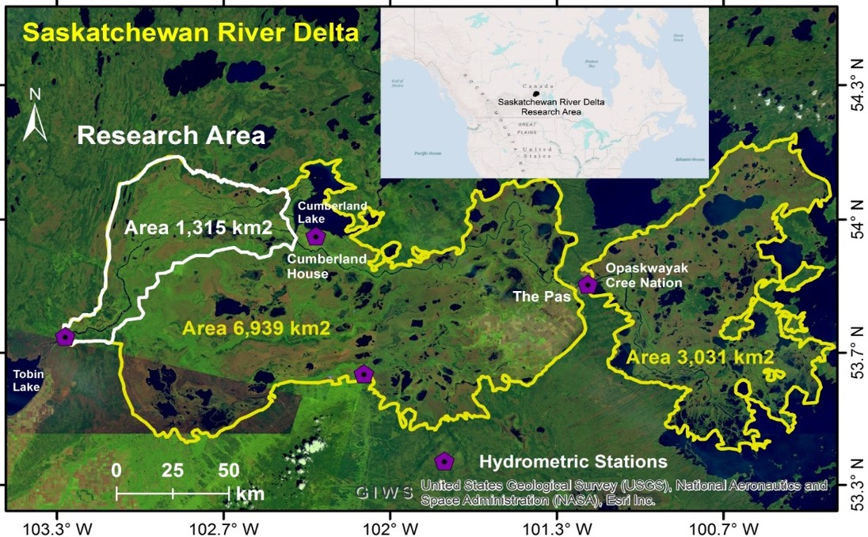
We need more than just water: Assessing sediment limitation in a freshwater delta
The Saskatchewan River Delta is being starved of sediment leading to channel widening and deepening, loss of wetland connectivity, and loss of nutrient supply.
Objective: Determine if sediment restoration is a feasible option to sustain the delta
Methods
Combination of a community-planning process (Delta Stewardship Committee), interviews with elders, sediment toxicity testing, sediment transport model, community monitoring
Project contacts: Tim Jardine (tim.jardine@usask.ca) and Gary Carriere (gcarriere@sasktel.net)
Project coordinates: PI, email, website, etc
We need more than just water

Slide 2
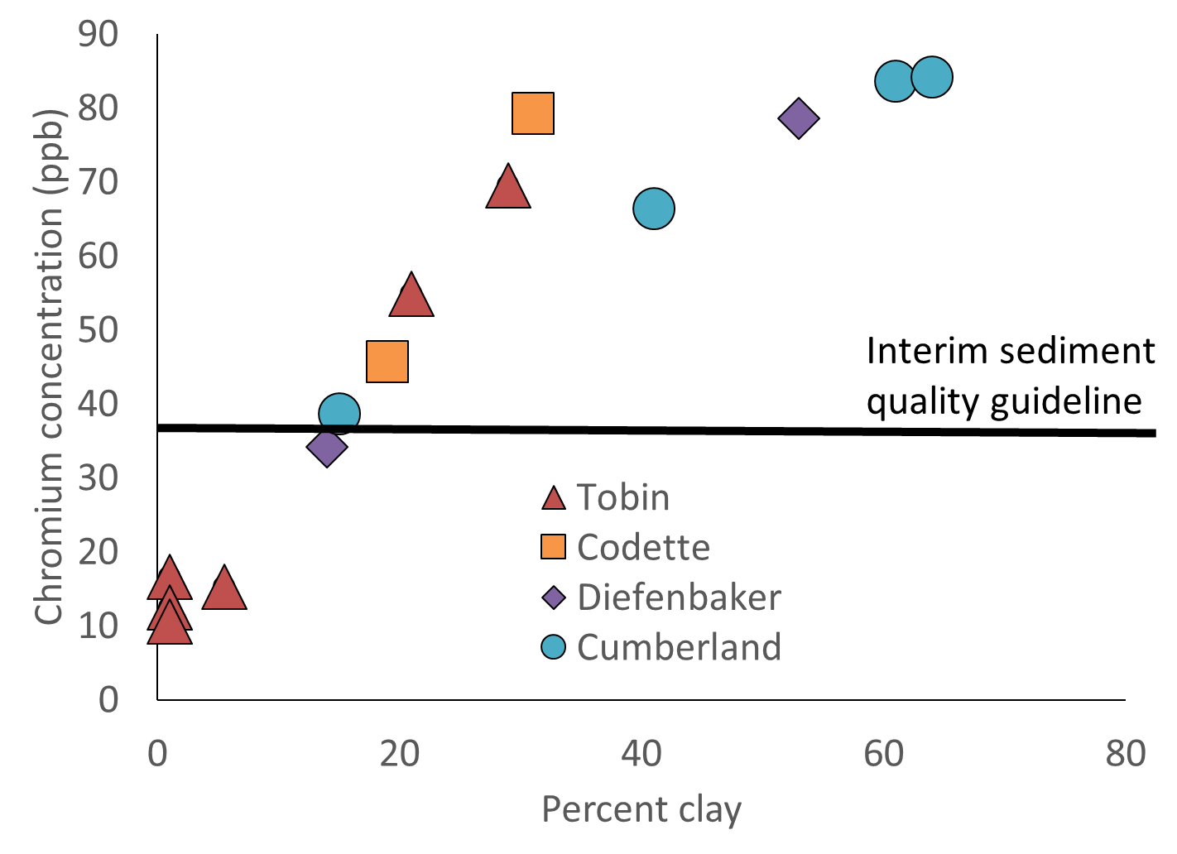
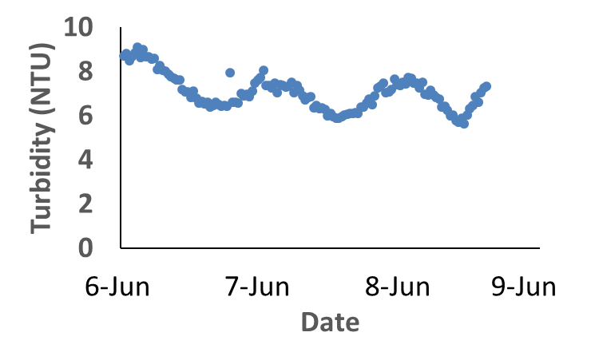
Highlights to date
Three Delta Stewardship meetings
10 interviews
40 hours of audio plus photovoice
Sampled bed sediment of four lakes/reservoirs
Diefenbaker, Codette, Tobin, Cumberland
Tested for metal concentrations
Spot sampling for turbidity and total suspended solids
Continuous turbidity data from “Delta Bob”
Sediment transport model development
Project Title
We need more than just water
Notes:
These accomplishments slides will be also be used to build slide bank for use in GWF presentations
How are these results key to advancing the science
How are these results linked to the needs of your partners/users?

Slide 3
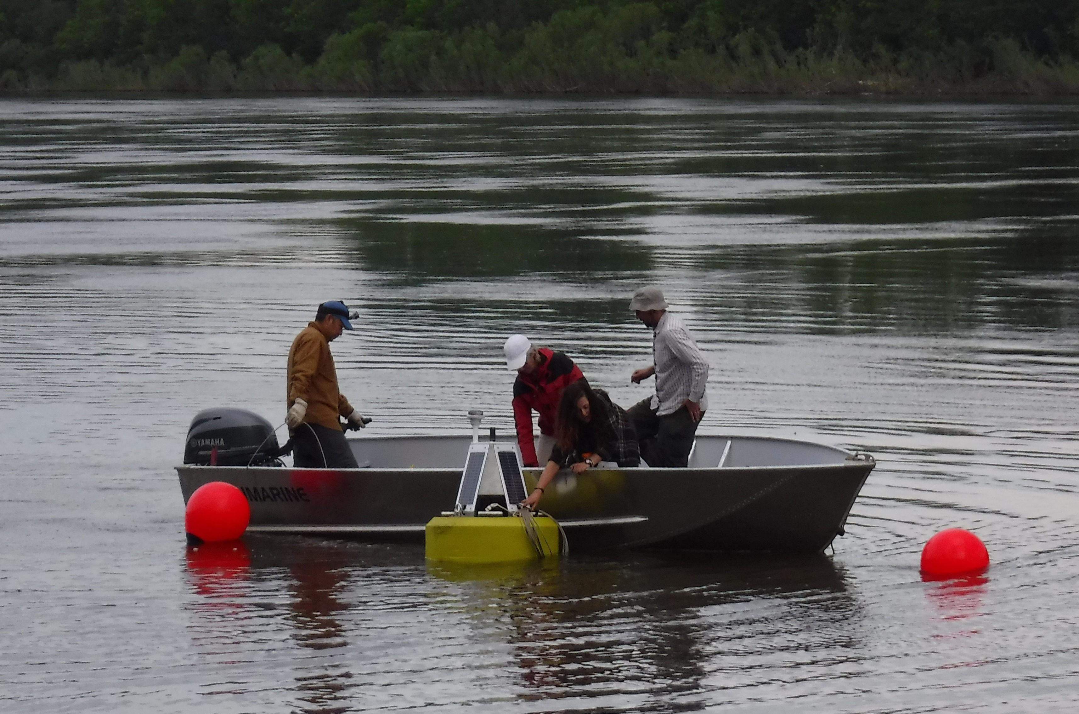
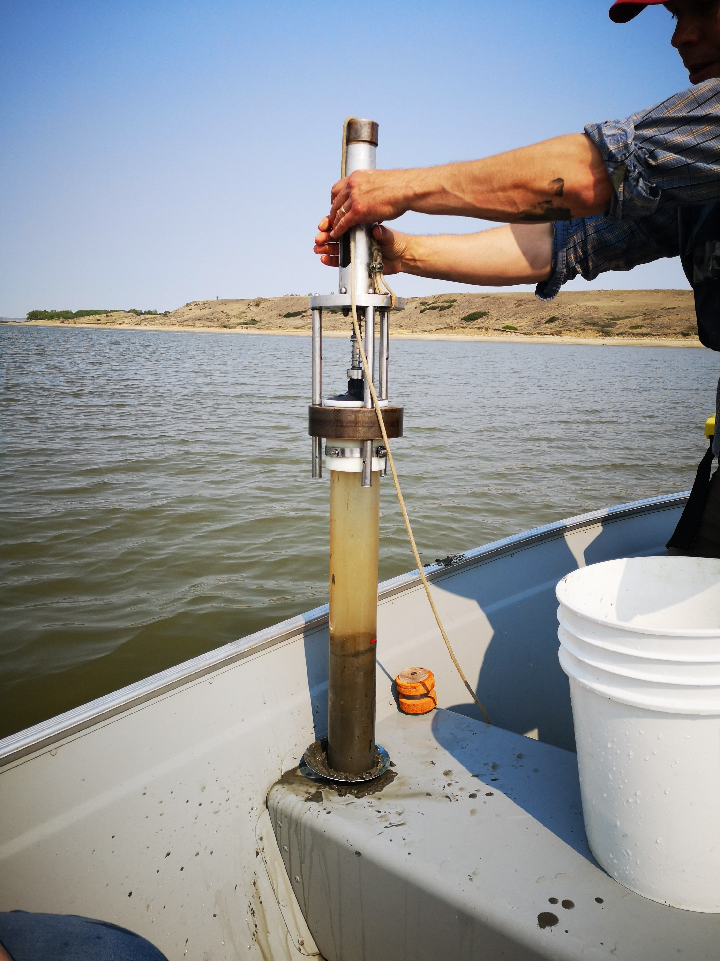
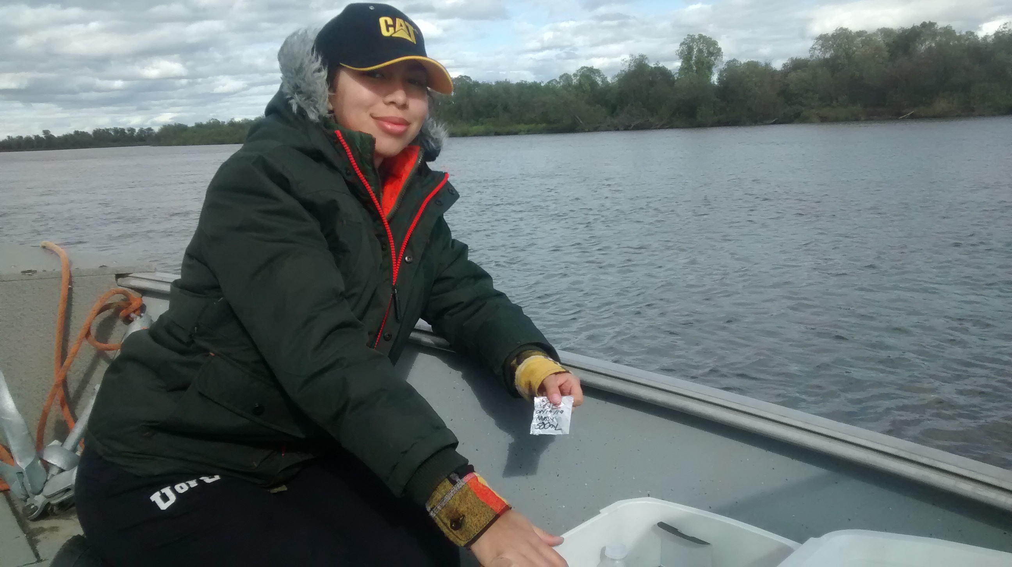
Future work
Reporting back
Workshop in winter
Annual symposium in summer
Laboratory work
Toxicity and chemical testing of sediment
Field 2020
Redeployment of Delta Bob
Additional spot measurements
Beyond 2020
Decision-making by Stewardship Committee
Recommendation to elected leadership
Project Title
We need more than just water

Slide 4
Cross-project Collaborations
Strong linkages to Integrated Modelling Program for Canada
Tight links between water flows and sediment flows
Recognized as a single entity (inseparable)
Shared travel and personnel
Computer Science team and Knowledge Mobilization team are working away at developing visualizations – critical to project success
Capacity building in community
Training + hiring summer students and project managers
Project Title
We need more than just water

