Slide 1
Global Water Futures: Solutions to Water Threats in an Era of Global Change

Slide 2
Northern Water Futures
PI: Jennifer Baltzer
Email: info@northernwaterfutures.ca
Website: www.northernwaterfutures.ca
Twitter: @NWF_Research
Facebook: @NorthernWaterFutures
Changing Biophysical Landscape
- Hydroclimatic changes
- Wildfire
- Permafrost thaw
- Habitat loss and fragmentation
Community health and wellbeing
- Food safety and security
- Drinking water safety
- Traditional livelihoods
- Harvester Safety
Sustainable development
- Infrastructure
- Reliable energy supply
- Responsible resource extraction
Project coordinates: PI, email, website, etc
Northern Water Futures
Notes:
It can help to frame your main research objective as a question. For example,
How will climate change affect agriculture in Canada?
How can we improve water quality and reduce algal blooms in Canadian lakes?
What are the links between fish health, food safety and food security in the Indigenous North?
What is the significance of groundwater fluxes on surface water flow?

Slide 3
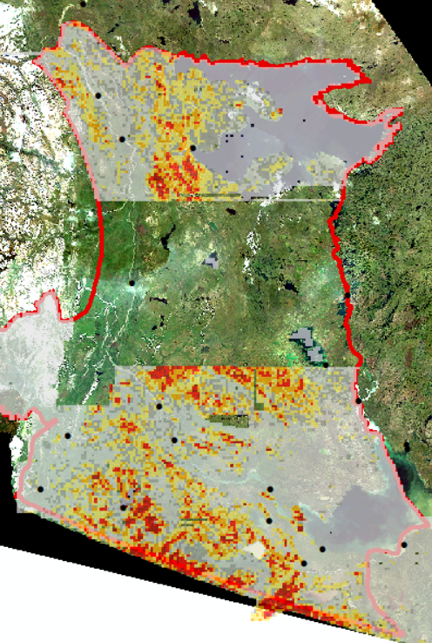
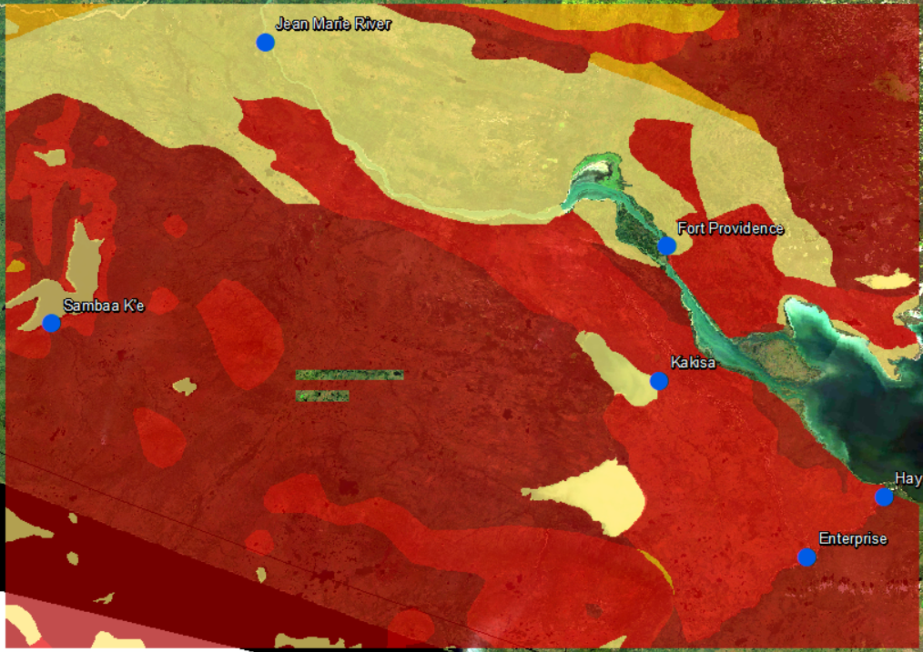
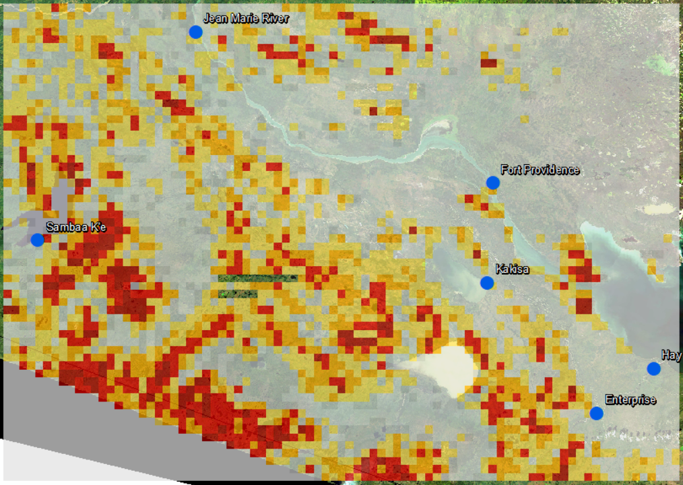



Transformational Science Highlights
Circumpolar Maps (Olefeldt et al. 2016)
Community-based Maps (Gibson et al. in prep)
Very High
High
Moderate
Low
None
Project Title
Northern Water Futures
Notes:
These accomplishments slides will be also be used to build slide bank for use in GWF presentations
How are these results key to advancing the science
How are these results linked to the needs of your partners/users?

Slide 4
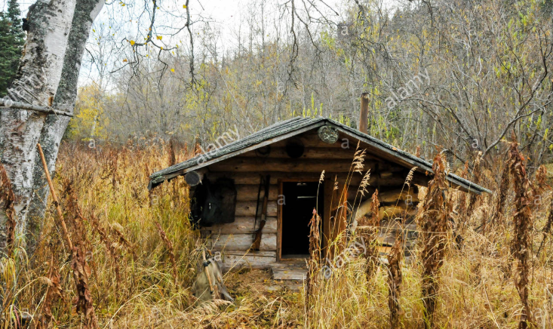
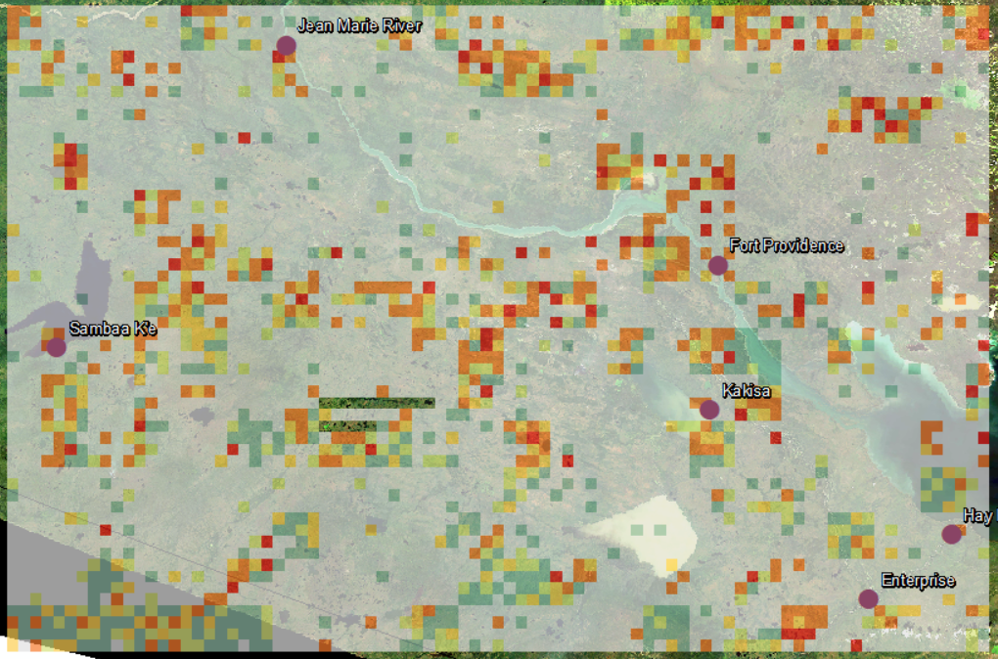
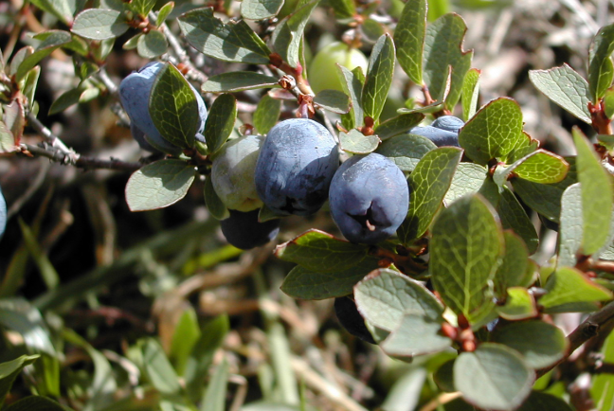
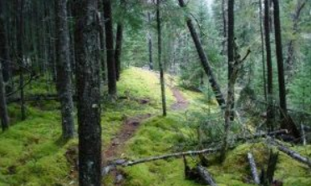
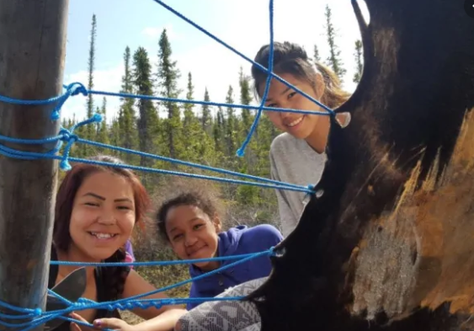
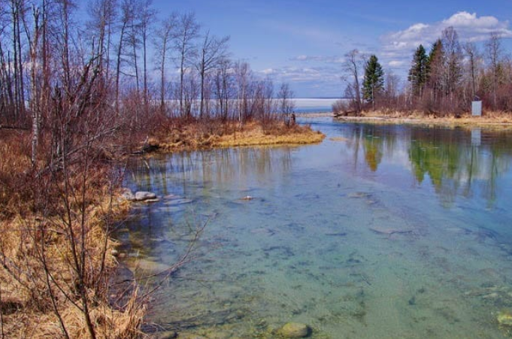
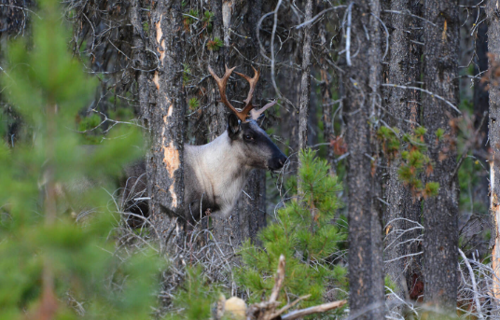
Transformational Science Highlights
Project Title
Northern Water Futures
Very High
High
Moderate
Low
None
Notes:
These accomplishments slides will be also be used to build slide bank for use in GWF presentations
How are these results key to advancing the science
How are these results linked to the needs of your partners/users?
What does risk mean to people on the ground?
Bring together community knowledge and vulnerability forecasting in a spatial framework.

Slide 5
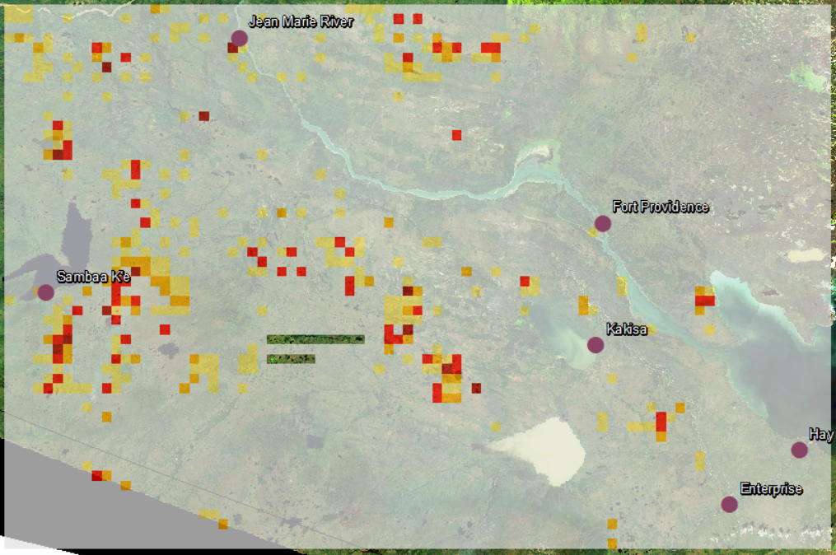
Transformational Science Highlights
Thaw Probability
Ecosystem Services
(# Services per cell)
Permafrost Thaw Risk
Risk = Probability of a negative event X Consequence of the negative event
Project Title
Northern Water Futures
Notes:
These accomplishments slides will be also be used to build slide bank for use in GWF presentations
How are these results key to advancing the science
How are these results linked to the needs of your partners/users?
What does risk mean to people on the ground?
Bring together community knowledge and vulnerability forecasting in a spatial framework.

Slide 6
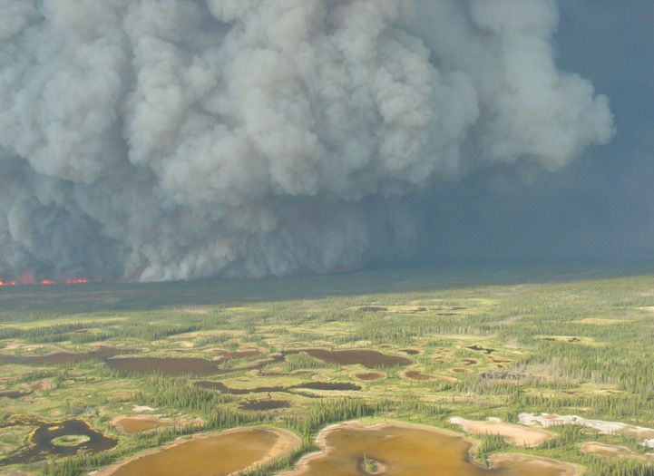
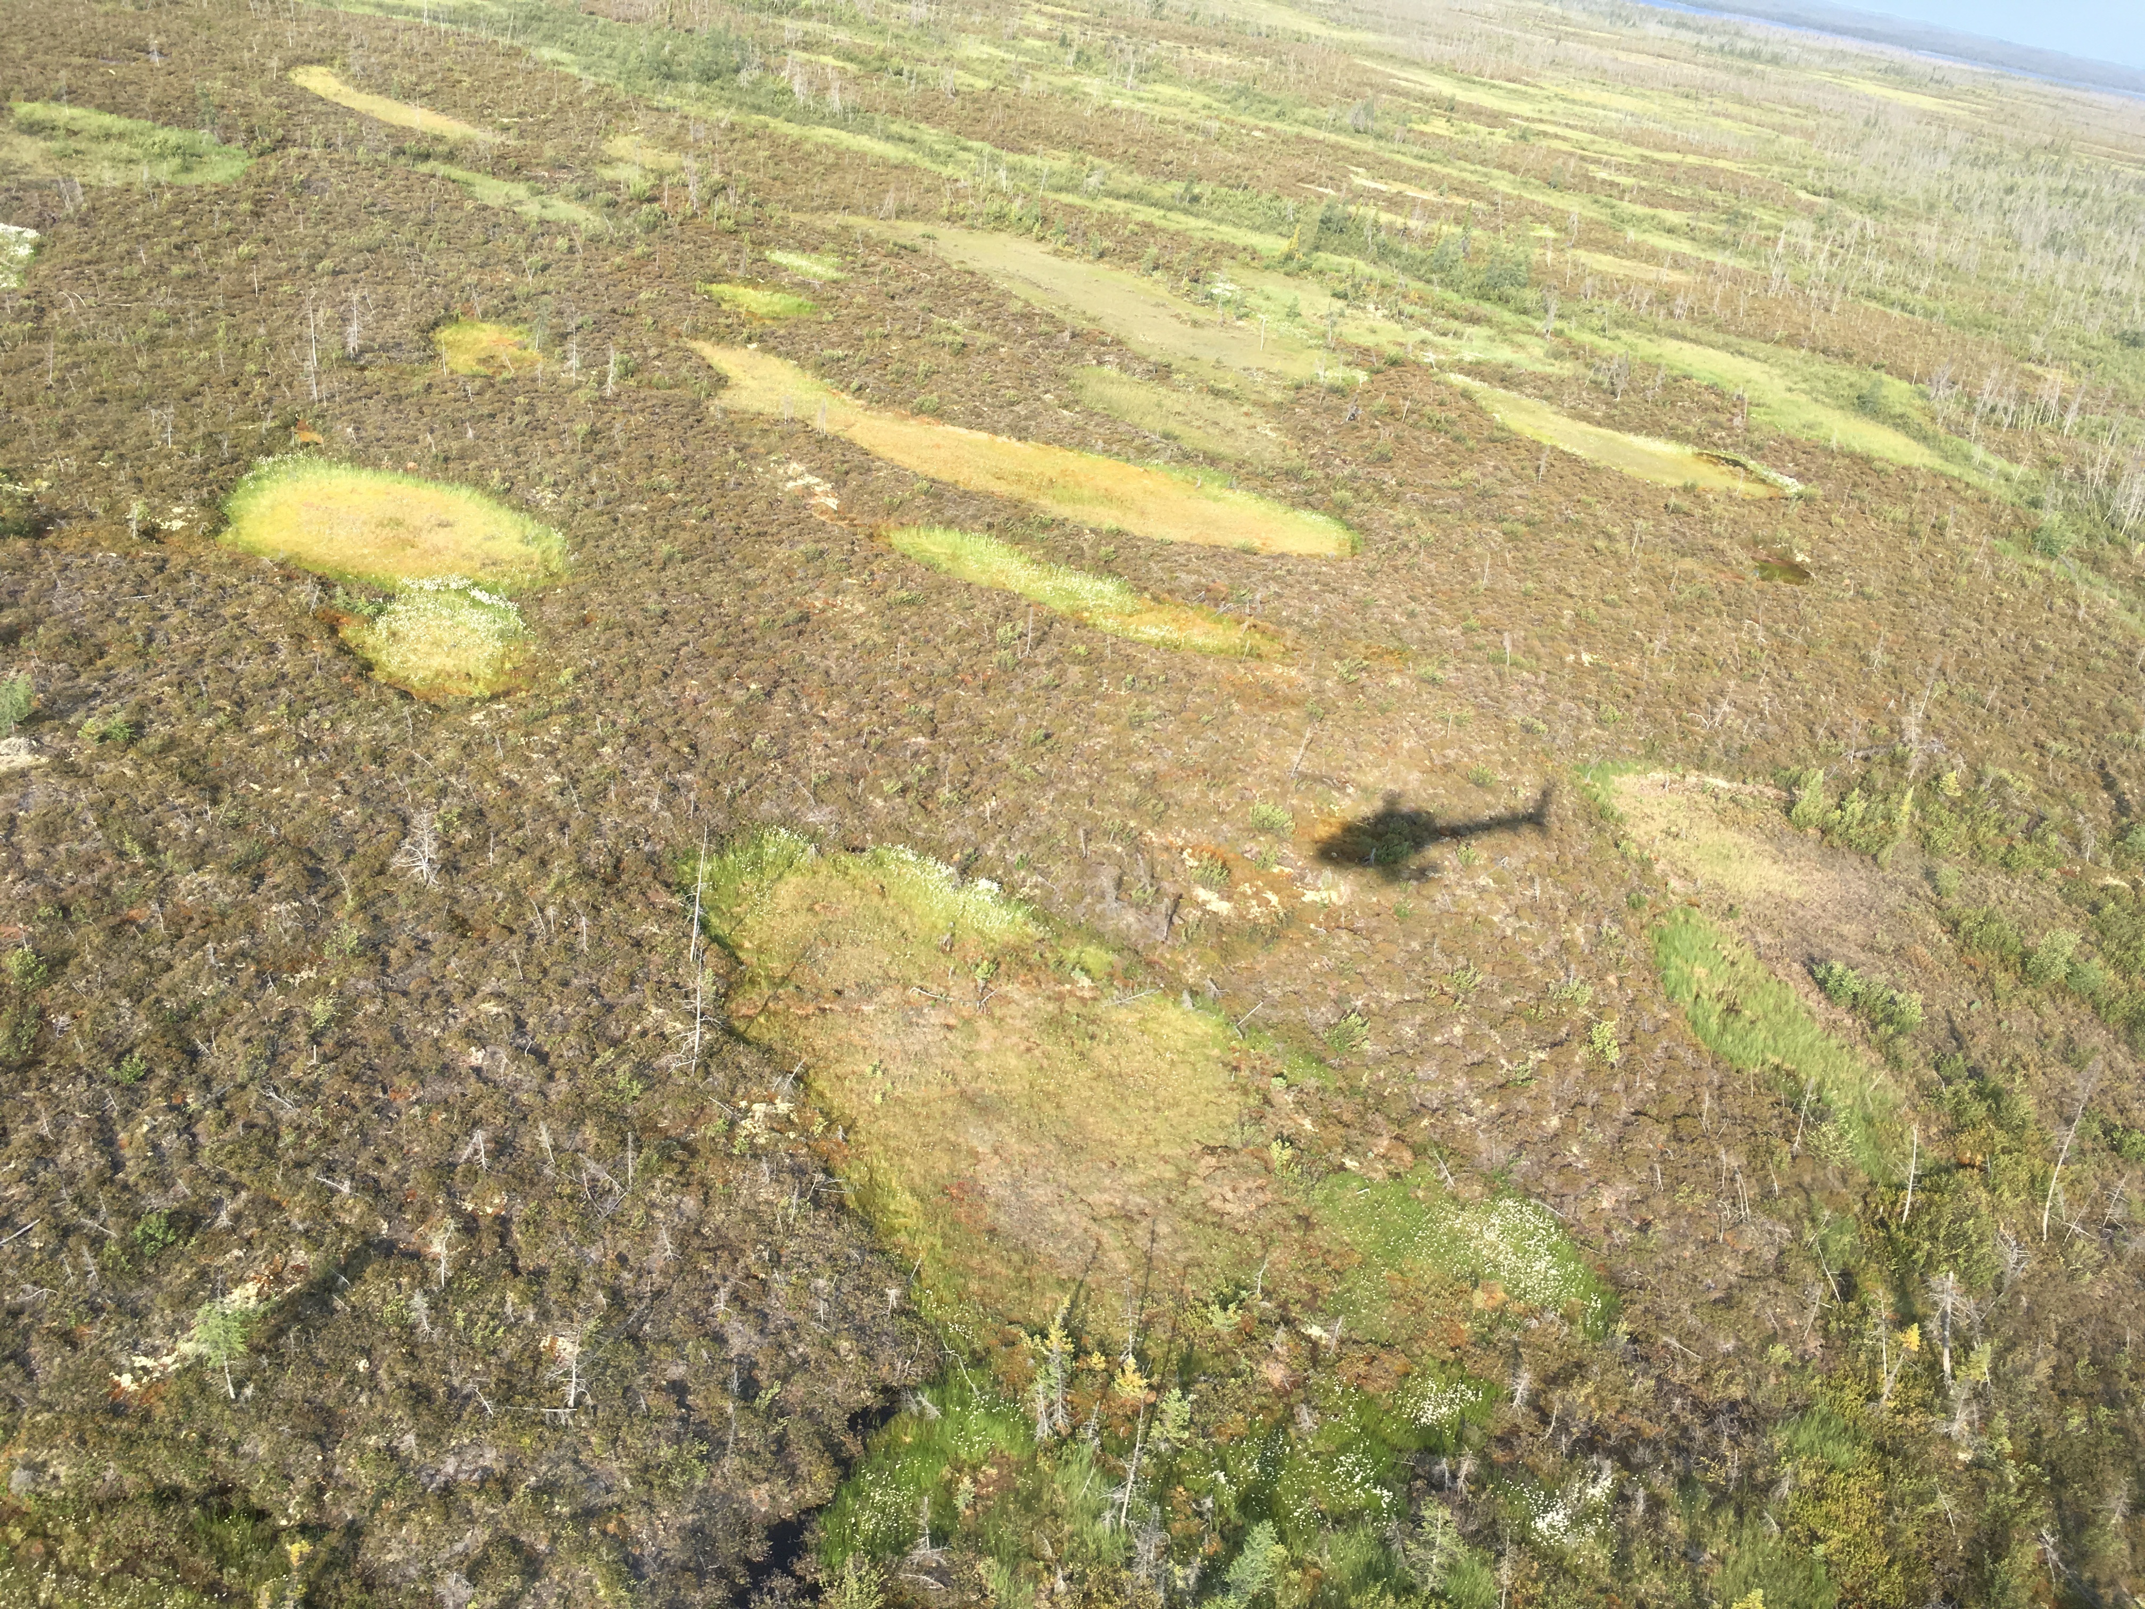
This is what climate change looks like in the north
Photo credit: GNWT ENR
Project Title
Northern Water Futures

Slide 7
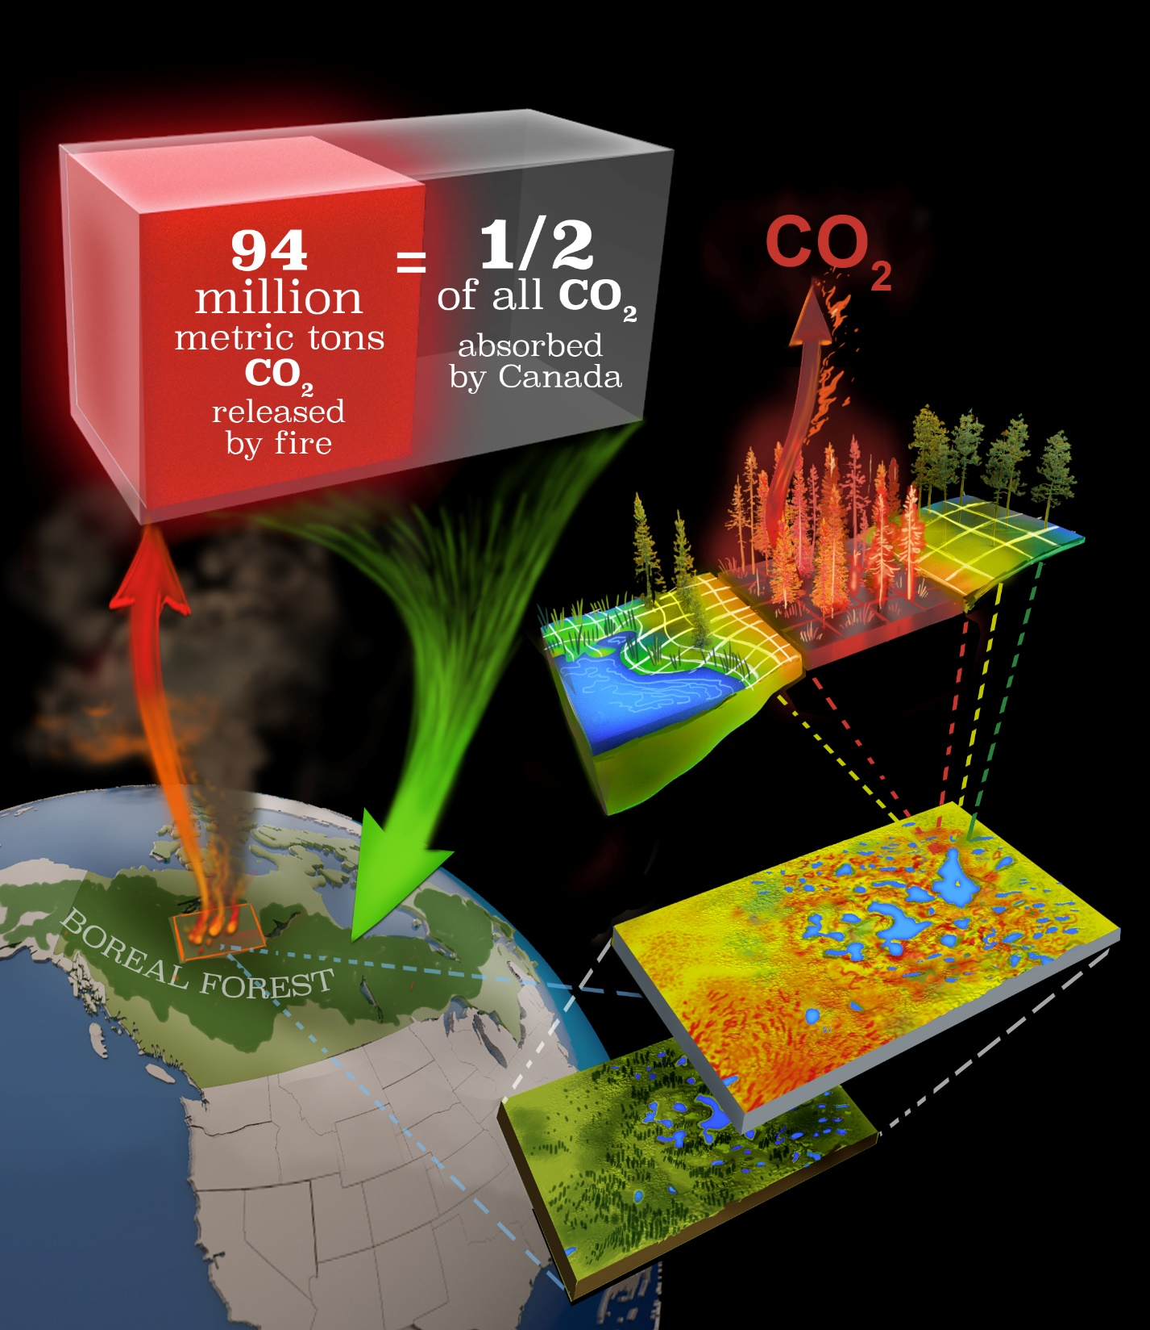
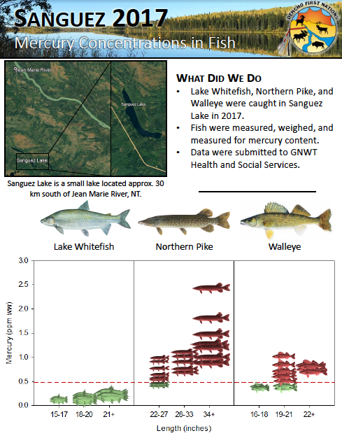
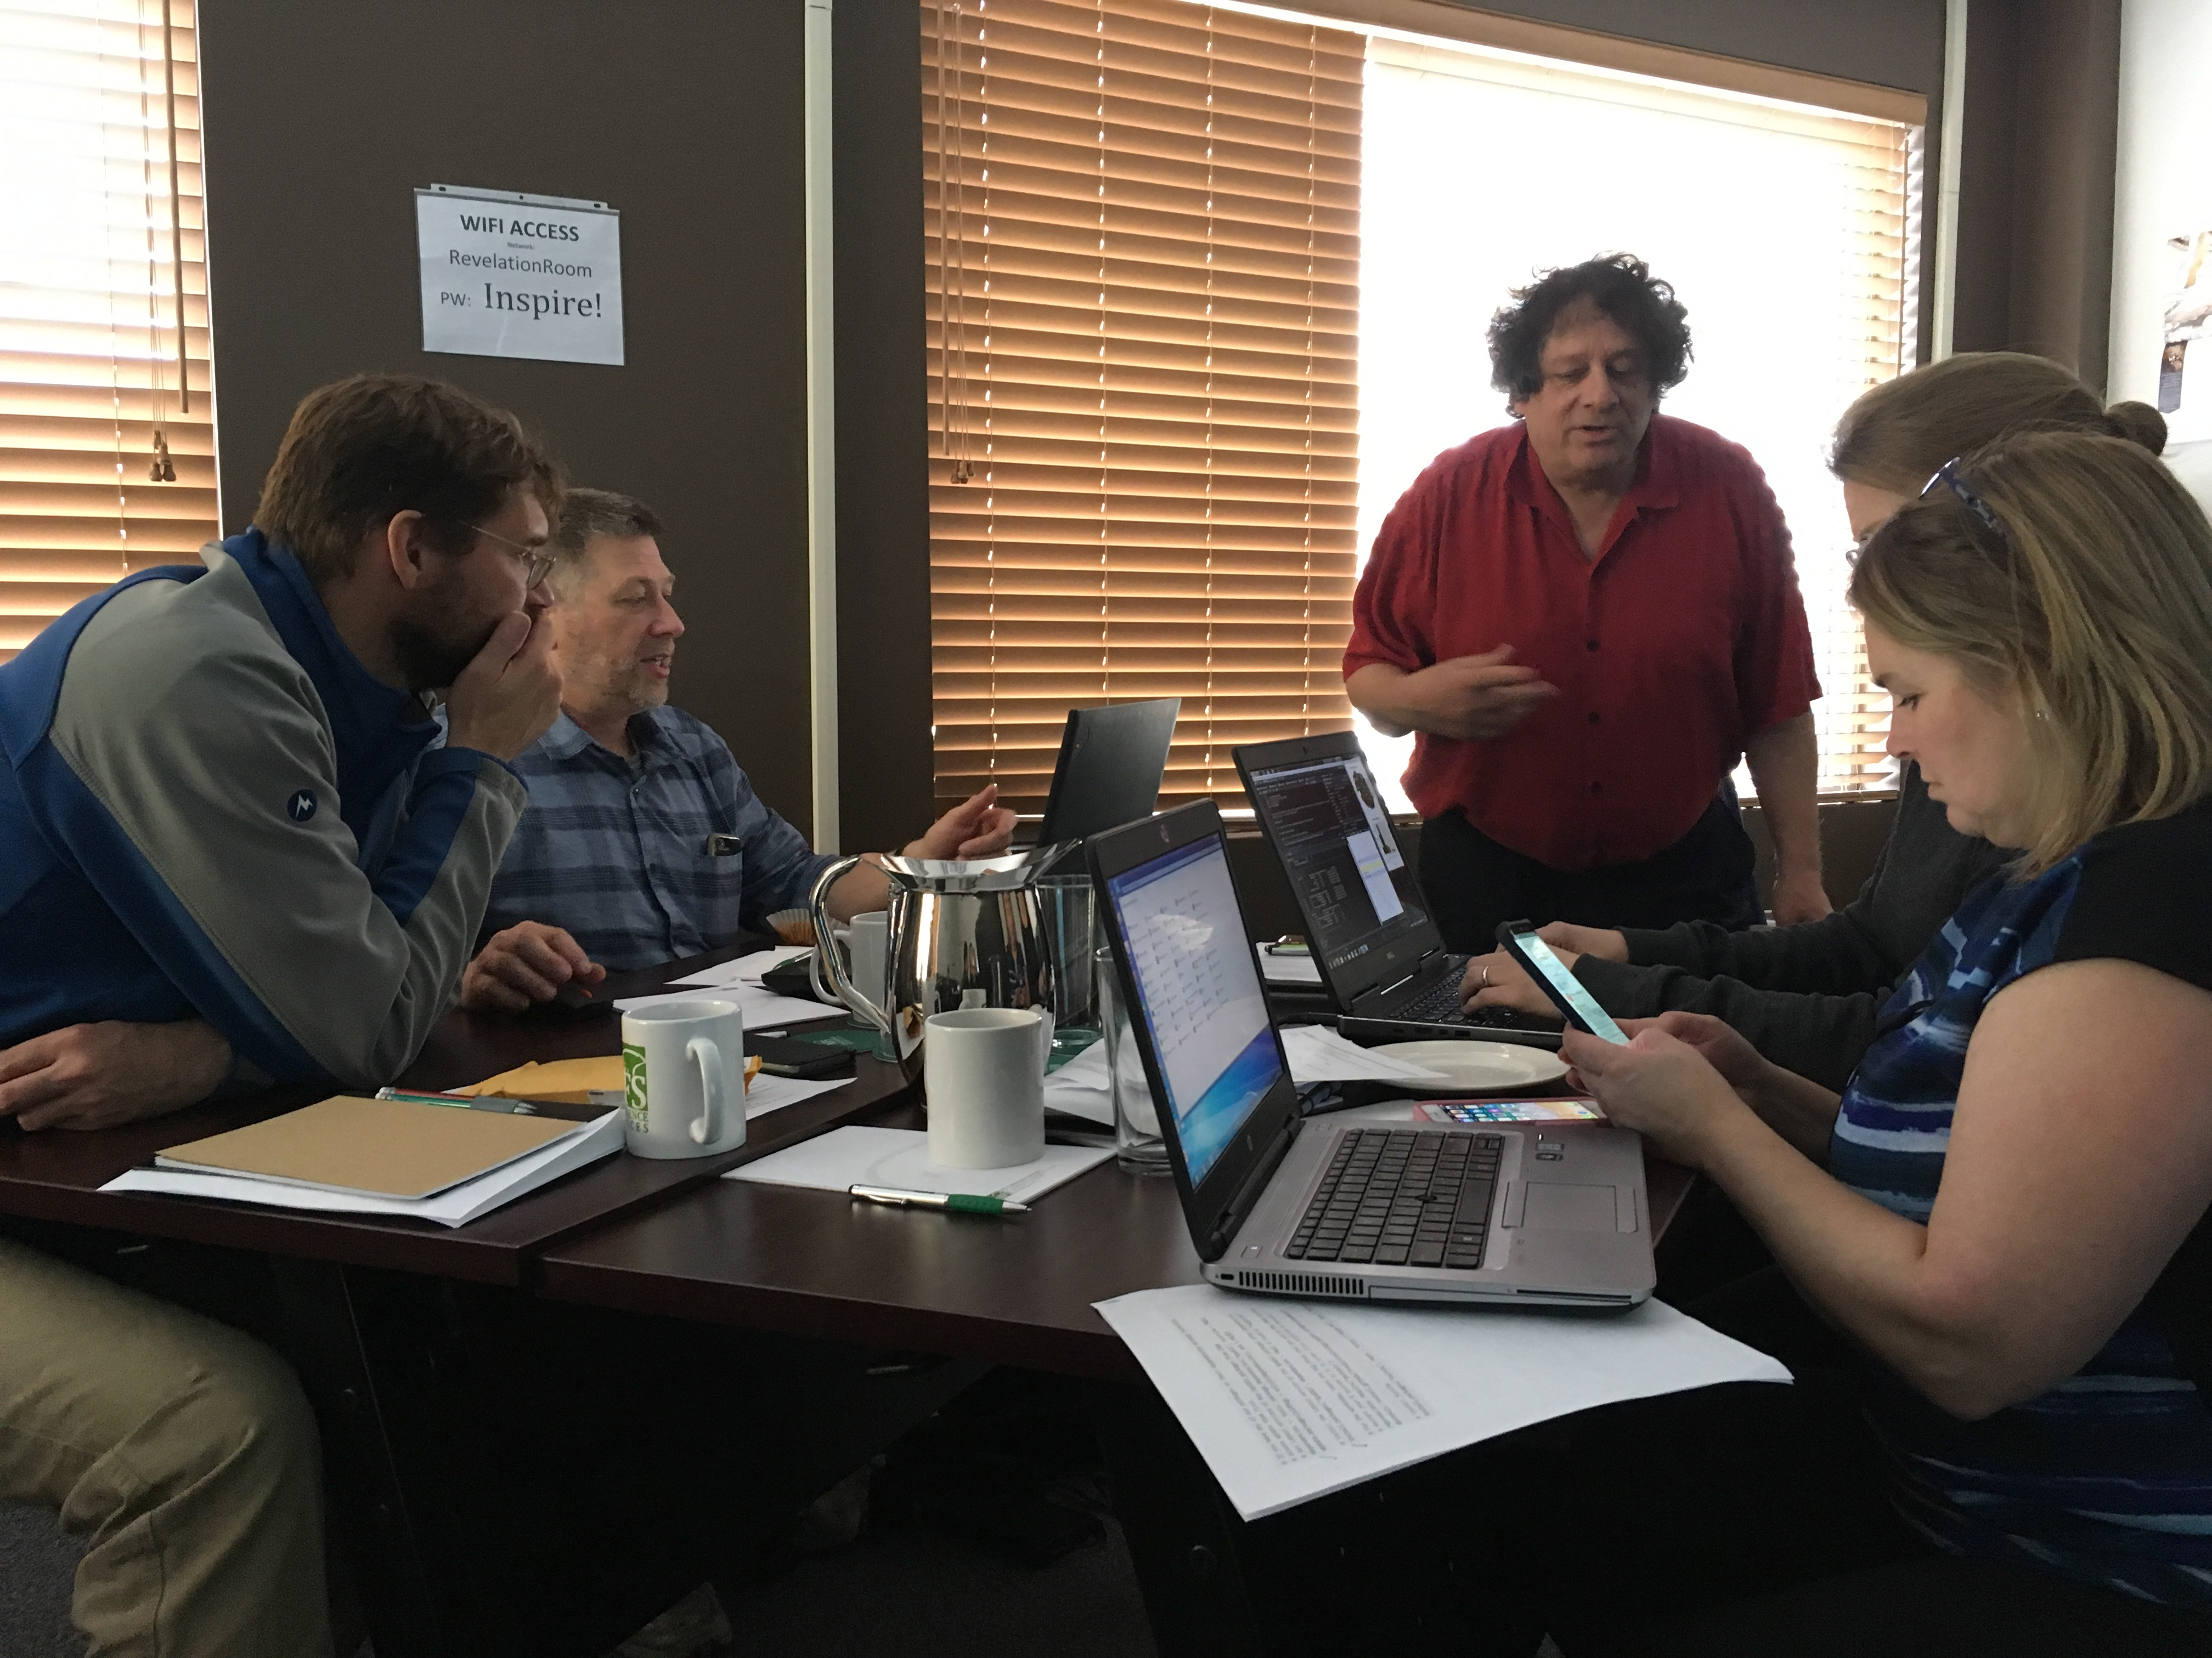
Project Impact: Prediction of vulnerability and support for adaptation solutions
Project Title
Northern Water Futures

