Slide 1
Transformative sensor Technologies and Smart Watersheds (TTSW)
Objective: Develop, test, and implement new technologies for monitoring water quality and quantity.
Research:
Includes ground-based, drone, and airborne sensors, satellite remote sensing and modeling techniques, as well as “smart” sensor communication modems intended to deliver valuable environmental data in near-real time.
End-users and collaborators include technology developers, government agencies, natural resource industries, and the GWF/overall water research community.
Claude Duguay (PI)
Geography & Environmental Management
University of Waterloo
Email: crduguay@uwaterloo.ca
Website: uwaterloo.ca/transformative-technologies-smart-watersheds/
Project coordinates: PI, email, website, etc
Transformative sensor Technologies and Smart Watersheds (TTSW)
Notes:
- Understanding and adapting to short and long-term water threats in the face of climate change will require a transformative enhancement in the way environmental data are collected and communicated.
- The development of these tools and techniques will offer our end-user communities enhanced methods to collect and deliver important environmental data from multiple scales. The end-user communities who
will benefit from the key deliverables of this project include technology developers, government agencies, natural resource industries, and the overall water research community.
- Team of over 50 researchers and students are collaborating with industry and government to develop, test, and implement various technologies including ground-based, drone, and airborne sensors, as well as satellite remote sensing techniques to monitor water quality and quantity.

Slide 2
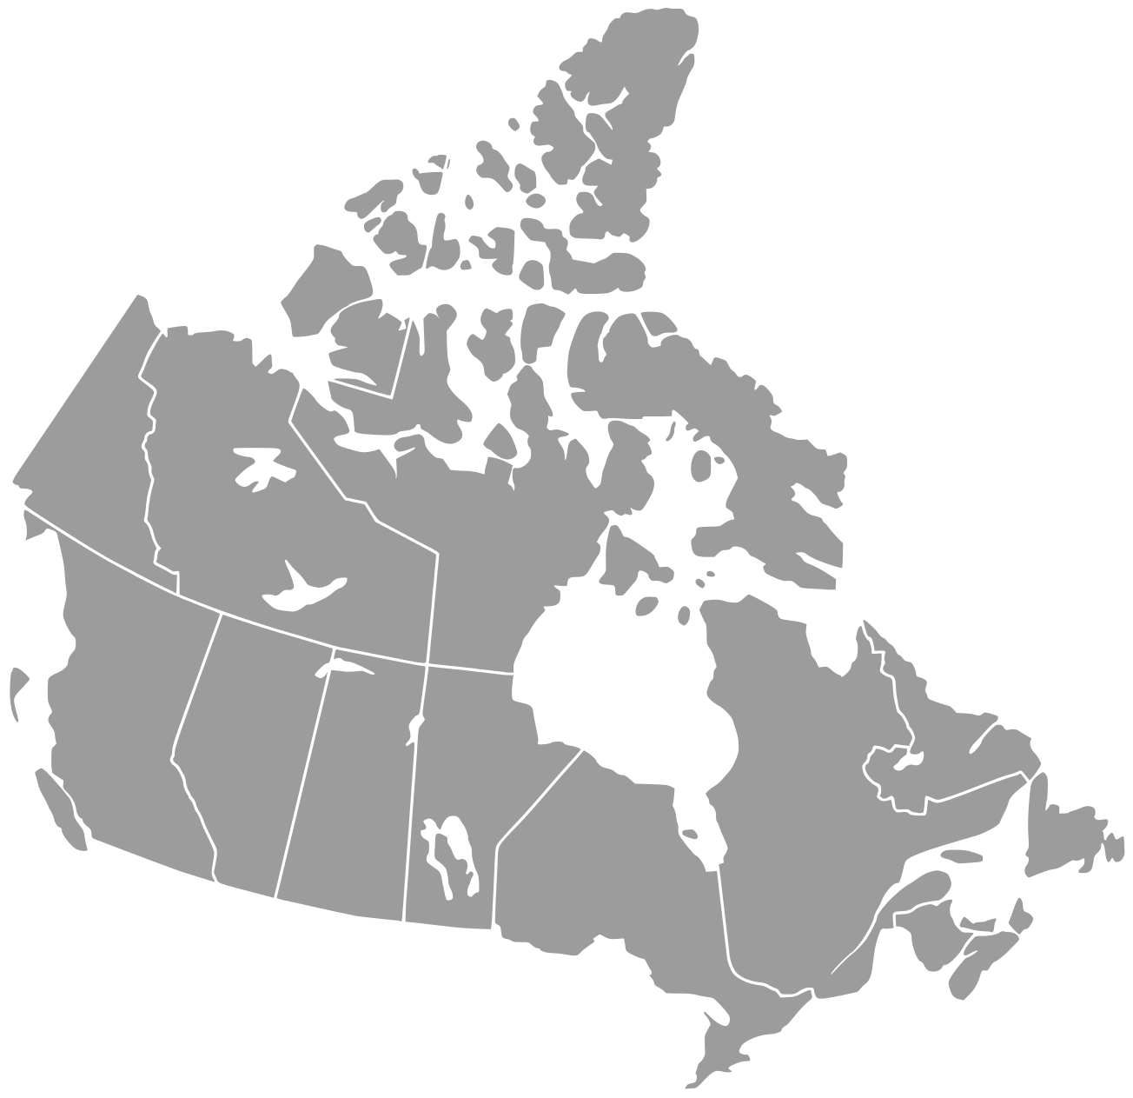
Transformative sensor Technologies and Smart Watersheds (TTSW)
TTSW Research Sites and Collaborations
1
Alder Creek, ON (collab. with eDNA)
Sunfish Lake, ON (collab. with AWF)
Lake Erie (Western Basin), ON
North Saskachewan River (Borden), SK
Buffalo Pound Lake, SK (collab. with FORMBLOOM)
Kananaskis Mountains/ Canmore, AB
Norman Wells, NT (Collab. with NWF)
Noell Lake, NT
Mackenzie River, NT
2
5
4
3
4
5
3
2
1
Transformative sensor Technologies and Smart Watersheds (TTSW)
Notes:
- Understanding and adapting to short and long-term water threats in the face of climate change will require a transformative enhancement in the way environmental data are collected and communicated.
- The development of these tools and techniques will offer our end-user communities enhanced methods to collect and deliver important environmental data from multiple scales. The end-user communities who
will benefit from the key deliverables of this project include technology developers, government agencies, natural resource industries, and the overall water research community.
- Team of over 50 researchers and students are collaborating with industry and government to develop, test, and implement various technologies including ground-based, drone, and airborne sensors, as well as satellite remote sensing techniques to monitor water quality and quantity.

Slide 3
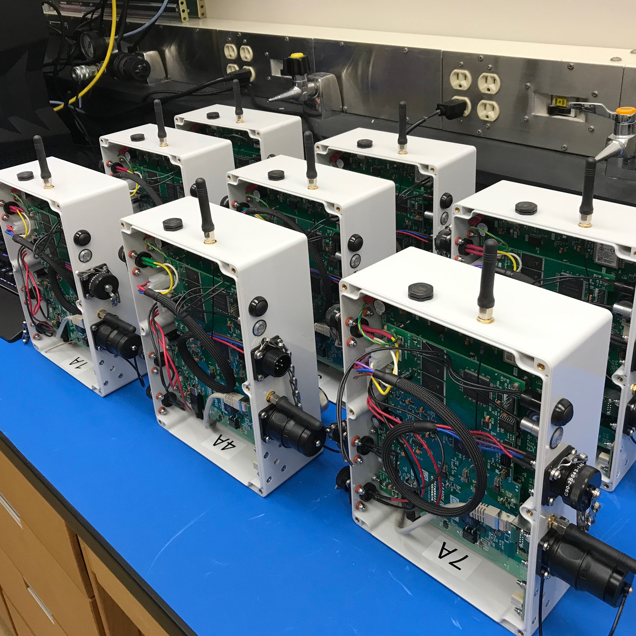
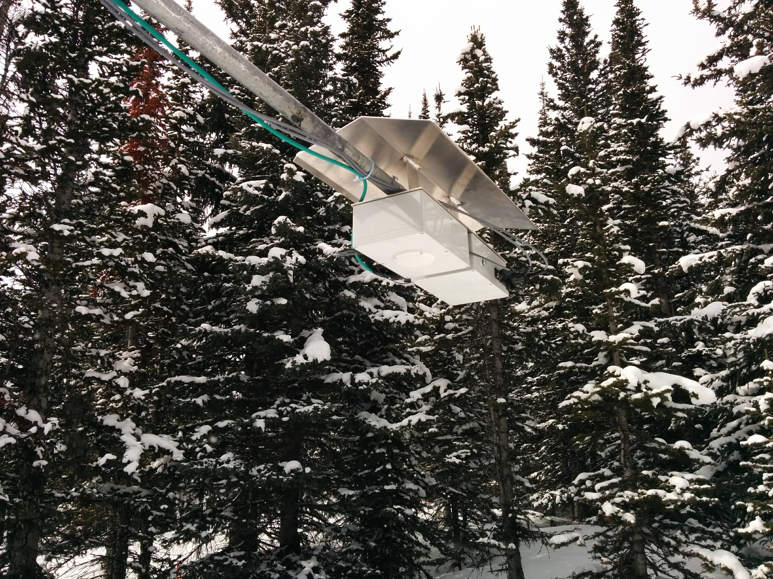
Transformational Science Highlights (1)
‘Chione’ acoustic snow sensor is being field tested at several sites across Canada.
The instrument can determine snow density, liquid water content, temperature, and Snow Water Equivalent (SWE).
Project Title
Transformative sensor Technologies and Smart Watersheds (TTSW)
Notes:
One of the goals of the project is to design and build cutting edge instruments to measure environmental parameters in cold regions. For example, co-investigator Dr. John Pomeroy and Research Scientist Dr. Nicholas Kinar at the University of Saskatchewan are working on an instrument that measures multiple variables in a snowpack using sound waves.
The device, called “Chione”, sends an acoustic signal down through the snowpack where it is reflected back and sensed by microphones. The signal is then used along with mathematics to determine snow density, liquid water content, temperature, and importantly, Snow Water Equivalent (SWE). SWE is a key hydrological variable that can help predict streamflow and water infiltration to soils which is important when forecasting flood risk and freshwater availability. Finding a way to quickly measure SWE has been a long term goal in the field of snow hydrology, as current methods can be time consuming and prone to human error. The instrument is currently being field-tested at sites across Canada, with plans to commercialize in the future.
The System for Acoustic Sounding of Snow, SAS, is an active acoustic sensing device that is being developed to non-invasively measure physical properties of the snowpack at distances less than 3m from the snow surface (Kinar and Pomeroy, 2015). This near-surface geophysical imaging apparatus can be used to obtain ground-truth data for validation/calibration of satellite measurements and is deployable in stationary and portable configurations for temporal and spatial sampling of snow. The acoustic data is used to obtain Snow Water Equivalent (SWE), density, liquid water content, and temperature of snow. The maximum temporal sampling rate of this device is approximately one acoustic snow sample per minute. Beamforming is used to change the sampling footprint from 10 cm to 1 m. The system is able to obtain images of snowpack layering with millimeter to centimeter-scale accuracy in lieu of digging a snowpit. Compared with gravimetric snow sampling for SWE, the SAS allows for snow properties data to be collected in a more efficient and expeditious fashion at stationary locations and along transects. SWE controls runoff generation over much of Canada and so is of great interest to many users. The latest version of this instrument is named ‘CHIONE’. Several copies of CHIONE are being deployed at field sites across Canada and in Europe to be evaluated against detailed snowpit measurements of depth, density,SWE, wetness, and temperature.

Slide 4
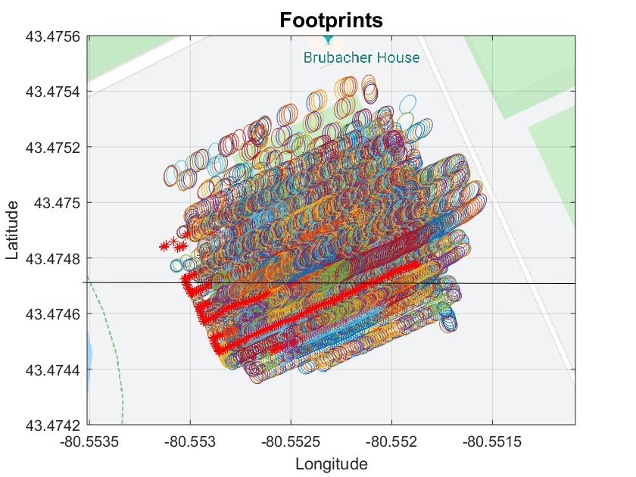
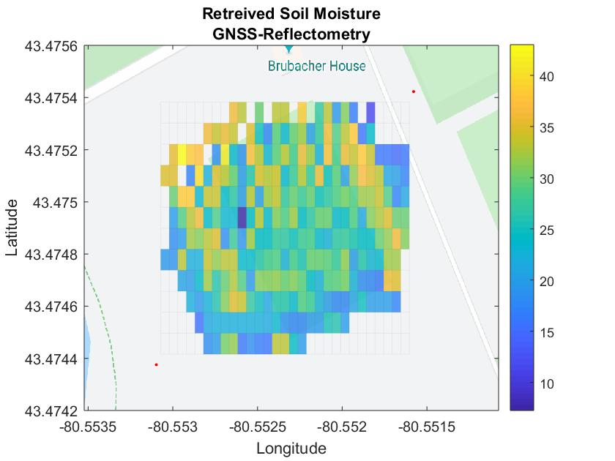
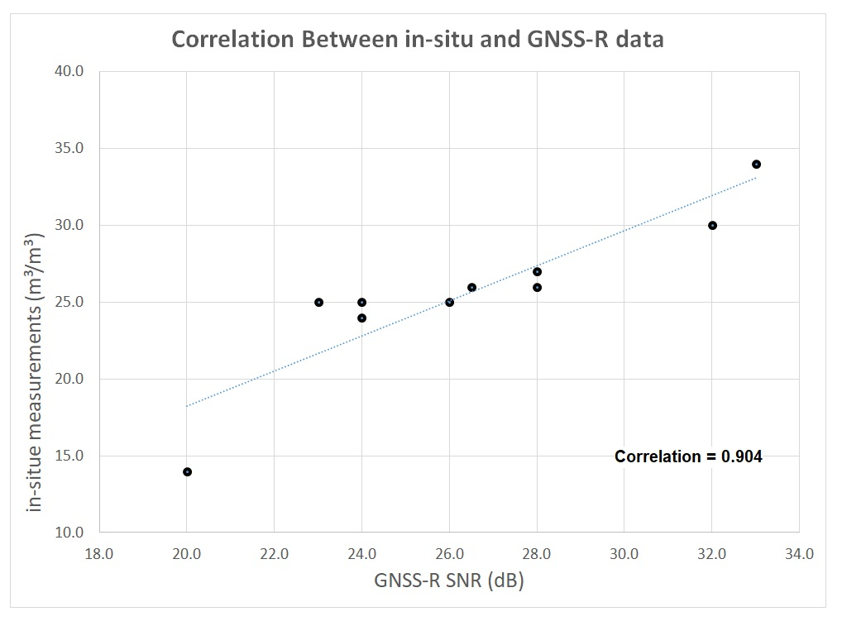
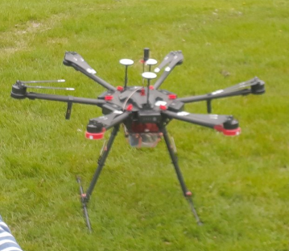
Transformational Science Highlights (2)
Developing drone-based GNSS-Reflectometer (L-band) to measure soil moisture.
Further work will investigate sensitivity of GNSS-R to soil freeze/thaw state, snow depth, SWE, lake ice thickness, etc.
Ghiasi, Y. (2019) [GNSS field data]. Unpublished
Project Title
Transformative sensor Technologies and Smart Watersheds (TTSW)
Notes:
These accomplishments slides will be also be used to build slide bank for use in GWF presentations
How are these results key to advancing the science
How are these results linked to the needs of your partners/users?

Slide 5
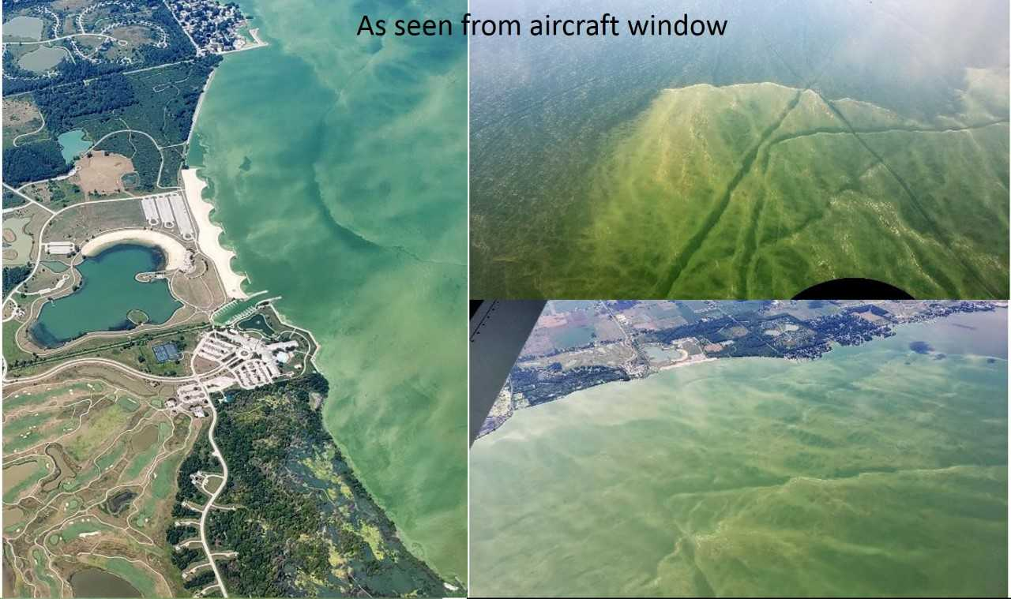
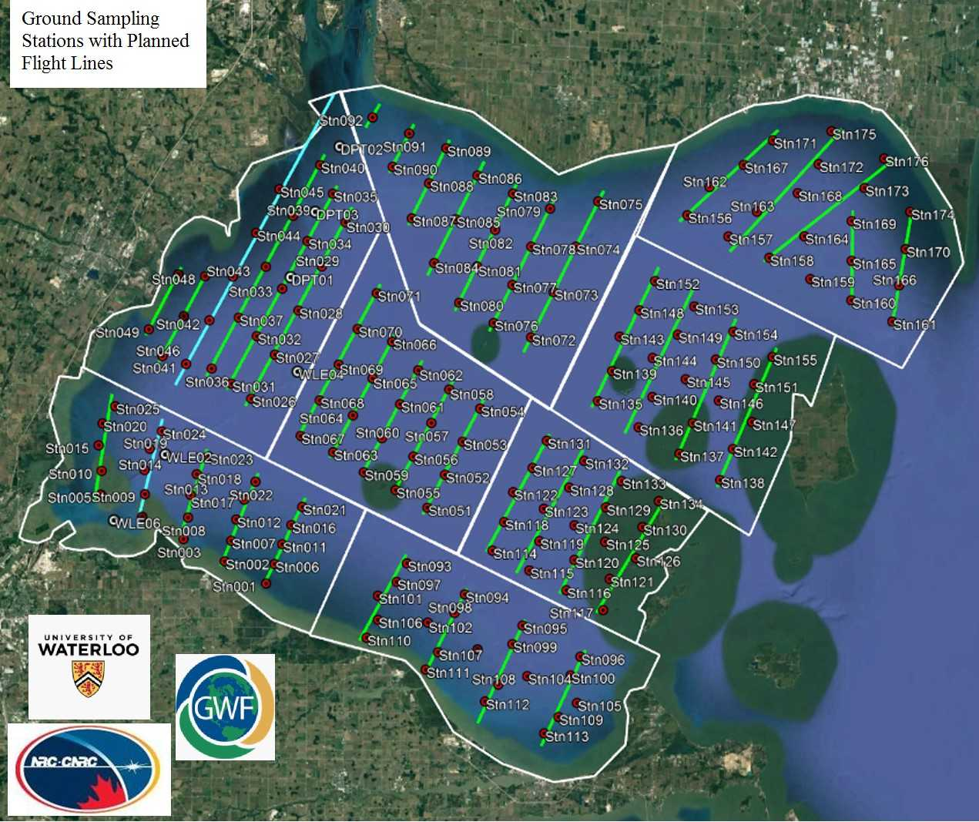
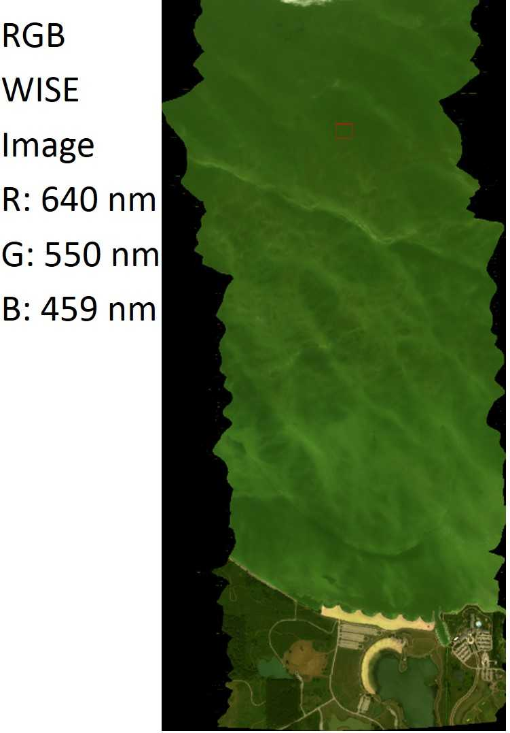
Transformational Science Highlights (3)
Participation in “HAB Grab Day” in collaboration with NRC, ECCC (Canada Centre for Inland Waters), and researchers from 15 Canadian/American organizations.
CASI and WISE hyperspectral instruments were flown over Lake Erie, coordinated hyperspectral imagery was collected by NOAA and NASA.
Project Title
Transformative sensor Technologies and Smart Watersheds (TTSW)
Notes:
Participation in “HAB Grab Day” in collaboration with NRC, ECCC (Canada Centre for Inland Waters), and researchers from 15 Canadian/American organizations. Coordinated imagery was also obtained with the NOAA hyperspectral sensor.
The multi-spectral instrument on ESA’s ENVISAT/MERIS (2002-2012) and now Sentinel-3A(since 2016) satellites have provided the best information to date regarding water quality parameters (e.g. chl-a, CDOM, TSS) but with a spatial resolution too coarse (300 m) for monitoring of water quality on all but the largest lakes of the world. Landsat and ESA’s Sentinel-2A/B satellites (10-40 m spatial resolution) have shown potential for retrieval of a limited number of water quality parameters for smaller lakes but bands are not optimized for this purpose. It has been recognized through ongoing satellite/sensor concept studies in Canada and elsewhere that a satellite mission carrying a hyperspectral sensor is urgently needed for monitoring water quality parameters. However, these studies have largely been driven by the needs of the ocean community that do not necessarily meet those of the terrestrial freshwater community. In August 2019, TTSW played a lead role (Research Scientist Dr. K. Zolfaghari) in the execution of a major airborne campaign involving hyperspectral data acquisitions by three sensors operated by NOAA, NASA, and NRC (Canada) coincident with water sampling from boats in the western basin of Lake Erie during “HABs grab” day, which involved participation by 15 US and Canadian institutions. This is the most extensive and complete dataset ever acquired to date for investigating the retrieval of water quality parameters from hyperspectral data.

Slide 6
Project Impact and Aspirations
Communications with Canadian Space Agency – Deployment of hyperspectral and SnowSAR (CFI grant) instruments and data analysis to inform future satellite missions.
Our impact will be improved resources and methodologies for the GWF and water science community.
Continue collaboration with other GWF groups in the coming year.
Project Title
Transformative sensor Technologies and Smart Watersheds (TTSW)

Slide 7
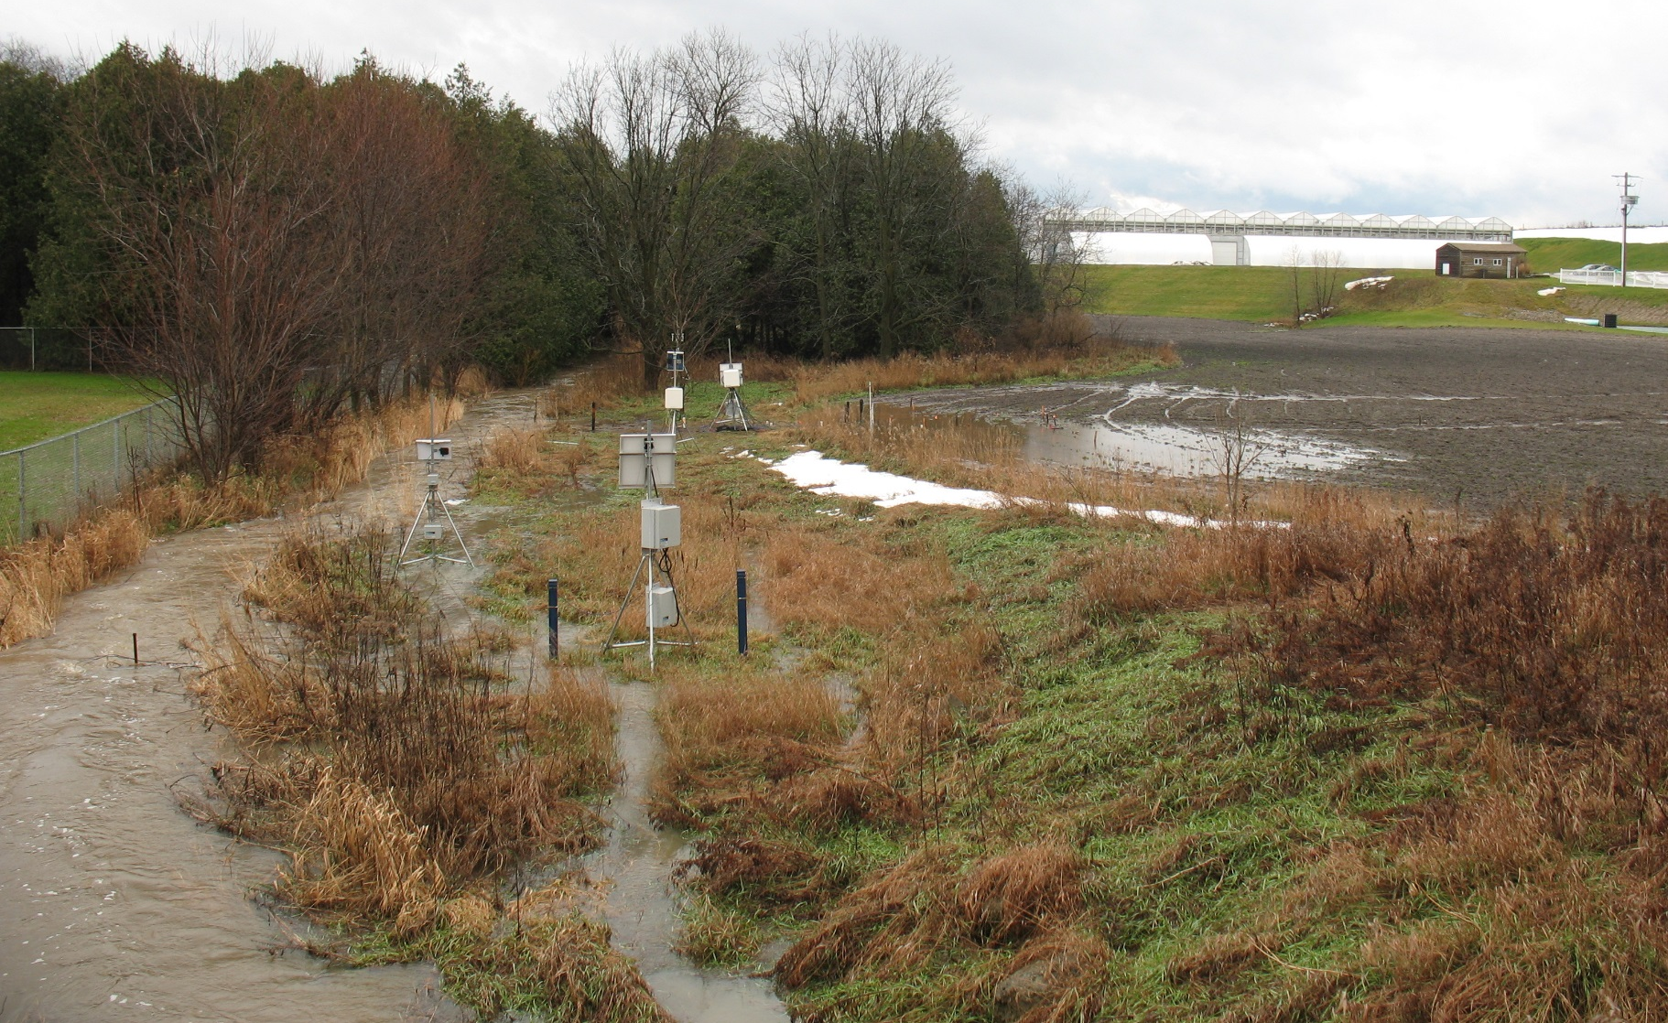
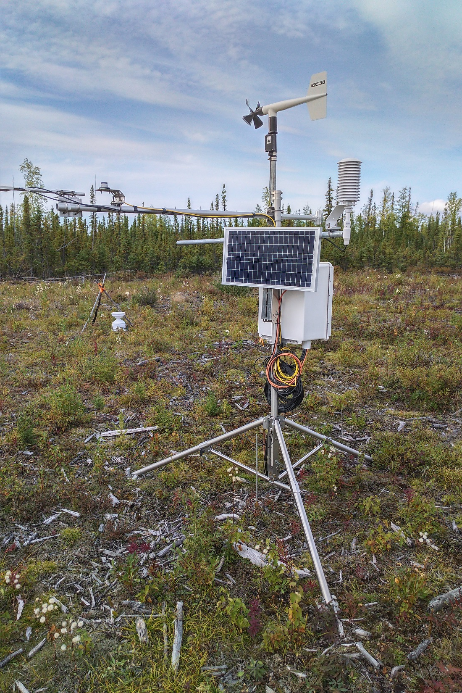
Challenges and Cross-project Collaboration Opportunities
Collaboration opportunity: we would like to reach out to other projects who would be interested in piloting the ‘smart watershed’ data loggers when they become available.
Currently still in testing phase at Alder Creek and Norman Wells research sites, but hoping to pilot at other sites soon.
Ideal candidates would be small research sites that are somewhat long-term, but only have 1-3 data loggers.
Please get in touch if interested.
Project Title
Transformative sensor Technologies and Smart Watersheds (TTSW)

