Slide 1
Global Water Futures:
Operations Team Meeting Nov 2019
John Pomeroy
Director, Global Water Futures

Slide 2
Operations Team Meeting
Review Science Progress – projects and core teams
Discuss Operational Issues
Plan Special Initiatives
  Revised Modelling and Prediction Strategy – link to projects
  Target applications for Planetary Water Prediction Initiative
  Roadmap for Canada’s contribution to UN Water Action Decade including GWF contribution to UN water-related SDGs
  Best practices for Indigenous community water research
  Update inventory of observatories and metadata
  Visualisation Task Force
  KM – coordinated approach in provincial capitals –
  The GWF Road Tour

Slide 3
Today
Core Team and Task Force Updates
UN Water Action Decade – UN University
Launch of Water Futures for the World We Want
User Question-led Projects
Transformative Science and Big Data Projects
Indigenous Community Water Projects
Networking and the Science-Art Project

Slide 4
Tomorrow
Breakouts to assess progress and needs on:
  Modeling and prediction
  Observations, remote sensing and sensors
  Indigenous community water
  Visualisation, computing and apps
  Water in cities
  Water quality and ecosystems
  Social science, policy and governance
  Cold regions processes
Rapporteur reports and discussion of the topics
  Will help to assess needs for new Pillar 1 and 2 projects

Slide 5
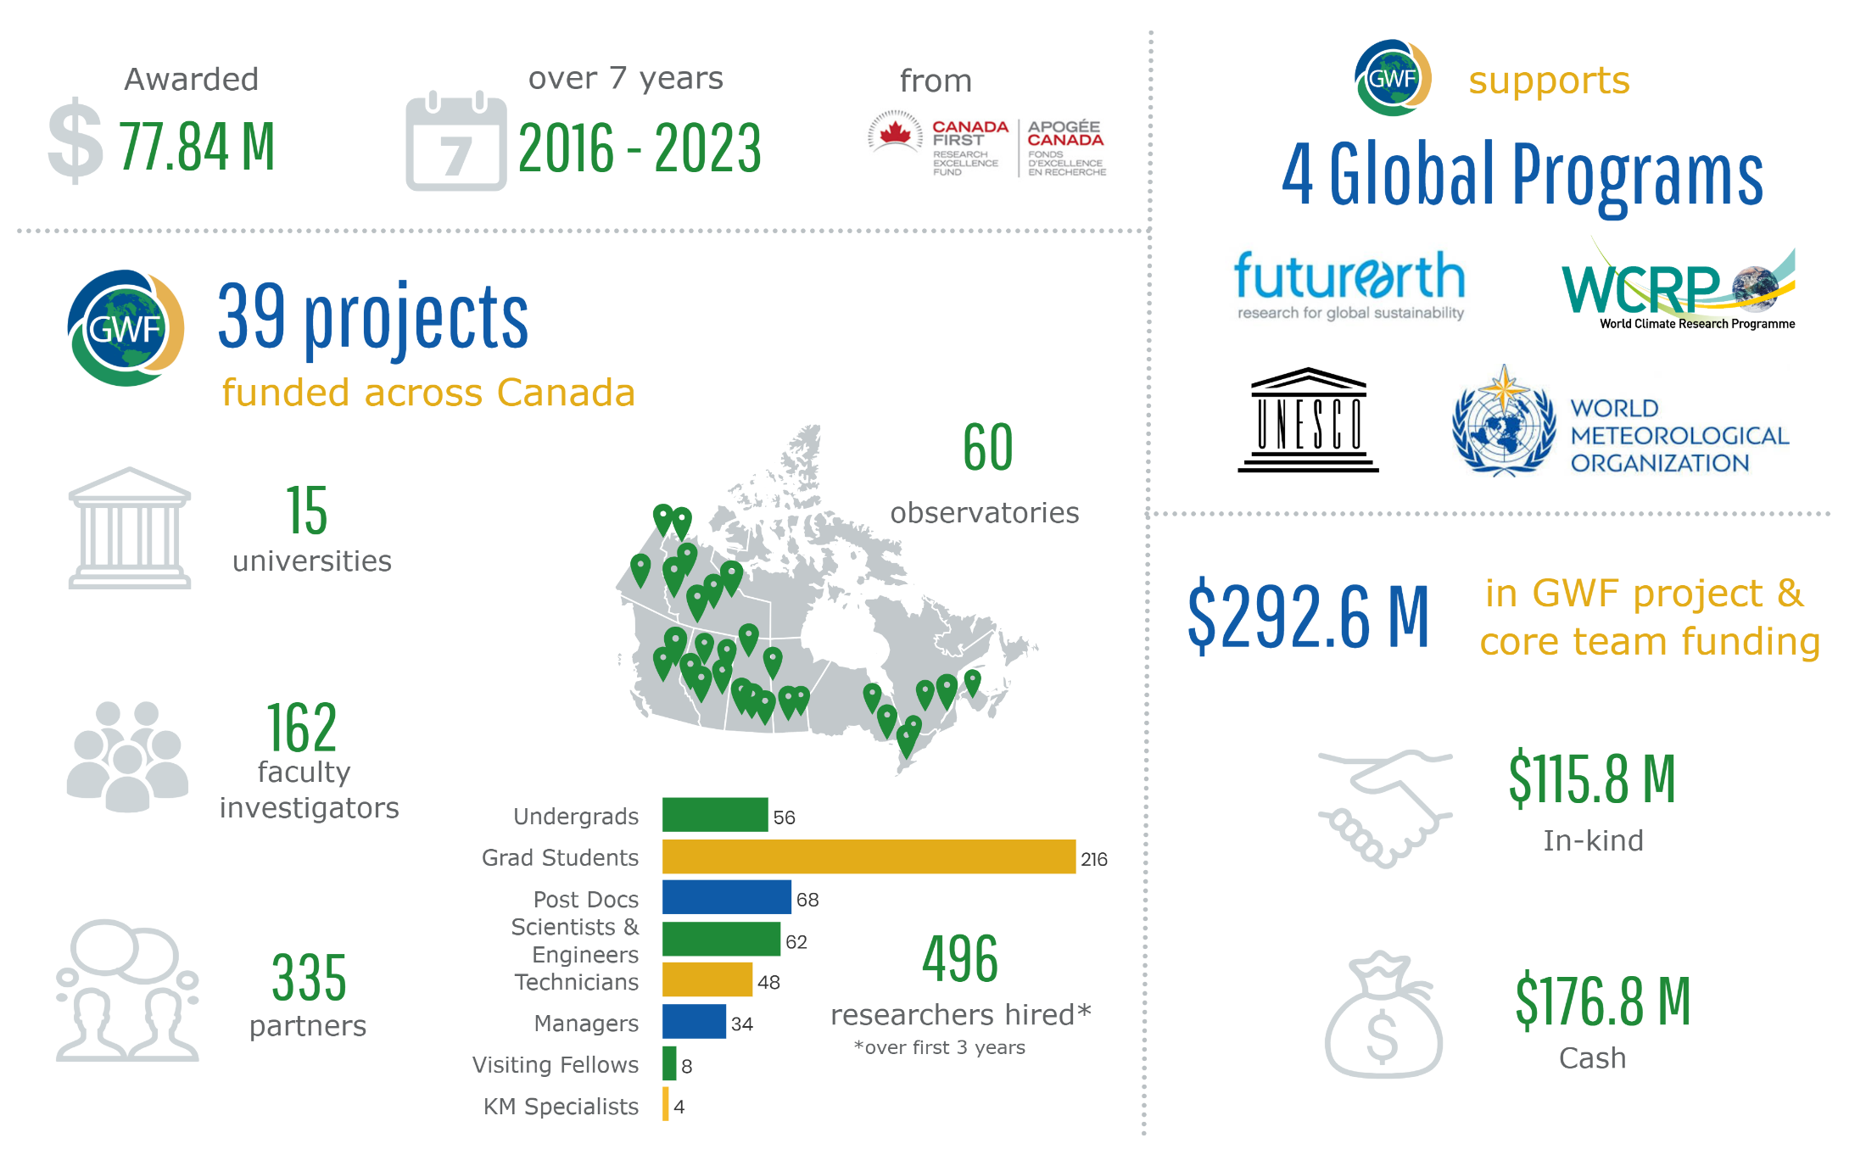
GWF 2019

Slide 6
GWF Affiliated Projects
Benefits
  Access to core modelling outputs and will facilitate links to existing GWF-funded projects and core teams,
  Access to some administrative and outreach support from the GWF Secretariat, and the opportunity to showcase their project on the GWF website and via social media
  Can participate in GWF topical workshops and Annual Science Meetings
Expectations
  Contributing to GWF goals and objectives
  Scientific excellence
  Open data and open-source modelling
  Diversity, equity, respect, inclusiveness

Slide 7
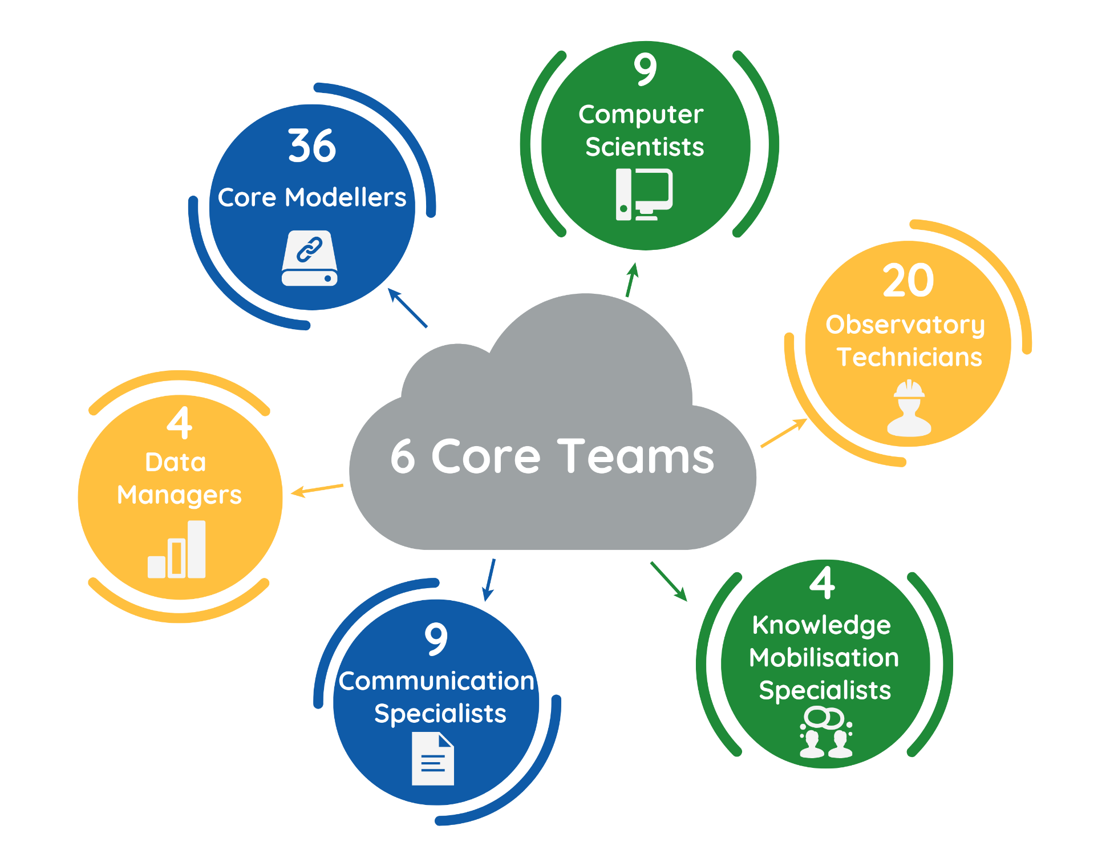
GWF Core Teams

Slide 8
GWF Core Water Observation, Prediction and Knowledge Mobilization Strategy

Slide 9
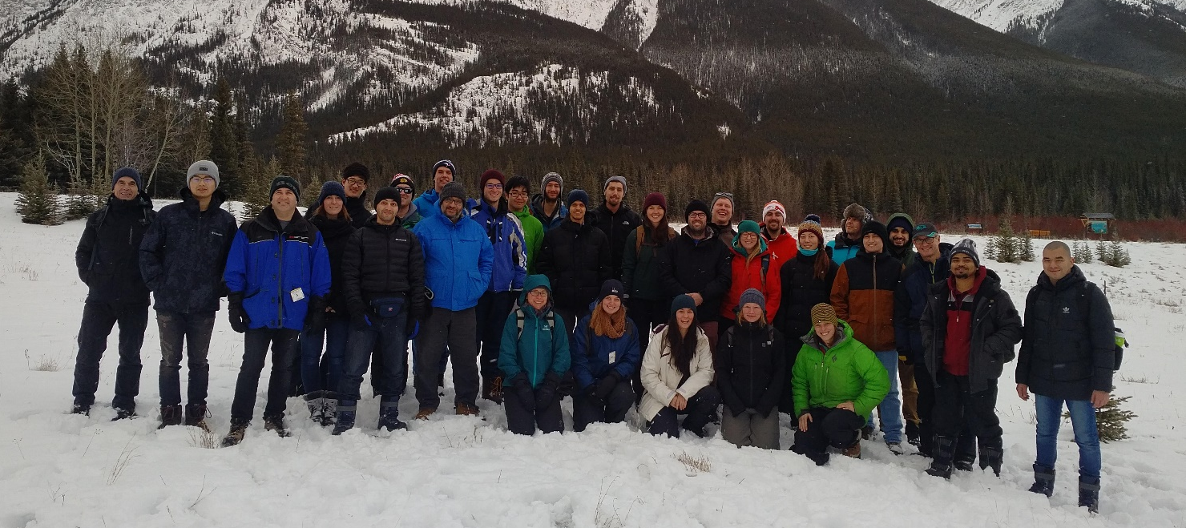
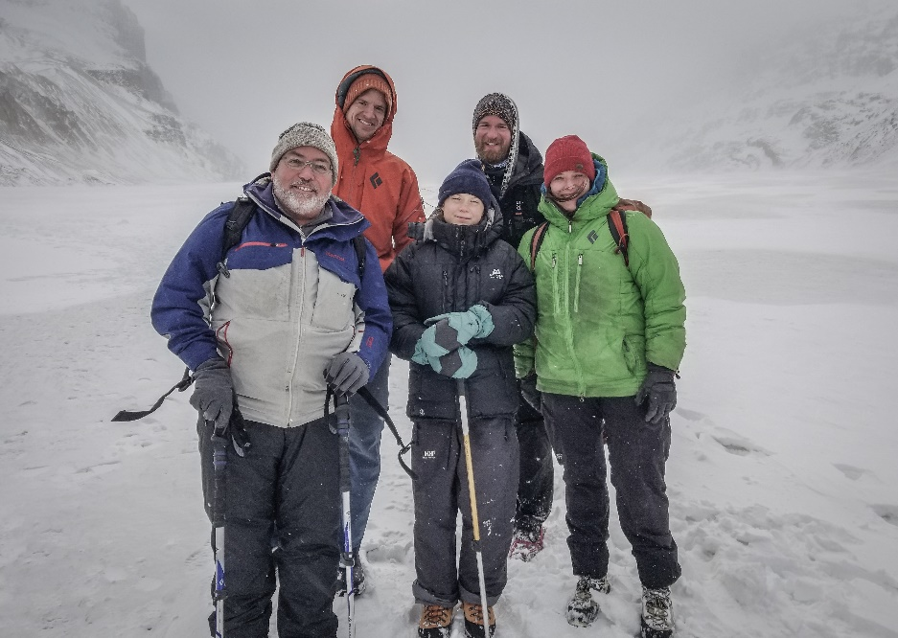
GWF Young Professionals
Brings together all new researchers (graduate students and postdoctoral fellows) from the national and international partnering institutions under the GWF program.
The overall objectives of the GWF-YP program to:
  provide a sense of community amongst new researchers with GWF;
  provide resources for mentoring amongst the GWF-YP;
  enable collaboration and networking, both nationally and internationally;
  offer professional development courses and activities.
Eligibility
  All graduate students and postdoctoral fellows under the GWF program are eligible to become members and run for GWF-YP executive roles.

Slide 10
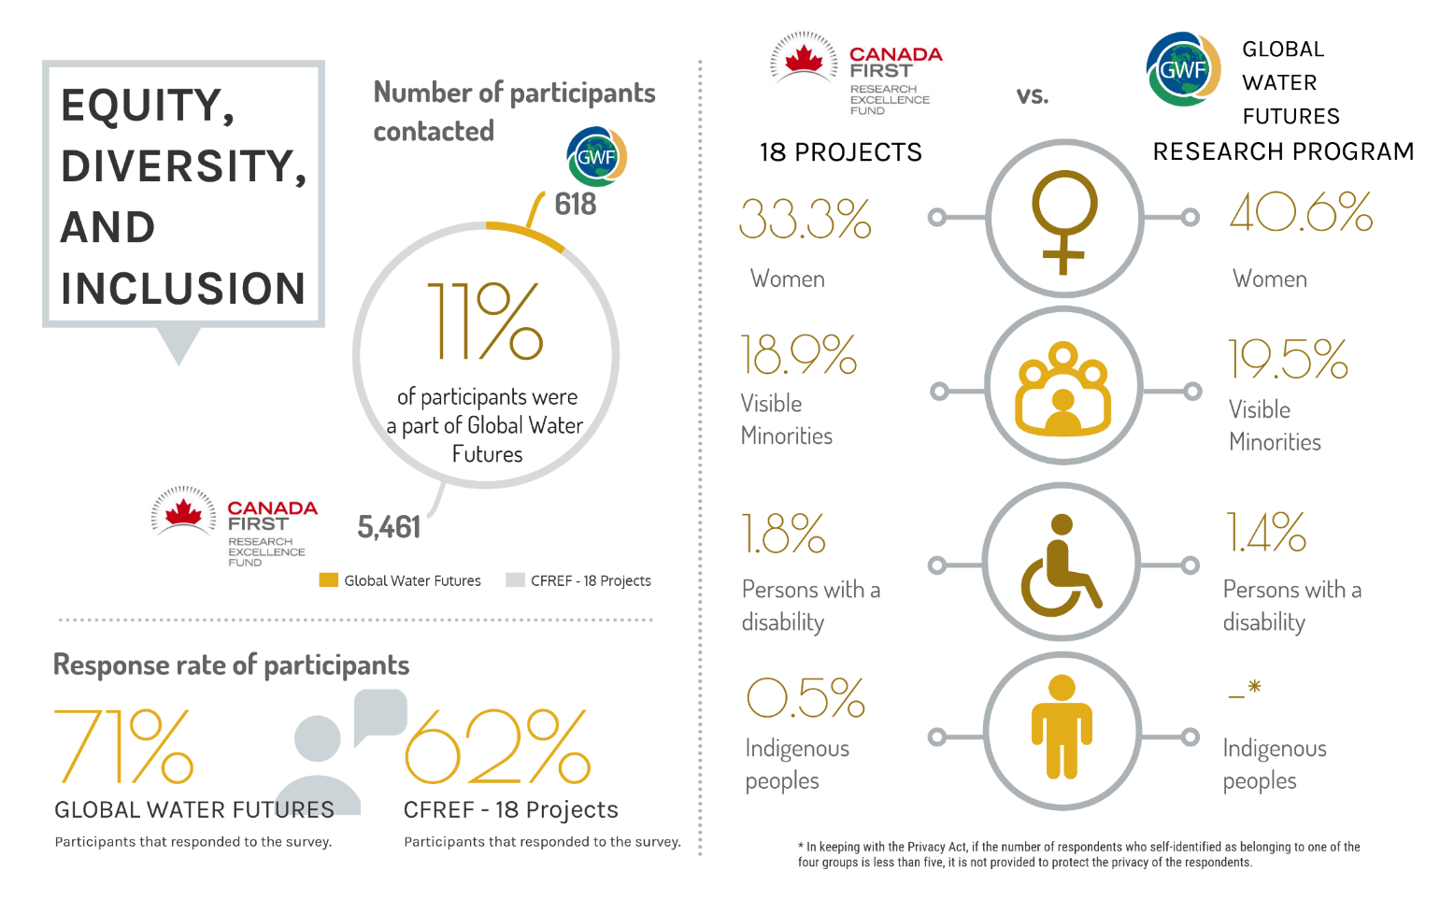

Slide 11
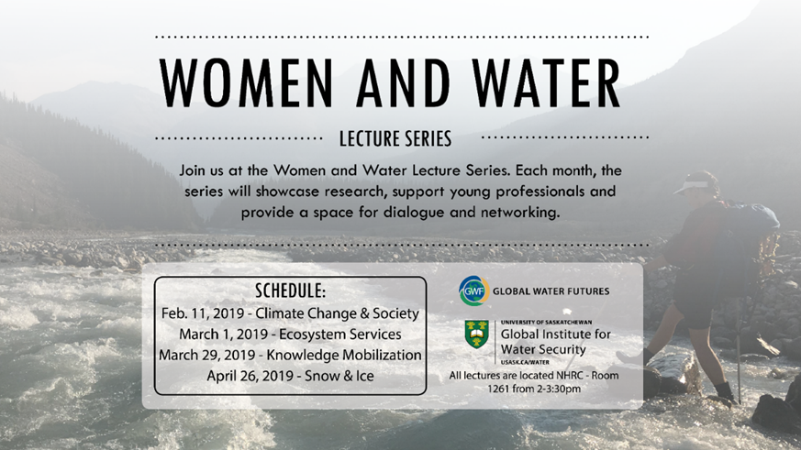
Lecture Series to an Initiative
  Showcase research, support young professionals and provide a space for dialogue and networking.
  Explores water-related challenges, roles of women in water, gendered water-related impacts, women researchers in water, and challenges and opportunities facing female water researchers.
  Determine actionable solutions to promote greater participation of women in water sciences and research

Slide 12






GWF International
INARCH – mountain hydrometeorology project
GEWEX –
  GWF is a Regional Hydroclimate Project
  Water for the Food Baskets of the World
UN Water Action Decade
  Collaboration with UN University
  Canada Water – SDG Strategy and Action Plan
UNESCO
  Future KM Event at UNESCO Headquarters
  Global Environmental Facility - Central Asian Hydrology Project
Future Earth – Sustainable Water Futures Programme.
  SWFP Conference, Bangalore, India Sept 2019
  Climate Impacts on Global Mountain Water Security Working Group
WMO – ECPHORS – Executive Council Panel of Experts on Polar & High Mountain
Observations, Research & Services
  WMO High Mountain Summit, Geneva, Oct 2019
  Arctic Earth System Modelling Workshop, Reykjavik, Nov 2019
Modelling – Iran, India, Israel, Kazakhstan, Spain, Chile, Argentina, China
GW4 Water Security Alliance - UK
Critical Zone Observatory – China-Siberia
Third/Three Pole Environment – Chinese Academy of Sciences

Slide 13
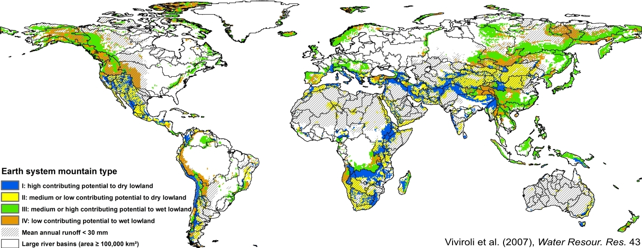
Planetary Water Prediction Initiative

Slide 14
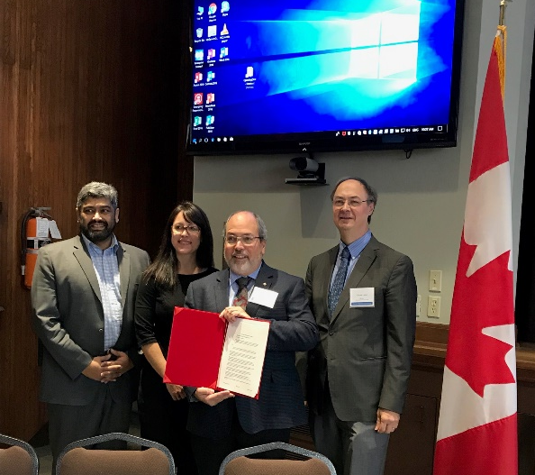
GWF National and Policy Initiatives
Engagement with ECCC
  Co-hosted 1st National Flood Forecasting Workshop,
  Vancouver Feb 2019
  Joint national water prediction strategy
MOU with NRCan
  Co-hosted Water Science Summit, Ottawa, November 2018
Sustainable Development Goals with UN University Institute for Water, Environment and Health (Hamilton) – UN Water Decade
Water Security for Canadians
  Strategic Briefing and Discussion, Ottawa, April 2019

Slide 15
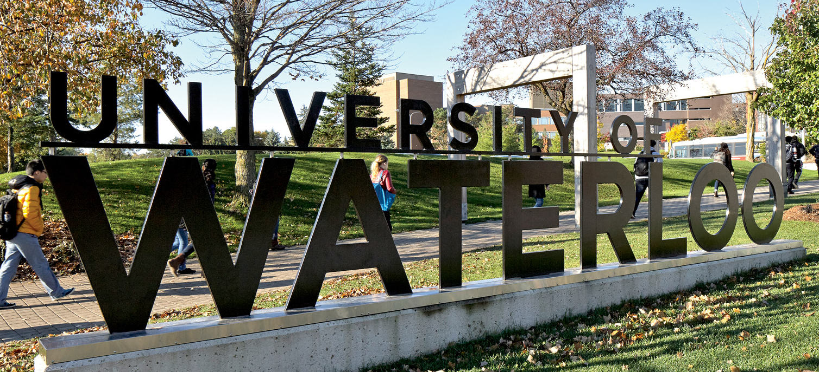
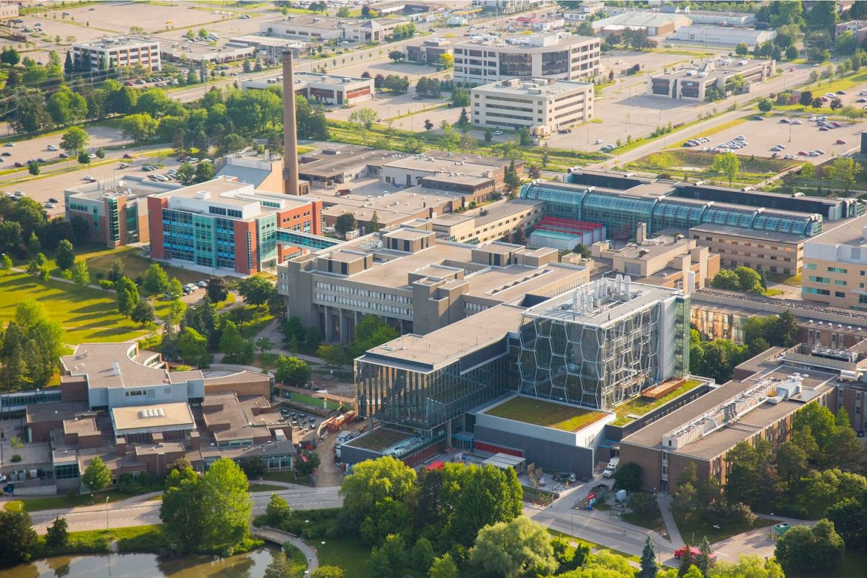
Global Water Futures Third Annual Open Science Meeting
GWF will hold its next Open Science meeting in Waterloo, ON, Canada
11–13 May, 2020
Hosted jointly by the University of Waterloo and Wilfrid Laurier University
We welcome everyone involved with GWF and anyone wishing to make connections to the program to attend and participate.
We expect 600–700 attendees over the 3-day event

Slide 16
CFREF Midterm Review 2020

Slide 17
Objectives of the Review

Slide 18
Process and Outcomes

Slide 20
136 Awards for research excellence
11 new faculty

Slide 22
By 2023, GWF will contribute to
Improved scientific foundations for solving water problems.
National water forecasting and prediction system
Predictions of water futures around the world
Water solutions for food security, energy security, infrastructure, economic development, safe communities, ecosystem conservation, governance.
Decolonialization of Indigenous water management in Canada.
Water, peace and security around the world
Revitalized water strategy for Canada
Making Canada known as the water solutions country.

Slide 23
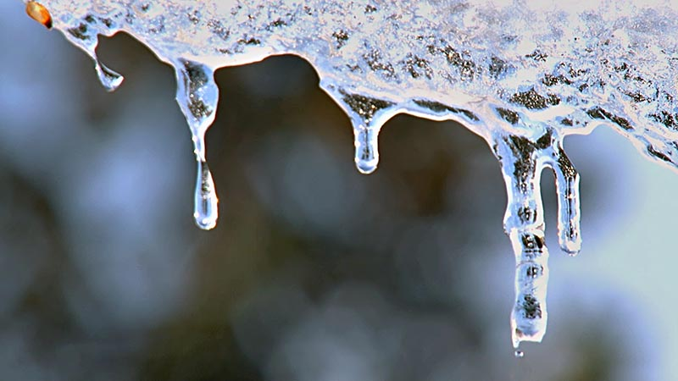
Global Water Futures
National Hydrology Research Centre
11 Innovation Boulevard
Saskatoon, SK S7N 3H5 Canada
Tel: (306) 966-2021; Fax: (306) 966-1193
Email: gwf.project@usask.ca
Website: www.globalwaterfutures.ca

