Slide 1
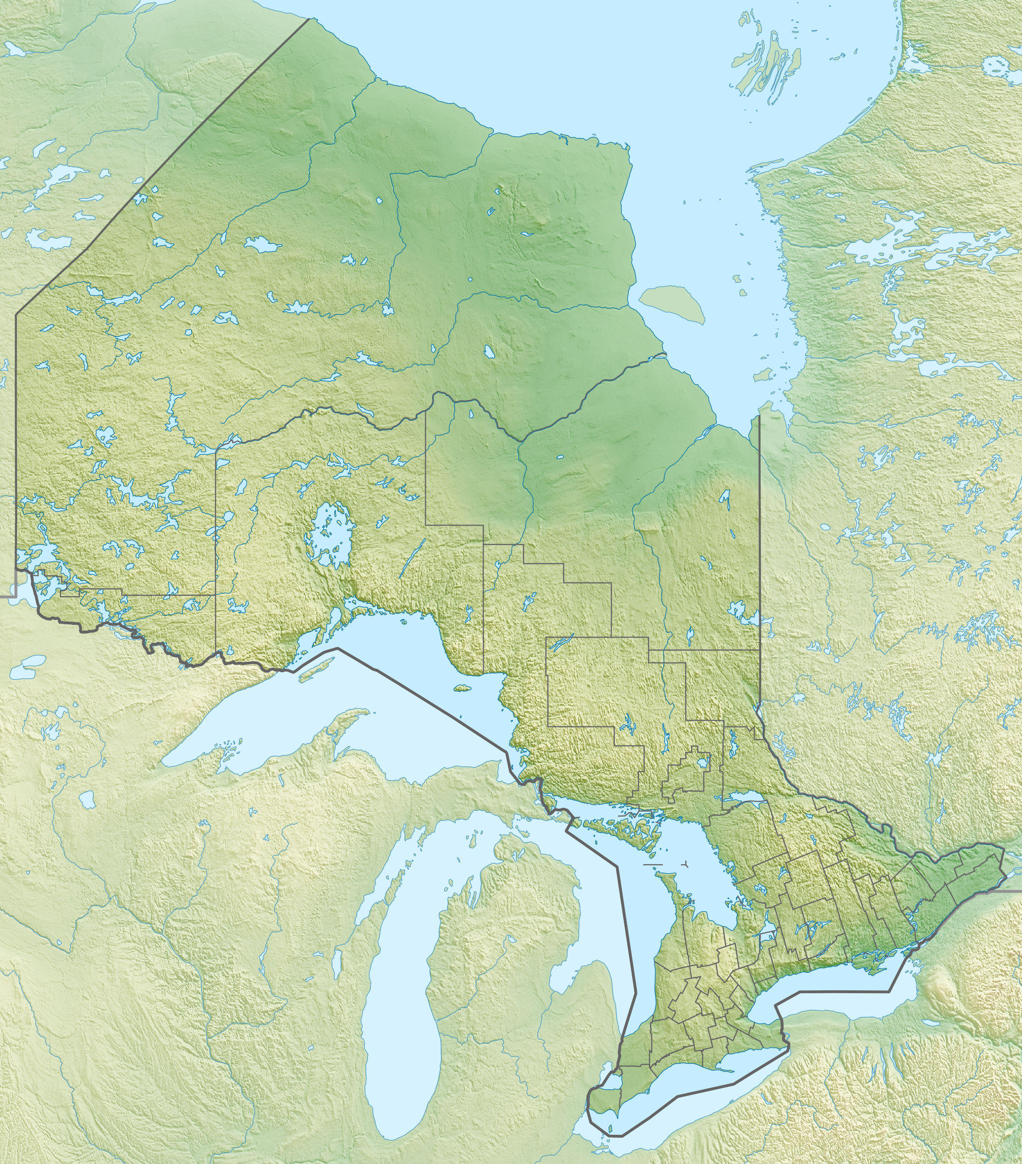
FIShNET (Fish & IndigenouS NorthErn healTh):
Healthy Water, Healthy Fish, Healthy People
Community co-PIs: Vern Cheechoo and Michaela Paradis, Mushkegowuk Council
University co-PIs: Kelly Skinner (kskinner@uwaterloo.ca), Brian Laird, Heidi Swanson, University of Waterloo
4 key statements:
Wild-harvested fish is generally associated with good nutrition, but can be a source of mercury exposure
In some regions, mercury levels in fish are increasing due to environmental change
Changes could impact fish and human health
Fort Albany→
Objective:
To characterize the links between environmental change, water quality, fish health, food safety, and food security
Project coordinates: PI, email, website, etc
FIShNET
Notes:
It can help to frame your main research objective as a question. For example,
How will climate change affect agriculture in Canada?
How can we improve water quality and reduce algal blooms in Canadian lakes?
What are the links between fish health, food safety and food security in the Indigenous North?
What is the significance of groundwater fluxes on surface water flow?

Slide 2
Transformational Science Highlights
Changes in water affect the mercury in fish
E.g., wetlands on the landscape, watershed slope, water temperature, and water chemistry variables – e.g., primary productivity (Swanson et al., 2019).
In Fort Albany:
Environmental contaminants were reported as a barrier to traditional food acquisition impacting food insecurity (Skinner et al., 2013a).
70% of households are food insecure (Skinner et al., 2013b).
Project Title
FIShNET
Notes:
These accomplishments slides will be also be used to build slide bank for use in GWF presentations
How are these results key to advancing the science
How are these results linked to the needs of your partners/users?

Slide 3
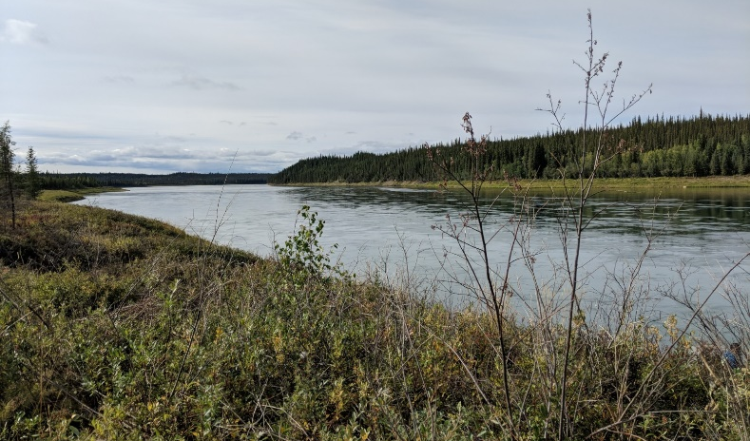
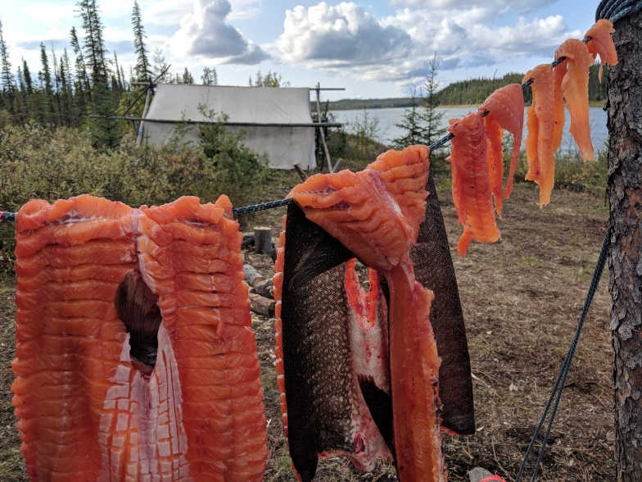
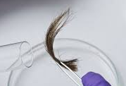
Project Impact and Aspirations
        WATER AND FISH
Ecological monitoring
Measure mercury, selenium and fatty acids in fish
Improved ability to detect and predict changes in the safety of subsistence sources of fish
        FISH AND NUTRITION
        Interviews and survey on fishing, fish consumption, food security, and perceived issues
        Document how fish and mercury challenges have an impact on people’s diet and cultural practices
        FISH AND HEALTH
        Hair sampling for mercury testing
        Report the level of mercury the people of Fort Albany are exposed to and if it has changed over time
Project Title
FIShNET

Slide 4
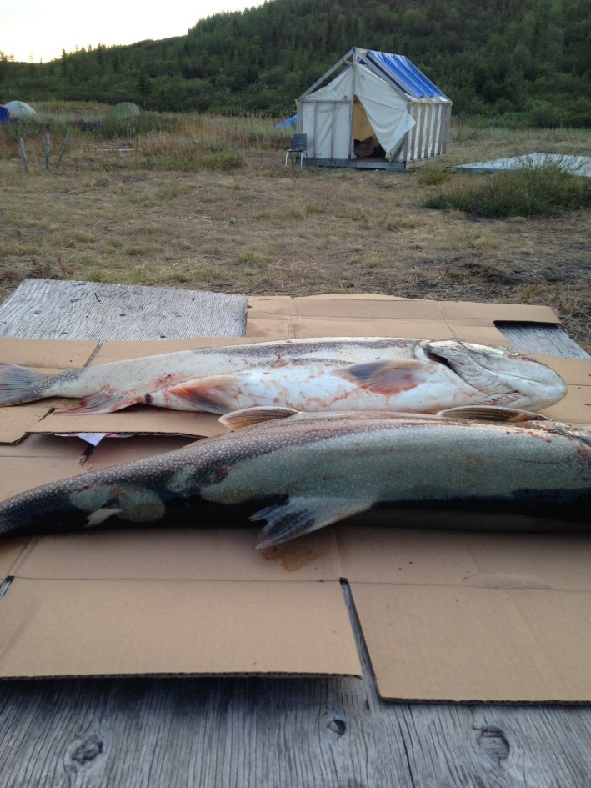
Challenges and Cross-project Collaboration Opportunities
Logistical challenges:
Remote community: limits in-person contact
Regional (Mushkegowuk) vs. local (Fort Albany) project organization
New collaboration opportunities:
Outside of GWF:
        FNFNES - First Nations Food Nutrition and Environment Study (data Fort Albany 2012)
        FEHNCY – Food Environment Health and Nutrition of First Nations Children and Youth (Fort Albany is a pilot community for new study)
Within GWF: NWF and Water Knowledge Camps
Project Title
FIShNET

