Slide 1
Pillar 1: Short-duration extreme precipitation in future climate
Project Introduction and Information
General introduction of the project and research focus
Main objectives:
1. Whether temperature scaling works at convective-permitting resolutions for short-duration local precipitation extremes?
2. How will the characteristics of mesoscale convective systems (MCSs) such as the precipitation intensity, size and life-span of storms change in the future?
3. What are the underlying physical processes for changes in MCSs and storm properties?
4. How do extreme precipitation features scale across resolution from GCMs to RCMs to convective permitting WRF?
The scientific approach: Continental scale convection permitting regional climate simulation for current and future (PGW method) climate simulation, CONUS I, CCRN 4-km WRF
Study regions: the whole Canada
Project contact information:
PI, Yanping Li (Univ of Saskatchewan), co-I: Francis Zwiers (Univ of Victoria)
email: yanping.li@usask.ca
website: https://gwf.usask.ca/science/projects/p1-extreme-precipitation.php
Project coordinates: PI, email, website, etc
Pillar 1: Short-duration extreme precipitation in future climate

Slide 2
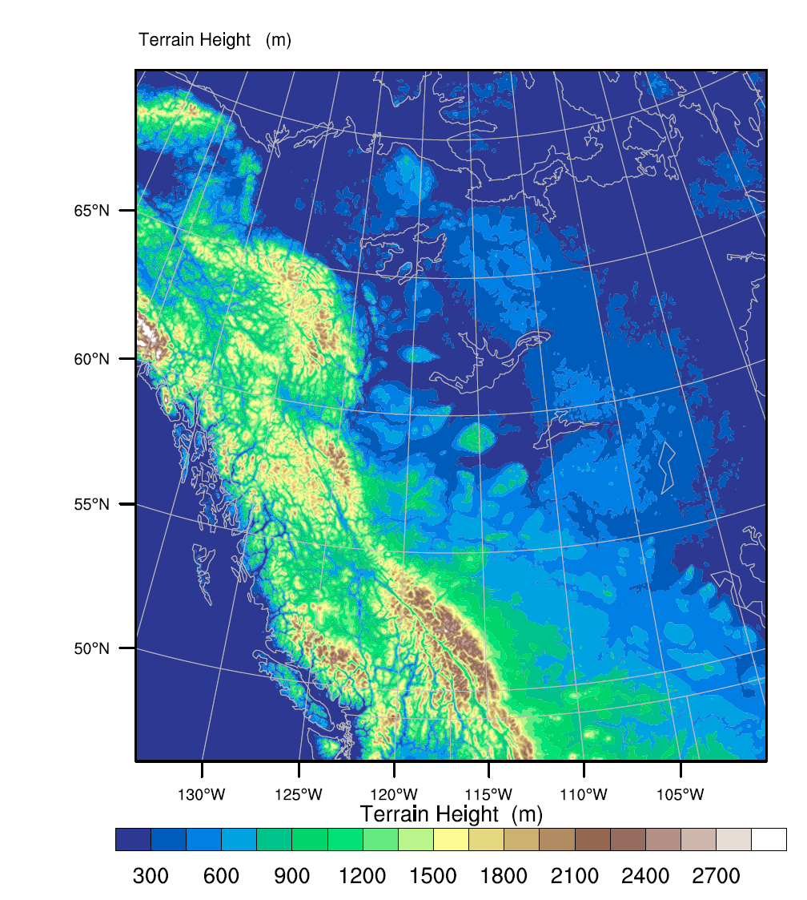
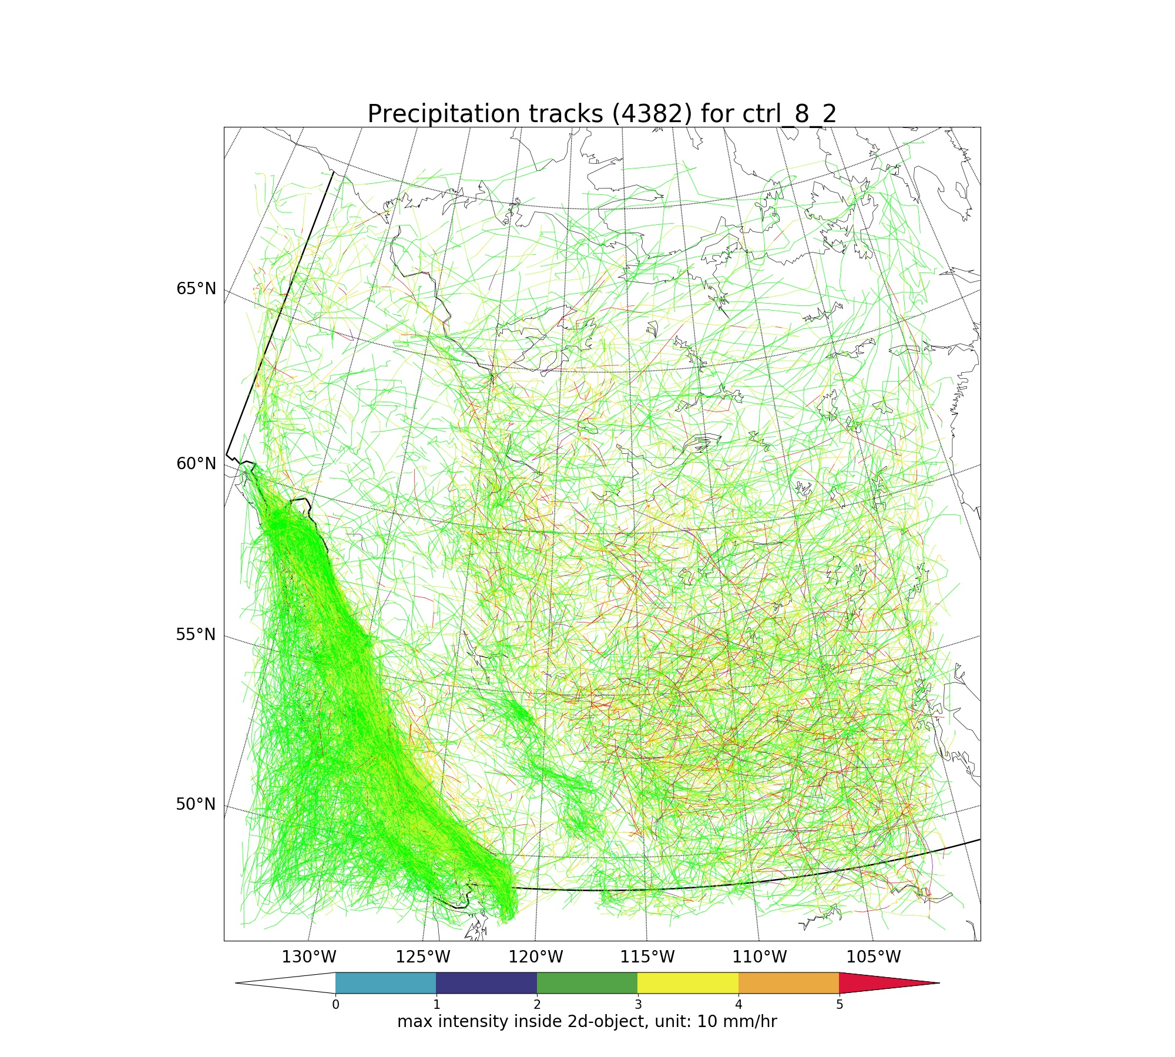
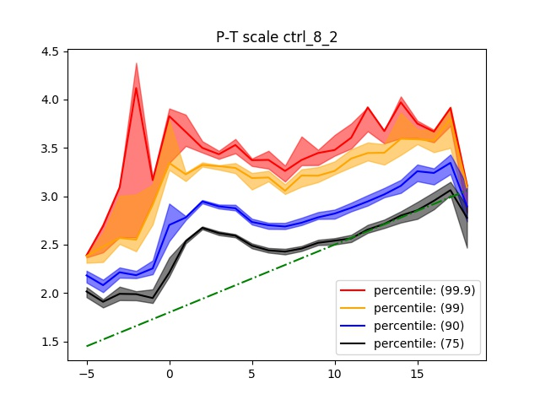
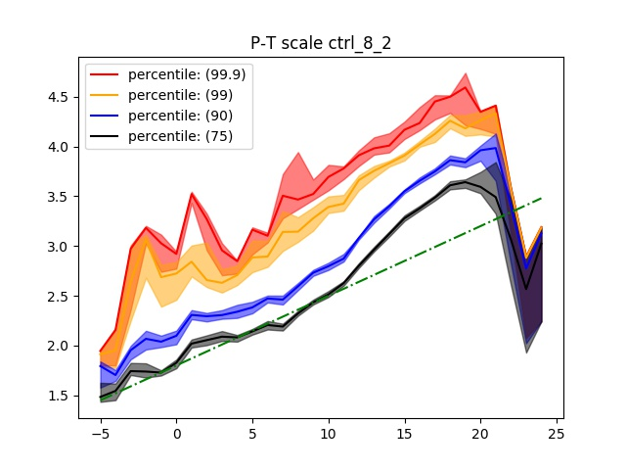
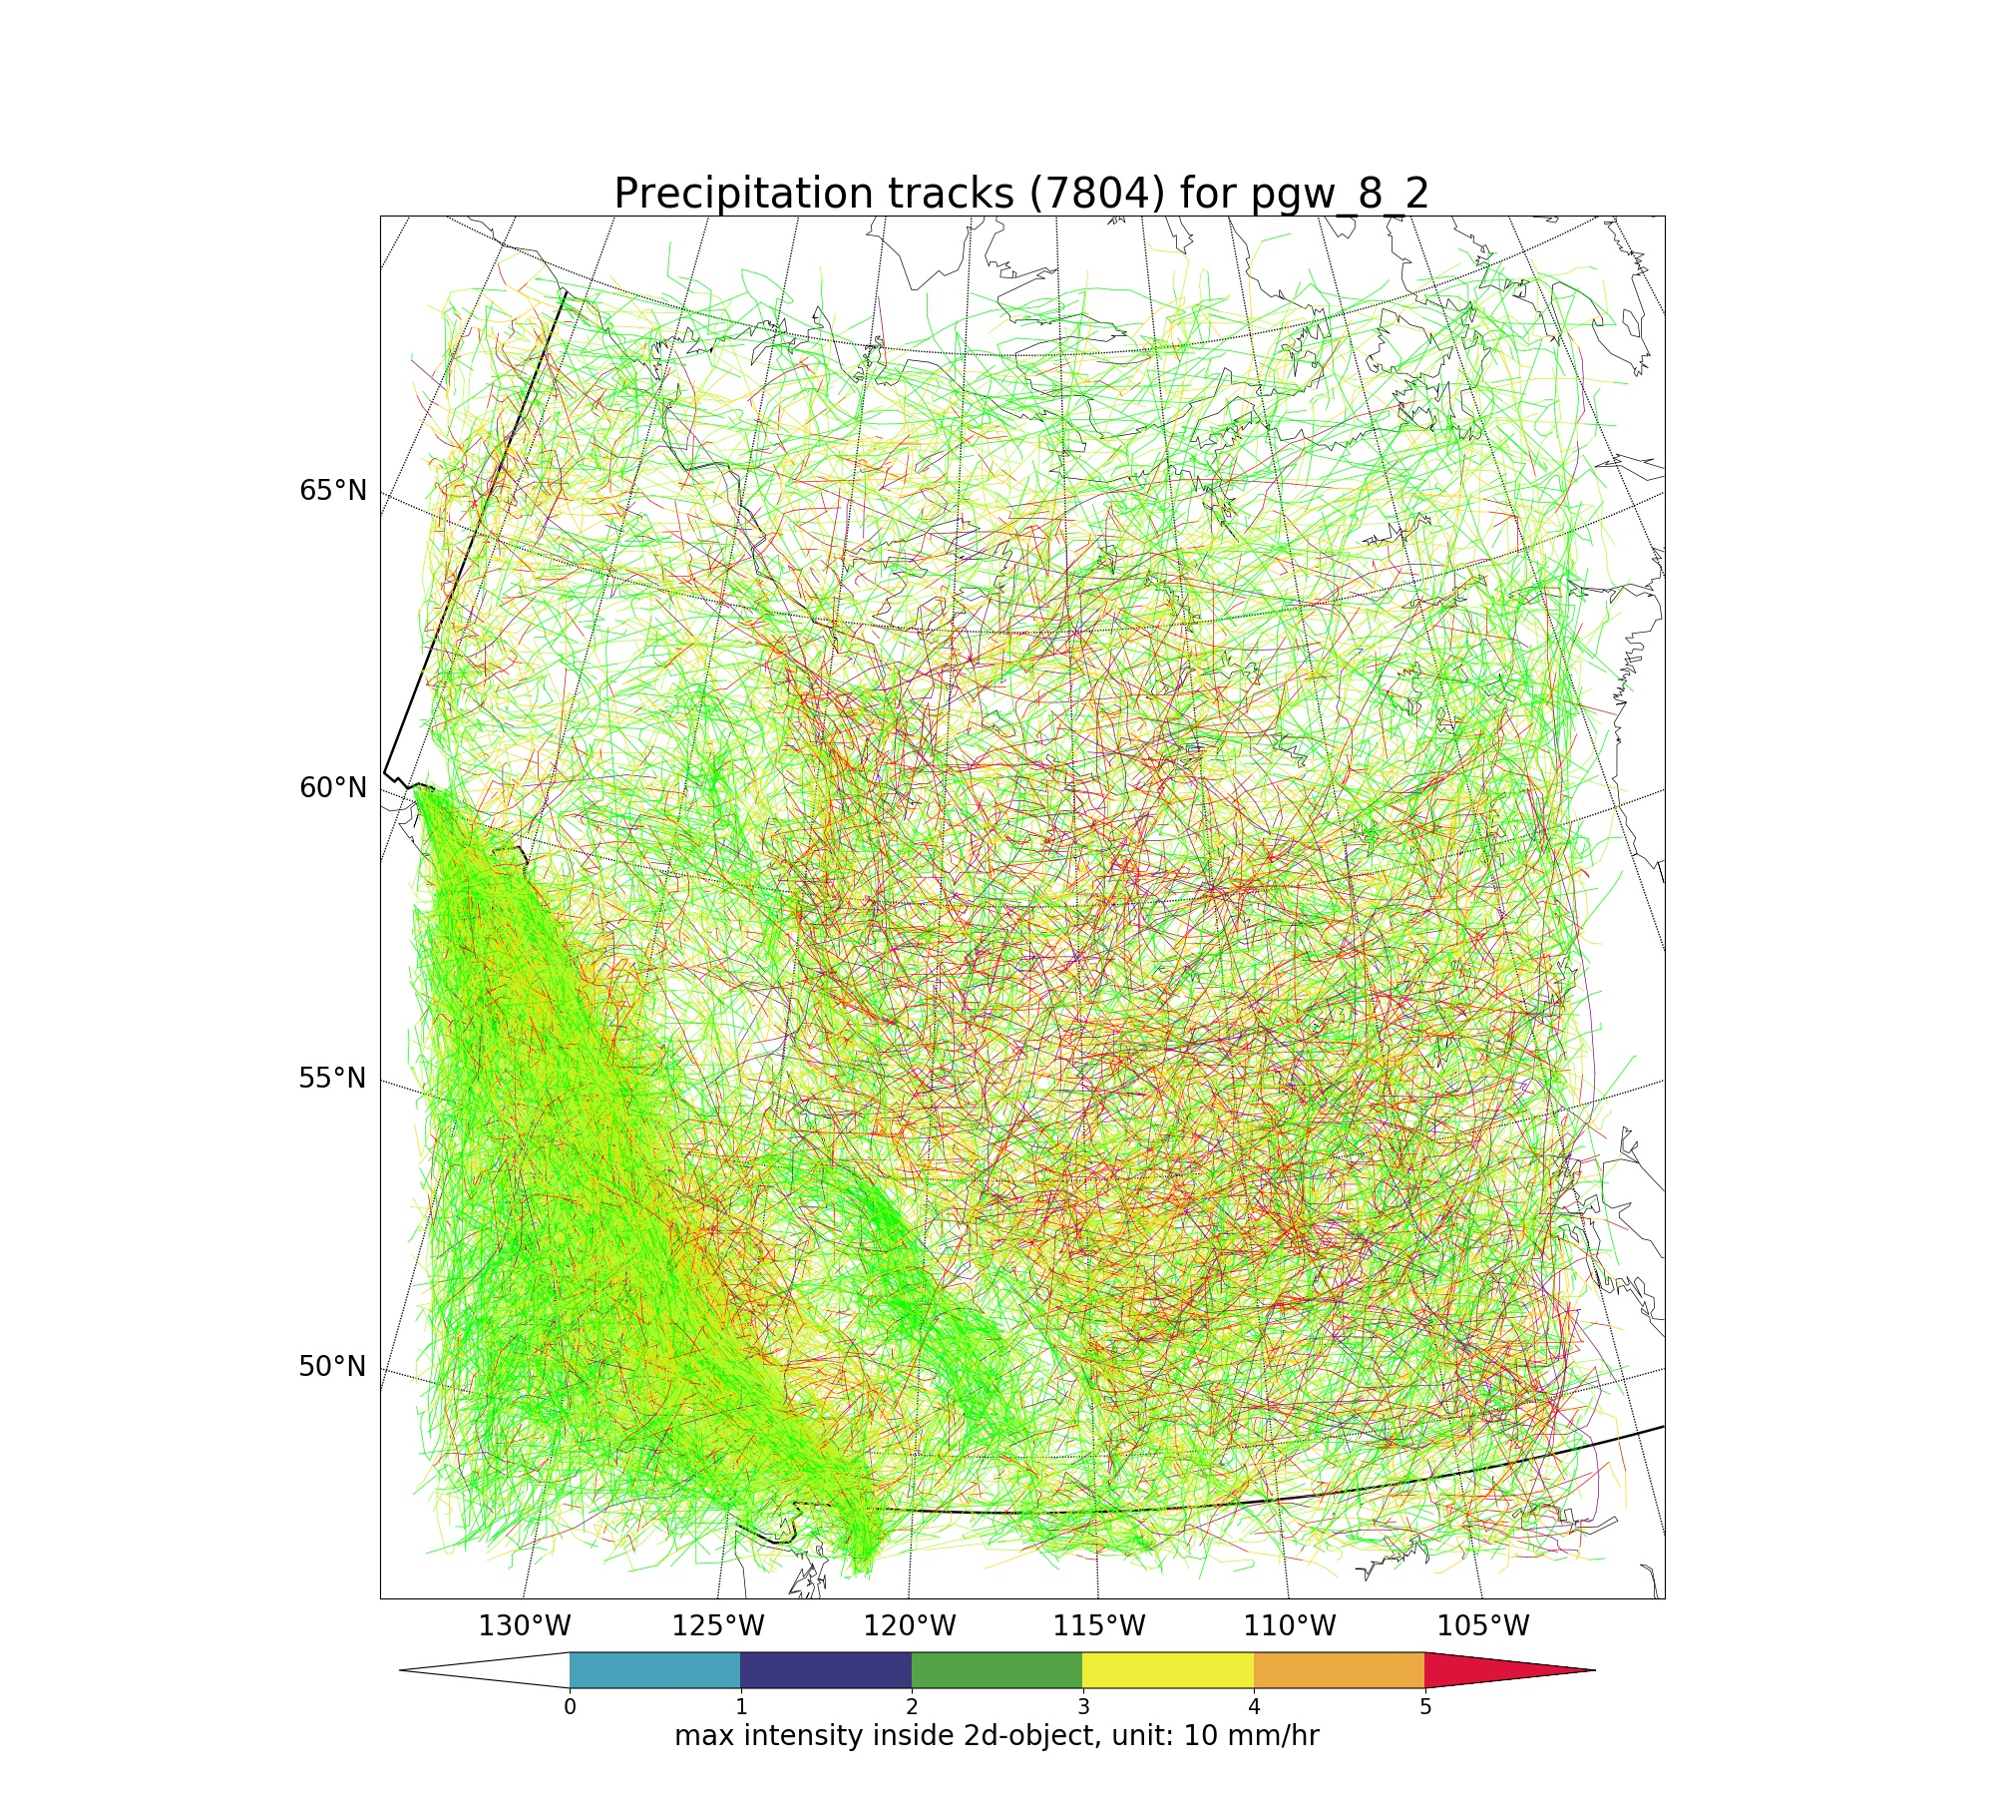
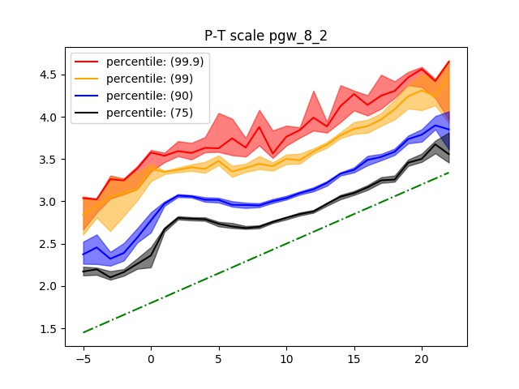
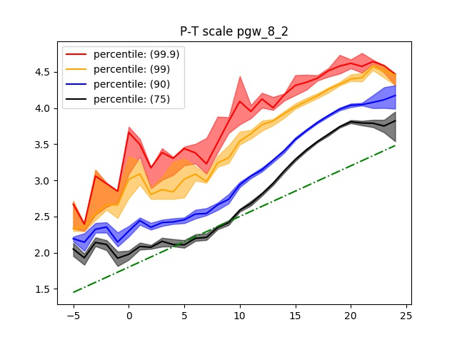
Transformational Science Highlights
1. Whether temperature scaling works at convective-permitting resolutions for short-duration local precipitation extremes?
West
East
Lg [Precip(mm/hr)]
Current
Temperature (ºC)
West
East
Future
Project Title
Pillar 1: Short-duration extreme precipitation in future climate

Slide 3
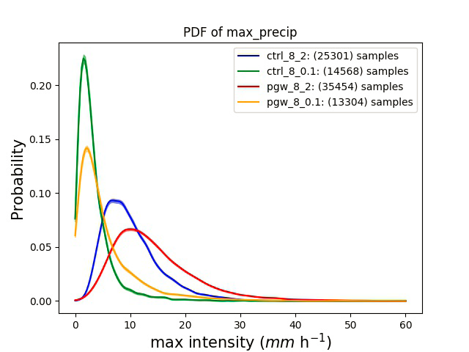
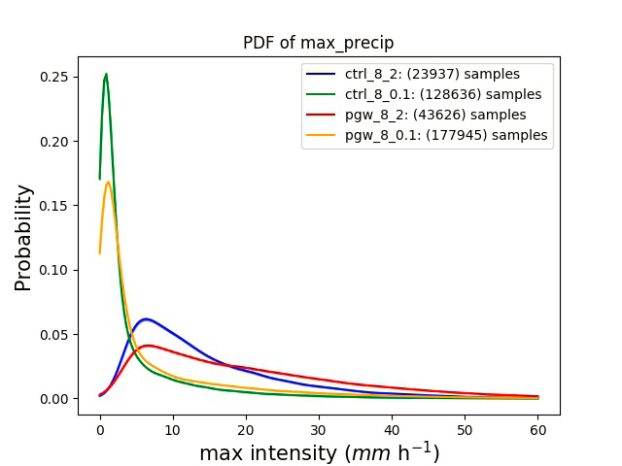
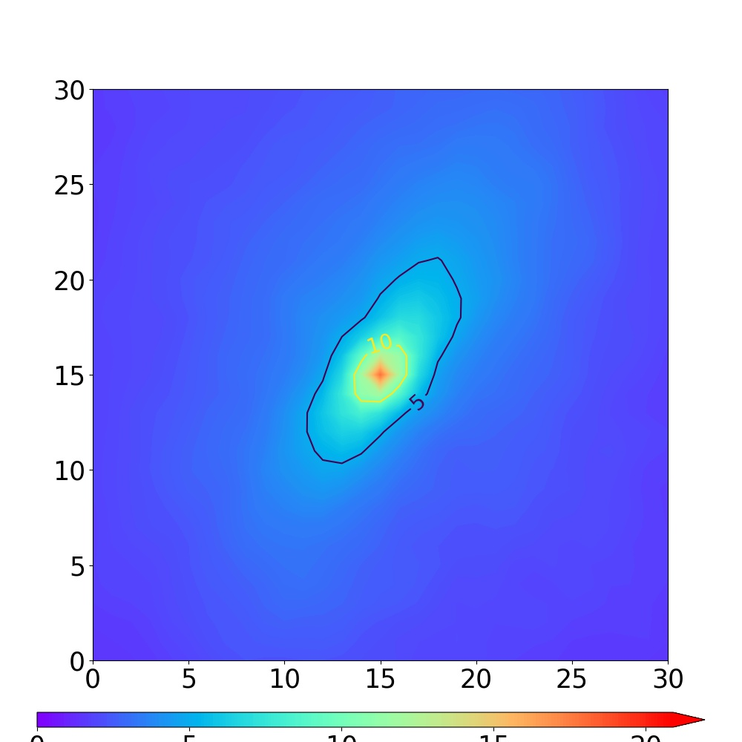
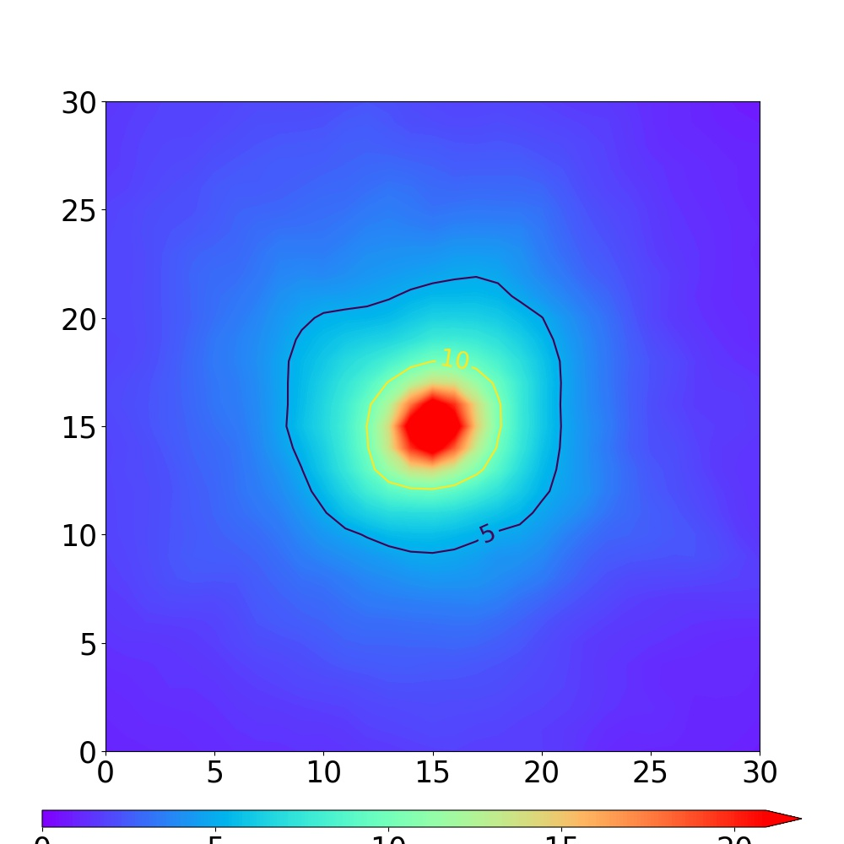
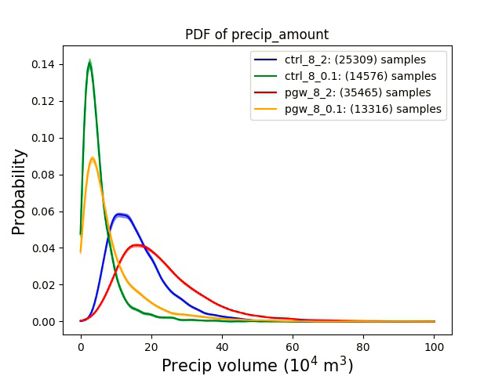
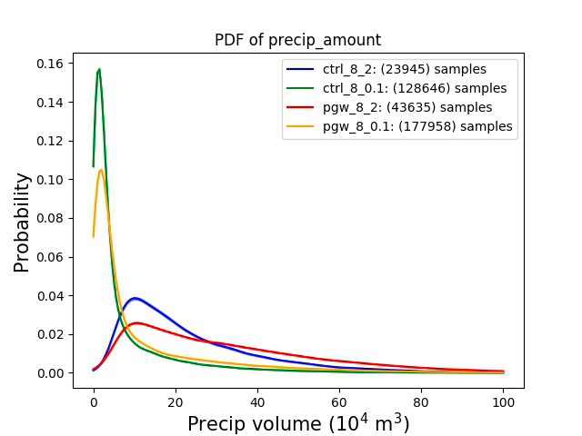
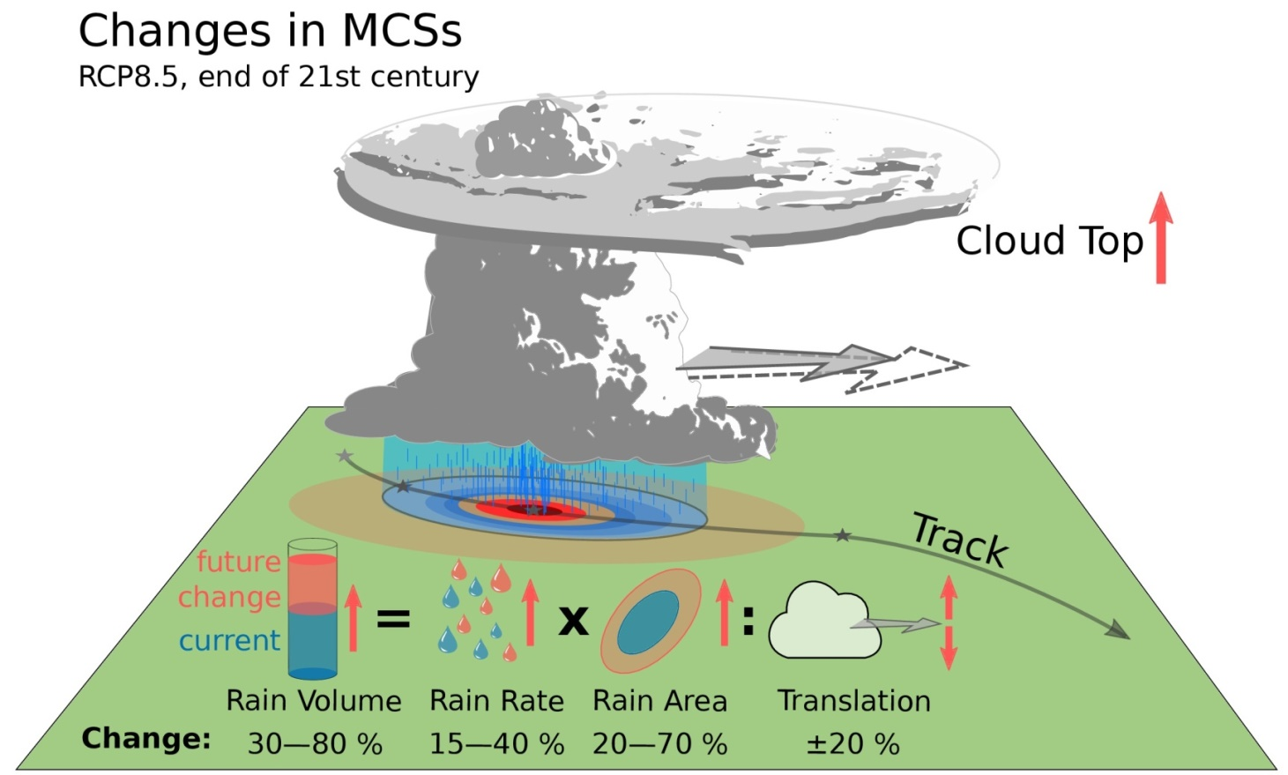
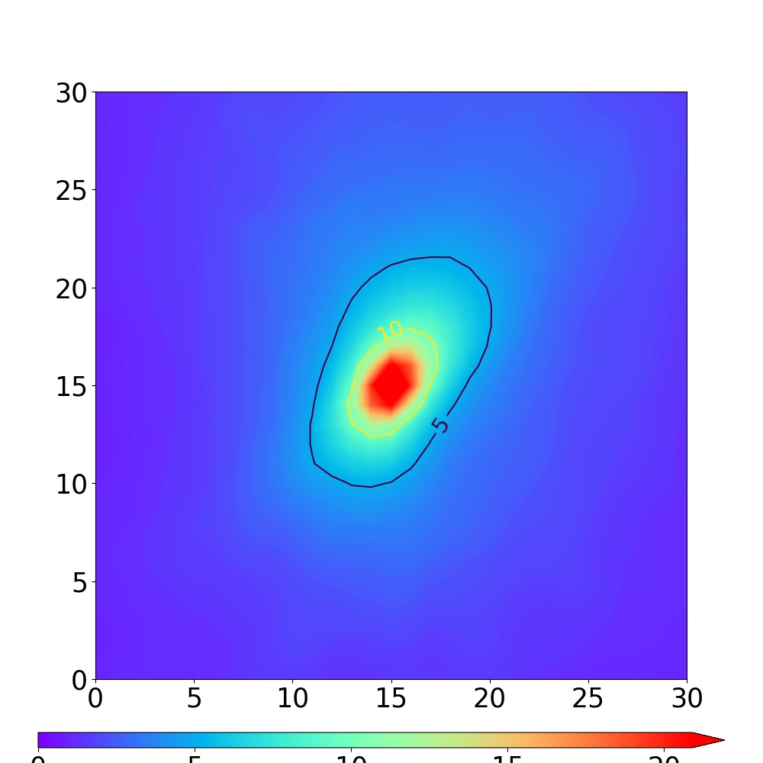
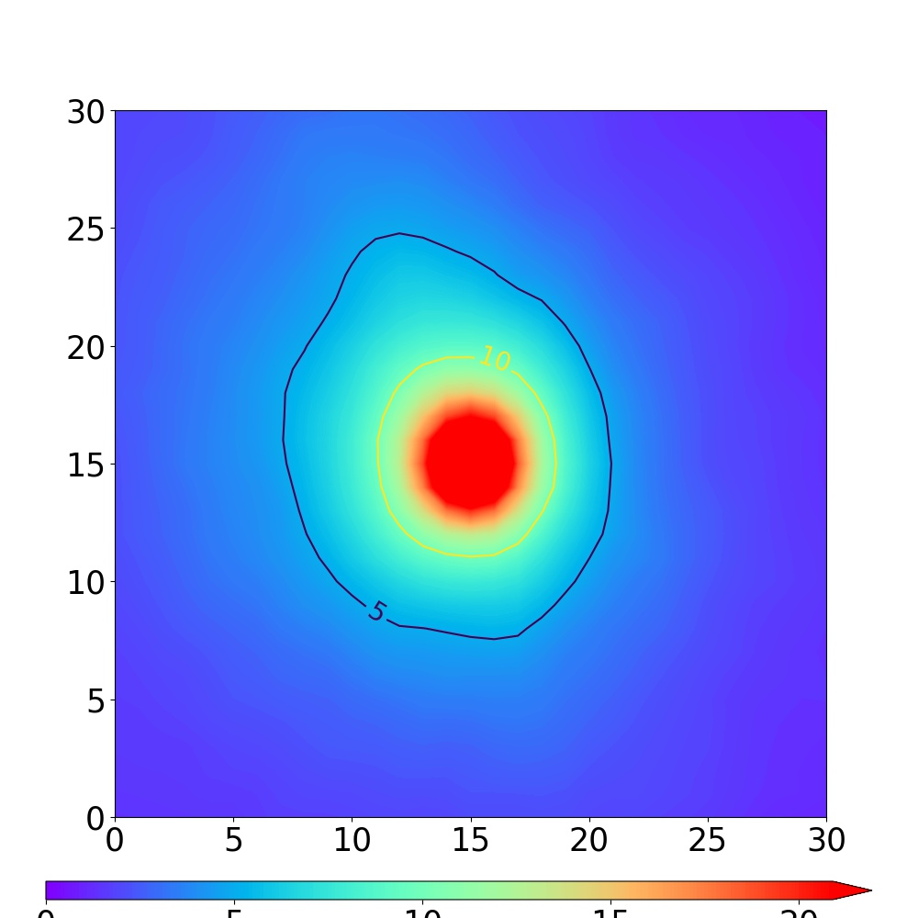
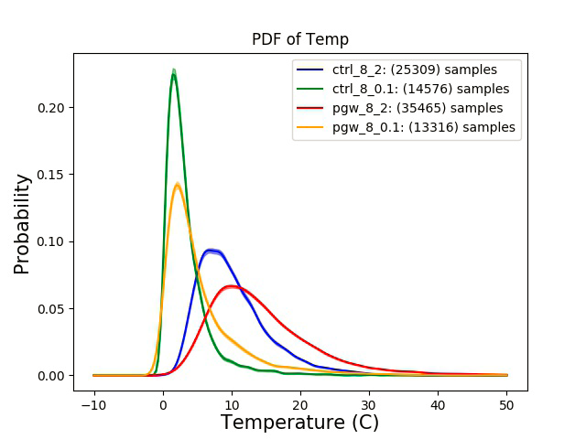
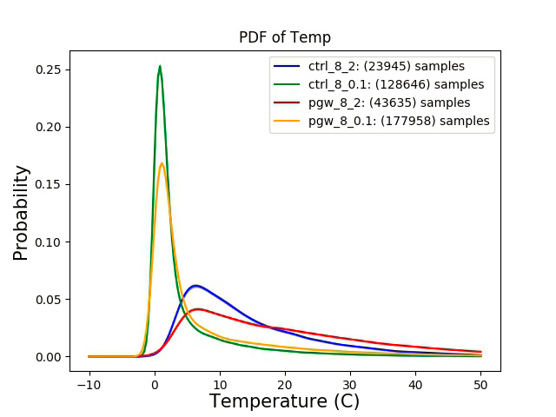
Transformational Science Highlights
West
East
2. How will the characteristics of mesoscale convective systems (MCSs) such as the precipitation intensity, size and life-span of storms change in the future?
West
East
Grid point (4km)
Current
Future
Project Title
Pillar 1: Short-duration extreme precipitation in future climate

Slide 4
Project Impact and Aspirations
Communicate the applications of our results:
Collaborations with NCAR, ECCC, and other GWF projects especially Pillar 3 EXTREME project for the use of model projections
In the coming year, we will examine the underlying physical processes for changes in MCSs and storm properties, and to understand how do extreme precipitation features scale across resolution from GCMs to RCMs to convective permitting WRF.
The impact of this research to society will be a better understanding of the physical soundness of future precipitation projections by climate models, thereby providing a scientific foundation for the proper use of model projections that many GWF’s users depend on.
Project Title
Pillar 1: Short-duration extreme precipitation in future climate

