Slide 1
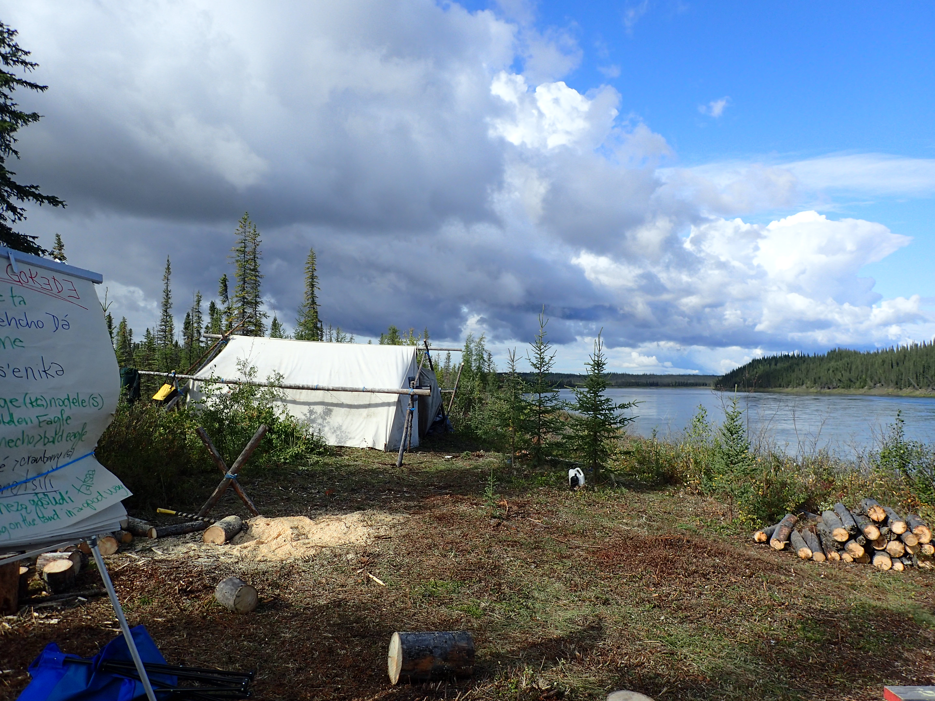
Water Knowledge Camps: Building Capacity for Cross-Cultural Water Knowledge, Research, and Environmental Monitoring
Enhancing community-based research and monitoring of water and climate change issues in the Sahtú region of the NWT
Project Leads:
Leon Andrew, Ɂehdzo Got’ı̨nę Gots’ę́ Nákedı -Sahtú Renewable Resources Board srrb.leon.andrew@gmail.com
Jennifer Baltzer , Wilfrid Laurier University jbaltzer@wlu.ca
Project coordinates: PI, email, website, etc
Water Knowledge Camps
Notes:
It can help to frame your main research objective as a question. For example,
How will climate change affect agriculture in Canada?
How can we improve water quality and reduce algal blooms in Canadian lakes?
What are the links between fish health, food safety and food security in the Indigenous North?
What is the significance of groundwater fluxes on surface water flow?

Slide 2
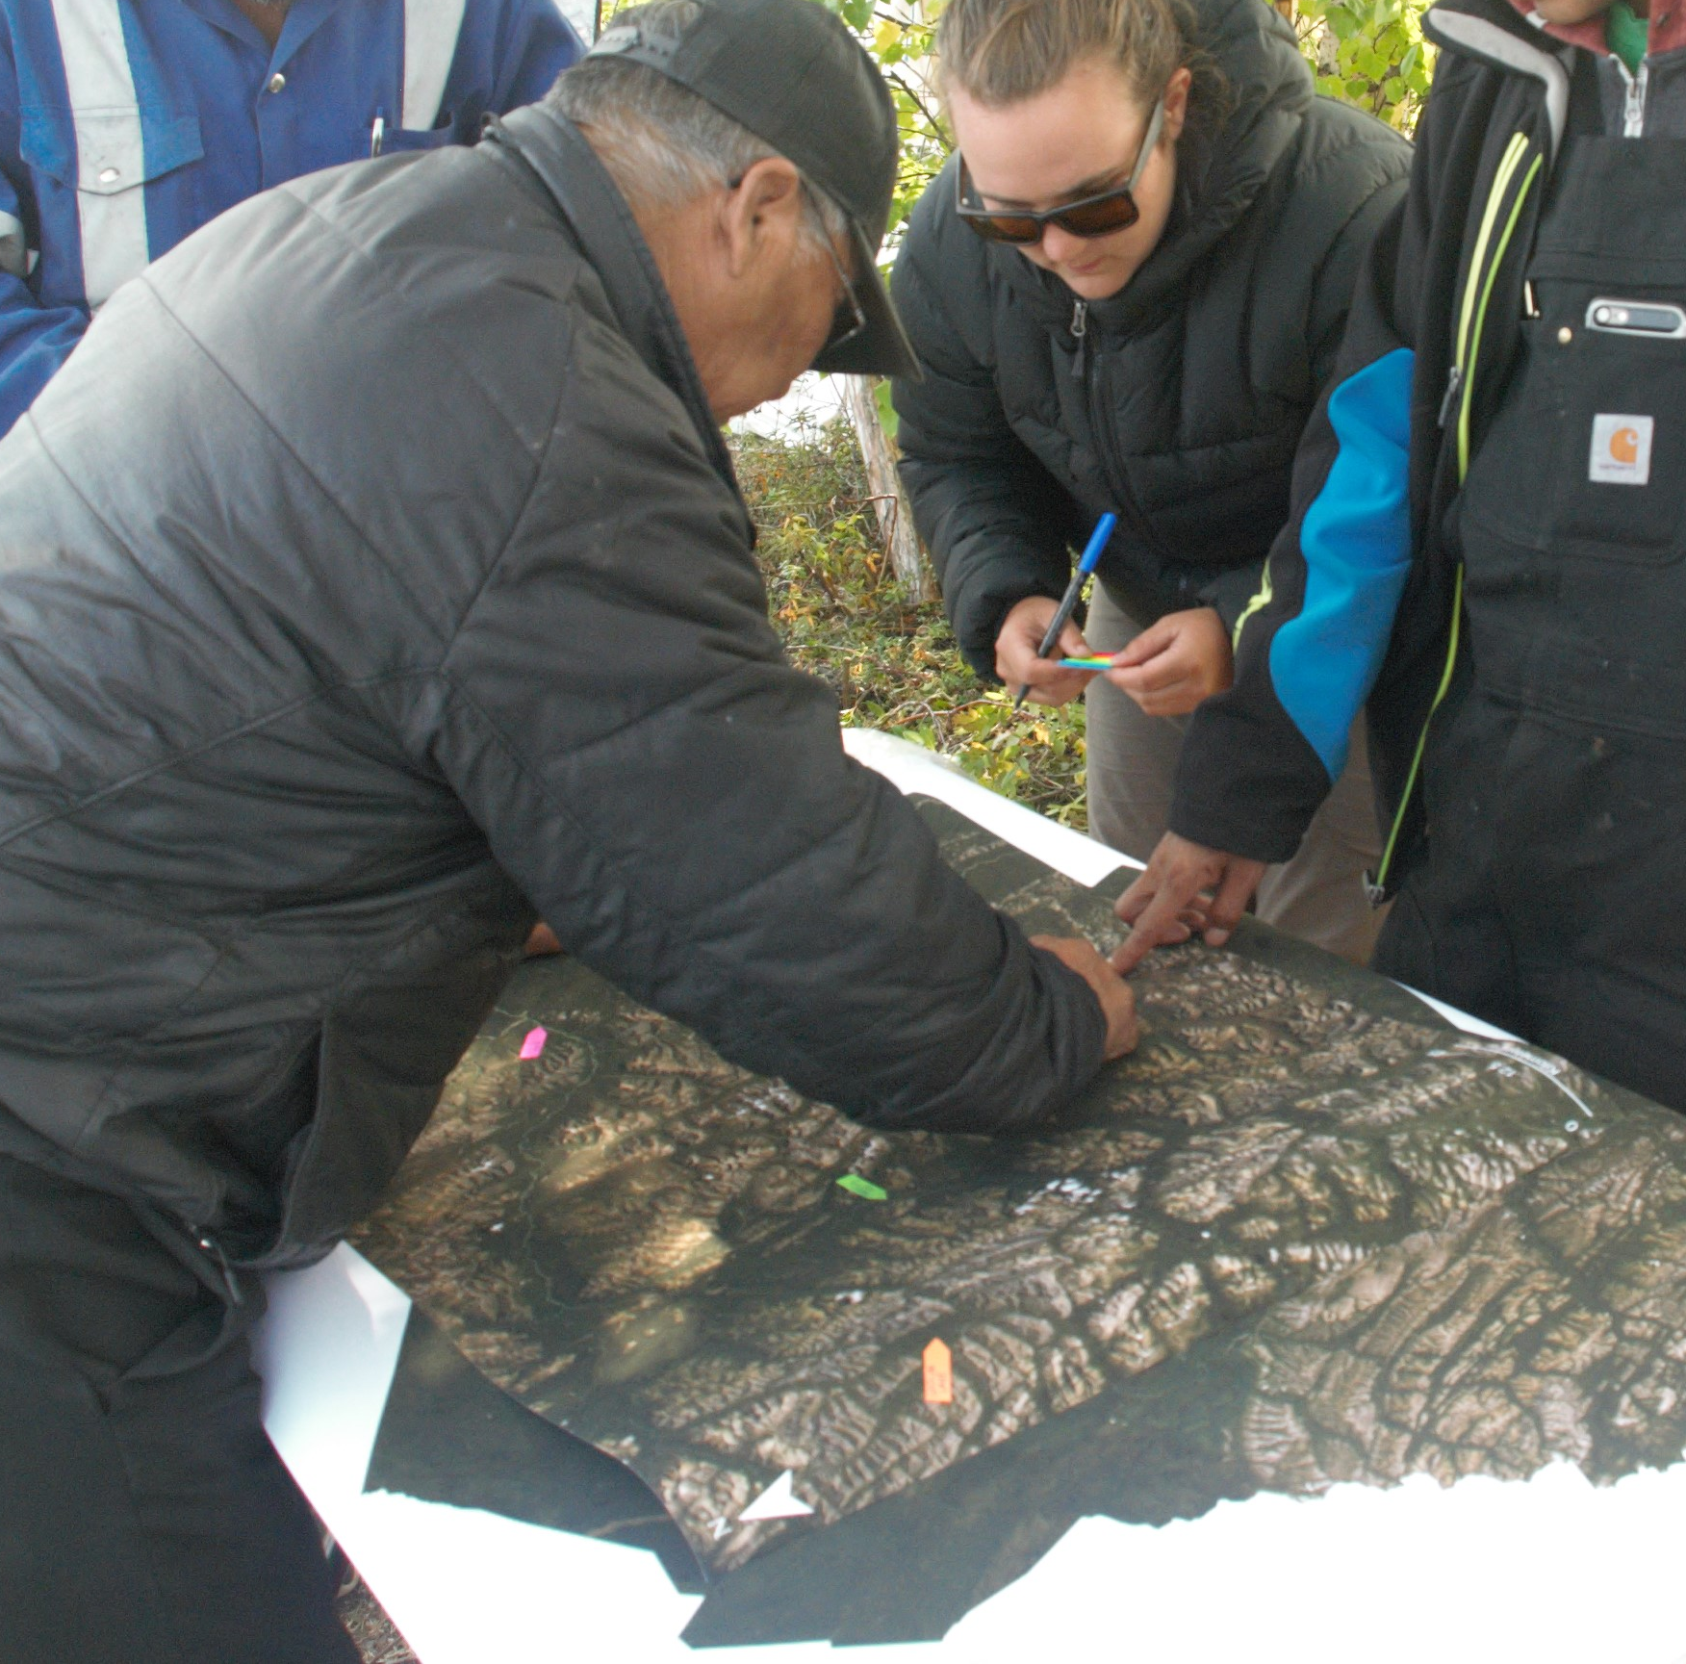
Transformational Science Highlights
Discussions and demonstrations of science tools and methods, and cross-cultural activities
Focus groups and sharing circles about changes being observed on the land, community concerns and need to build capacity for more engagement and involvement in research and monitoring
Co-production of knowledge is necessary to merge Dene and non-Dene way (two ways of knowing)
Accountability of researchers to communicate results and involve community
Project Title
Water Knowledge Camps
Notes:
These accomplishments slides will be also be used to build slide bank for use in GWF presentations
How are these results key to advancing the science
How are these results linked to the needs of your partners/users?

Slide 3
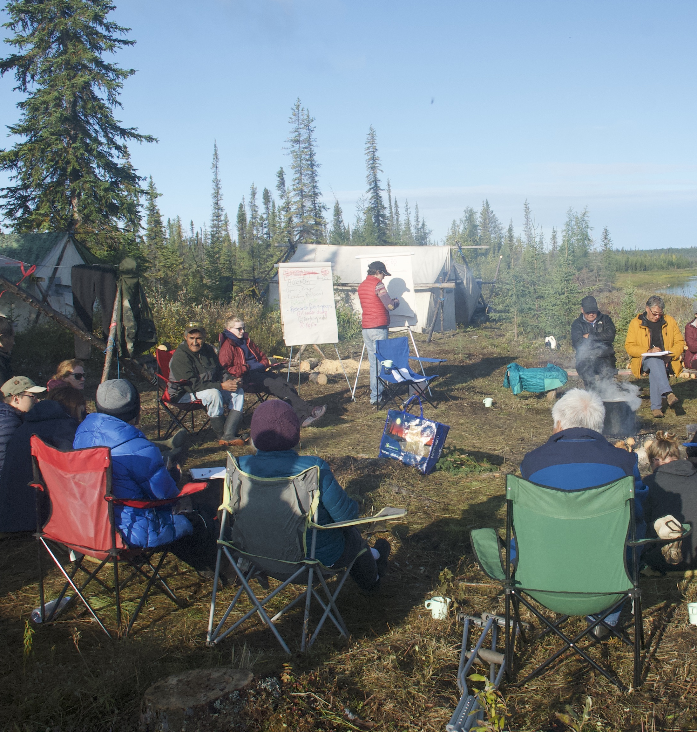
Project Impact and Aspirations
Camps support local and regional Indigenous Guardian programs
Continue to include Sahtú Youth in the project
Help establish local and regional monitoring networks
Upcoming camps
2020 Camp in Fort Good Hope
2021 Camp on Great Bear Lake with UNSECO Tsá Tué Biosphere Reserve
Project Title
Water Knowledge Camps

Slide 4
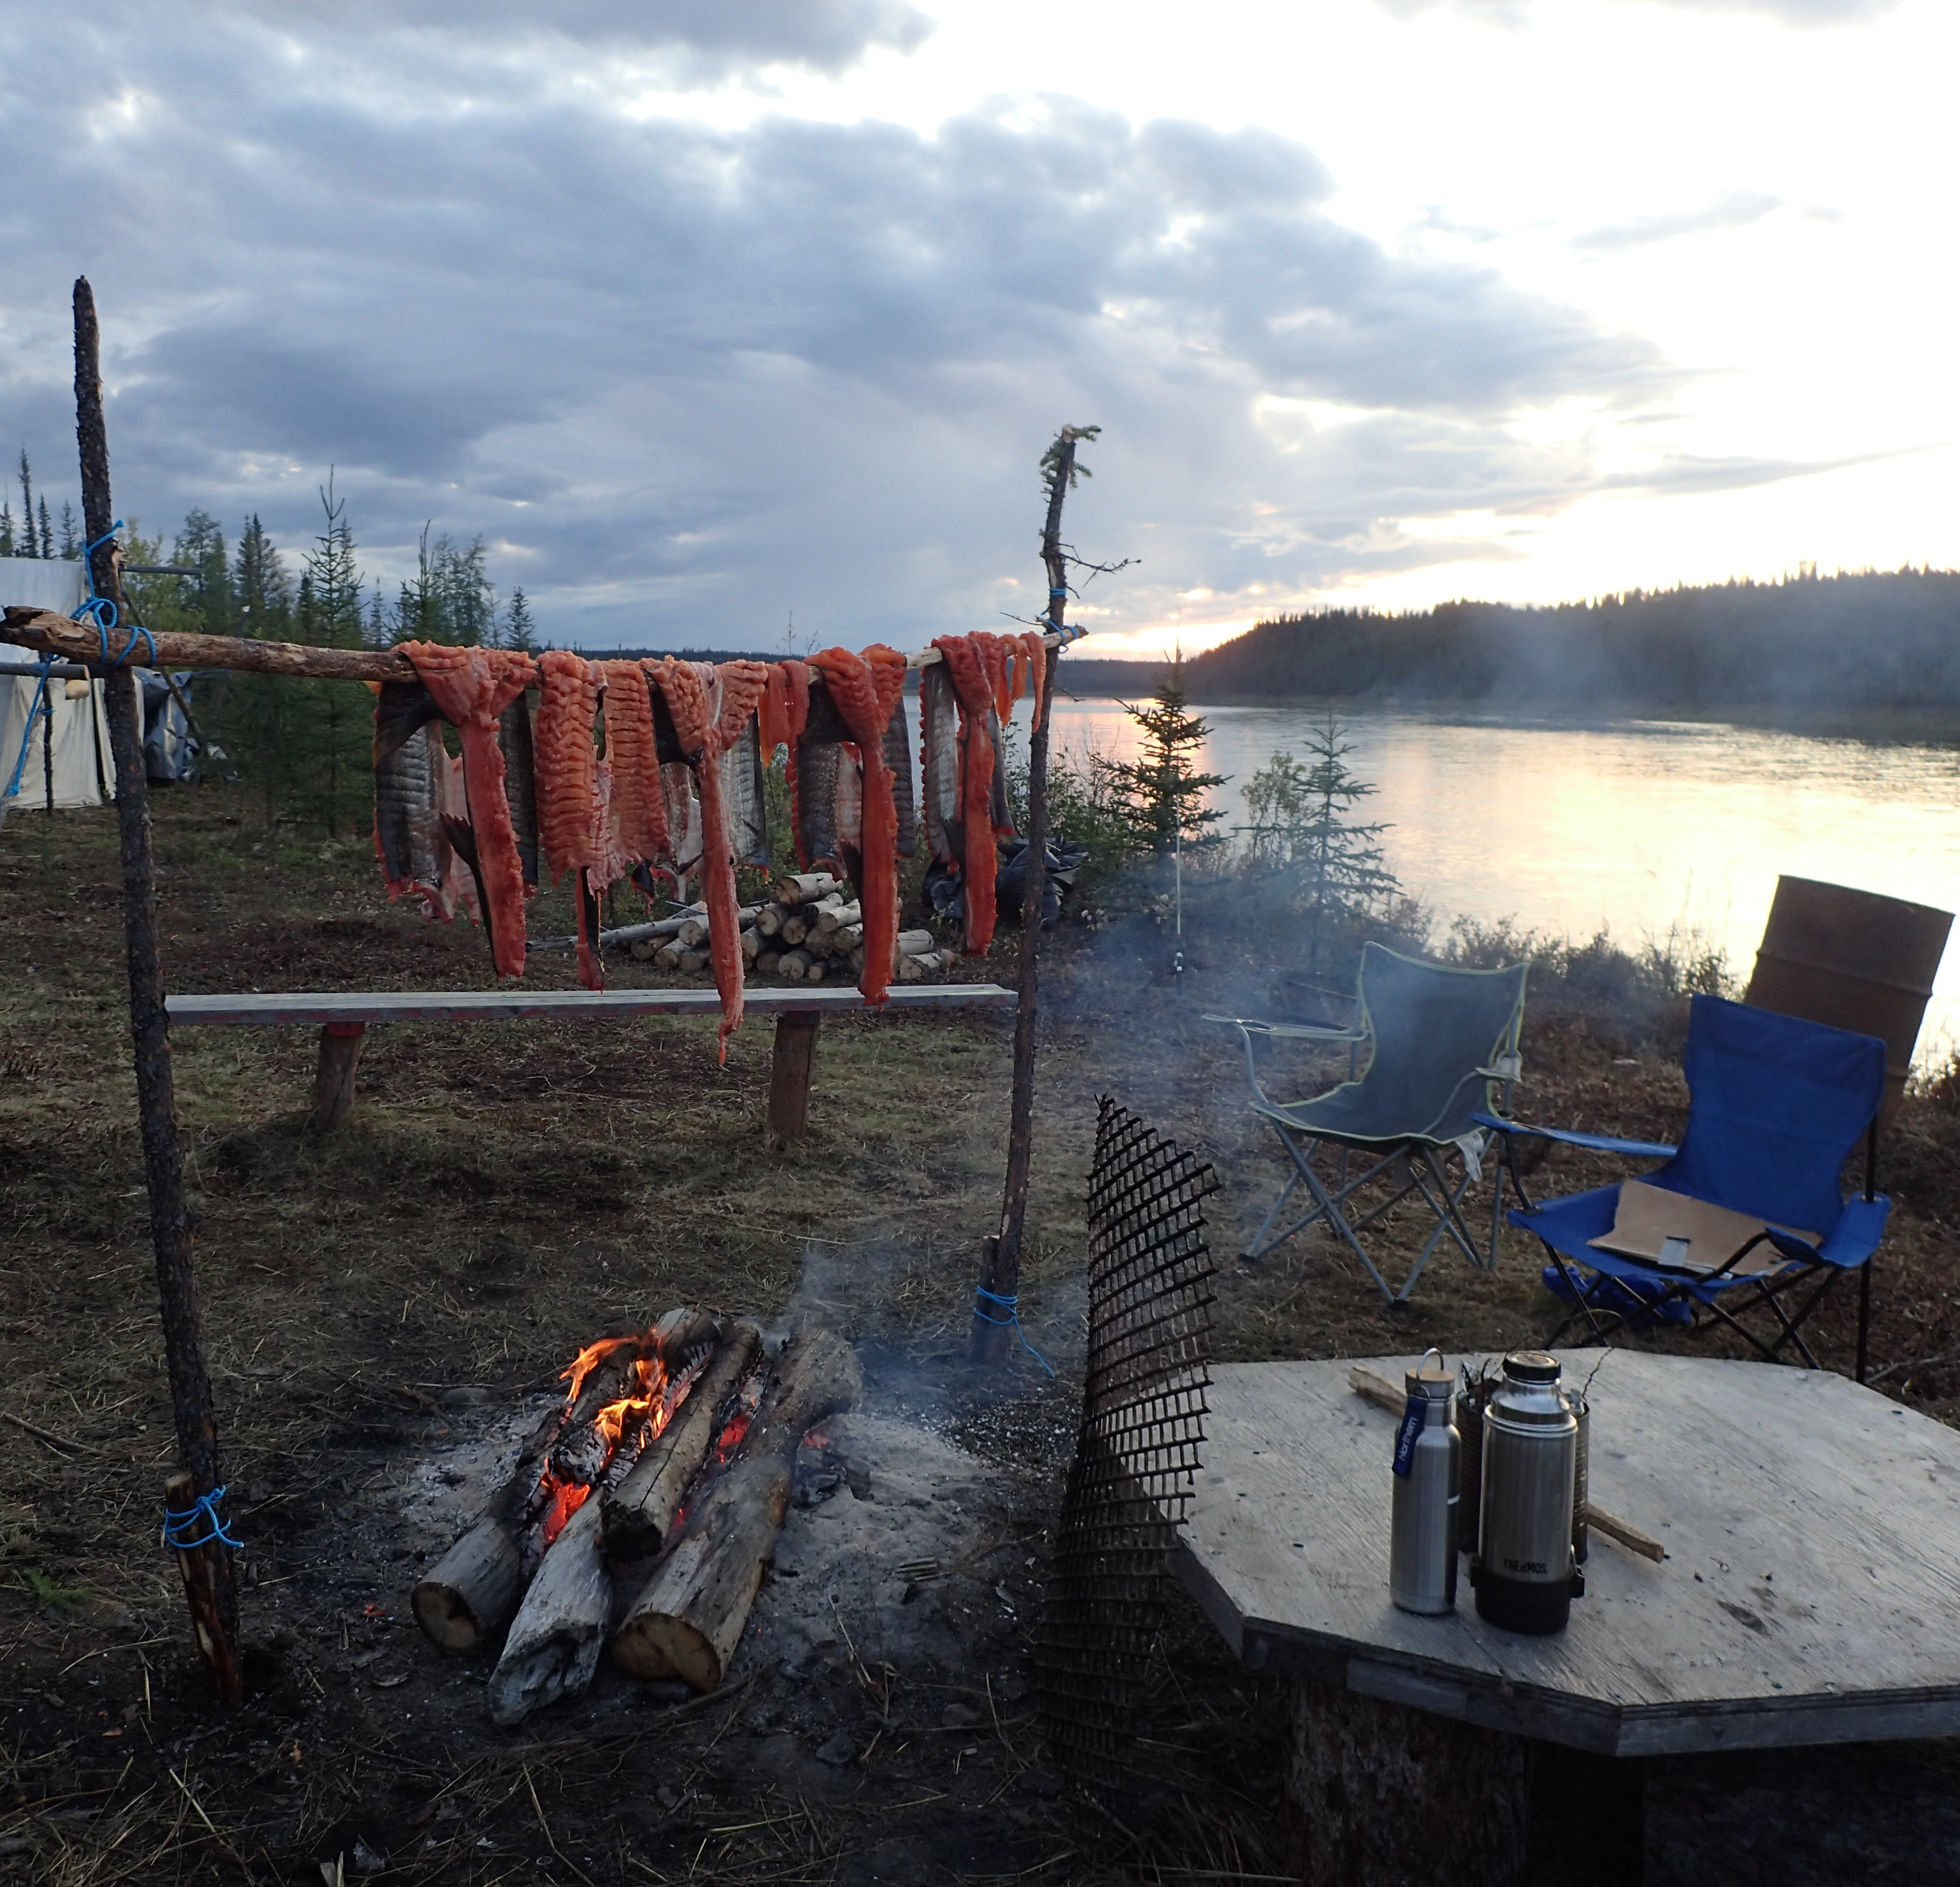
Challenges and Cross-project Collaboration Opportunities
On-the-Land camps are seen as a valuable way of building relationships, trust that can build towards co-creation of research projects and priorities
Sahtú communities value the experience of being on the land together and value the opportunity to connect with each other, the youth and the land
Ideal setting for bringing together two ways of knowing
Many challenges, but many opportunities to support community-led research in the NWT
Project Title
Water Knowledge Camps

